Slide 1
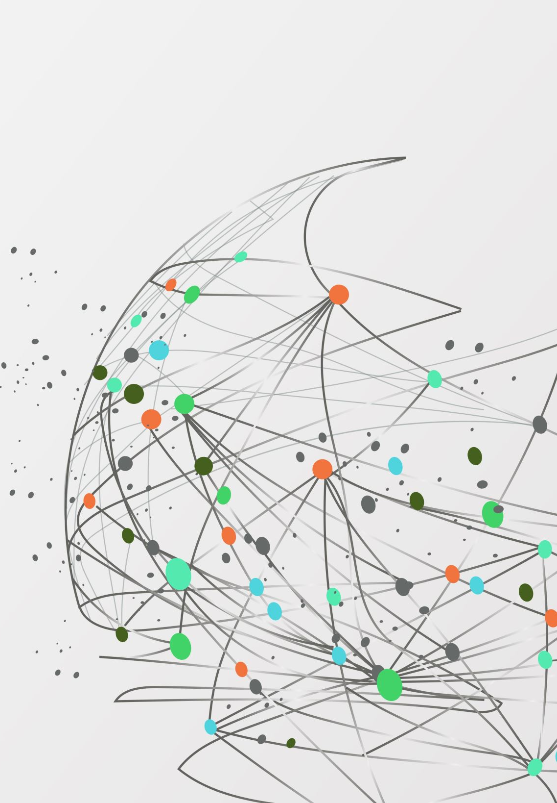
Asymmetric graphs
Simona Dubeková doc. RNDr. Tatiana Jajcayová, PhD.

Slide 2
Content
Graph symmetries
Minimal asymmetric graphs
Implementation
Removing edges/vertices
Adding edges
Knowledge used in this work
Main results

Slide 3
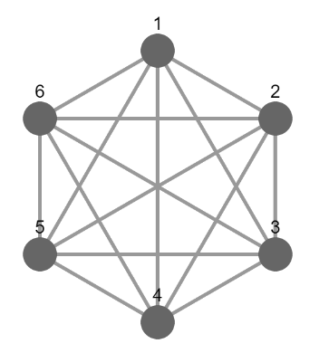
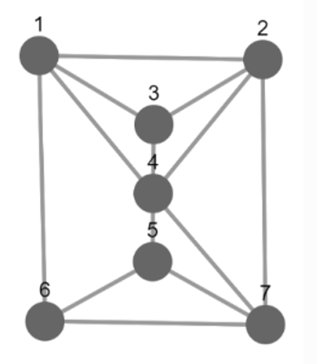
Graph symmetries
Symmetric graph
Has non-trivial symmetries
The group of its automorphisms has order greater than 1
Asymmetric graph
A graph which is not symmetric
The group of its automorphisms is trivial
Notes:
Majú netriviálne symetrie

Slide 4
Minimal asymmetric graphs
„An undirected graph G on at least two vertices is minimal asymmetric if G is asymmetric and no proper induced subgraph of G on at least two vertices is asymmetric.“ (Schweitzer, 2016)

Slide 5
Motivation
Graphs are generally a very needed structure
The automorphism groups of the graphs are being intensively studied
Minimal asymmetric graphs - their number (18) has only recently been proven and therefore this topic is still new and further explored
The article: Inverse monoids of partial automorphisms of graphs written by Robert Jajcay, Tatiana Jajcayová, Nóra Szakács and Mária B. Szendrei
Notes:
Zdokonalenie sa v Kotline, naučenie sa robiť v GAP-e

Slide 6
Implementation
Kotlin
generating
GAP
Grape
constructing
analysing
JupyterViz
drawing

Slide 7
Main Menu
Graphs - G
Create G with n vertices
Minimal asymmetric graphs - MAG
Create MAG
Print if MAG are bipartite
Create MAG with n vertices
Create MAG without n edges
Create MAG with n edges
Exit

Slide 8
Prim’s algorithm

Slide 9
Minimal asymmetric graphs

Slide 10
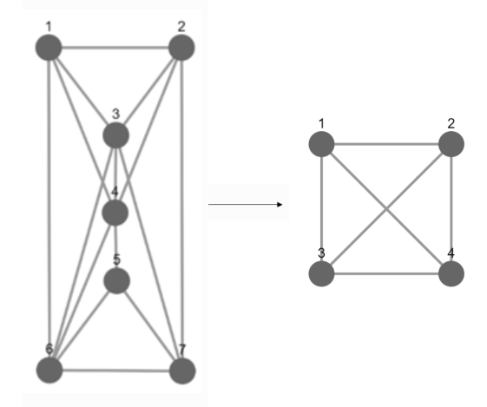
Removing vertices
Connected inducted subgraphs
Directly related to the issue of partial automorphisms
3 less vertices
The order of the automorphism group increased from 1 to 24
Notes:
Súvislé indukované podgrafy

Slide 11
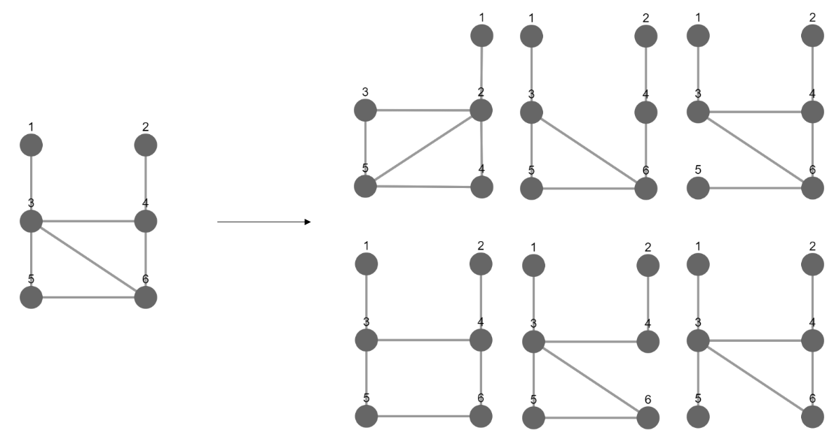
Removing EDGES
Connected inducted subgraphs
1 less edge
The automorphism groups of the order 1, 2, 4, and 6

Slide 12
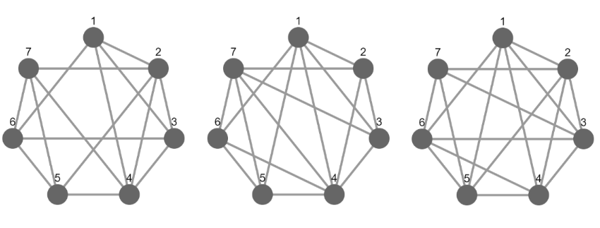
Adding EDGES
supergraphs
2 more edges
the order of the automorphism group increased from 1 to 16

Slide 13
Knowledge used in this work
Discrete mathematics with Combinatorics
Graph theory
Graph isomorphisms
Data structures
Kotlin
Group Theory
GAP
To understand articles
To pronounce and experimentally verify the hypothesis
To combine my results with existing ones
Notes:
Potenčná množina, automorfizmy, grafové algoritmy – hľadanie minimálnej kostry grafu, prechádzanie grafu, stromy, permutácie všetkých vrcholov

Slide 14
main results
Description: Complete catalogue of minimal asymmetric graphs with iteratively removed vertices
Interest: high order of the automorphism group
Challenge: a huge number of connected non-isomorphic graphs
Classification: symmetric, asymmetric but not minimal or minimal asymmetric graphs

Slide 15
Summary
Minimal asymmetric graphs
Adding/Removing edges/vertices
Kotlin/GAP
Complete catalogue of minimal asymmetric graphs with iteratively removed vertices
The order of the automorphism group can rapidly increased

Slide 16
Thank you for your attention

Slide 17
Bibliography
Pascal Schweitzer and Patrick Schweitzer. Minimal asymmetric graphs. Journal of Combinatorial Theory, Series B, 127(4):215227, 2016. [Citated 2021-03-21] Available at https://www.researchgate.net/publication/301896061_Minimal_Asymmetric_Graphs.
Robert Jajcay, Tatiana Jajcayová, Nóra Szakács and Mária B. Szendrei. Inverse monoids of partial graph automorphisms. Journal of Algebraic Combinatorics, 53(3):829849, 2021.

Slide 18
The main results and THEIR IMPORTANCE
Description: Complete catalogue of minimal asymmetric graphs with iteratively removed vertices
Interest: high order of the automorphism group
Challenge: a huge number of connected non-isomorphic graphs
Classification: symmetric, asymmetric but not minimal or minimal asymmetric graphs
My supervisor’s doc. RNDr. Tatiana Jajcayová’s research

Slide 19
rules according to which the Order of the automorphism Group increases, Achieve the top and decreases + example
The order of the automorphism group increased from 1, 2, 6, 12, achieve the top 24, and decreases to 6 and 2
In general: The order of the automorphism group of the obtained graphs increases and decreases randomly, with no system observed
One rule: Each graph, after removing several vertices, ends as a graph with two vertices connected by an edge

