Slide 1
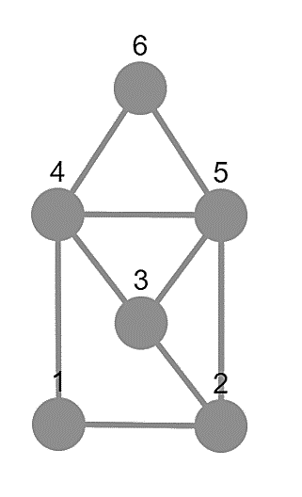
Asymmetric Graphs
Simona Dubeková

Slide 2
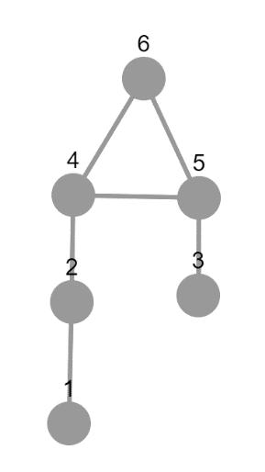
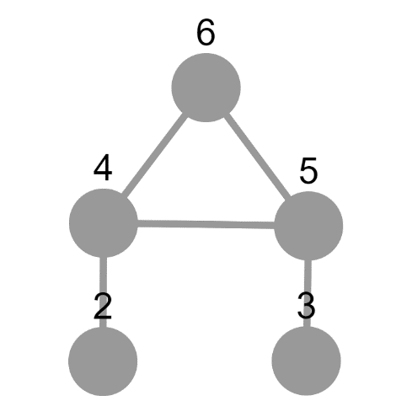
Symmetries of a Graph
Symmetric
The group of its automorphisms has order greater than 1
Asymmetric
A graph which is not symmetric

Slide 3
Goal
In general
We
The degree of symmetry of a symmetric graph
Measured by the size of its group of automorphisms
The degree of asymmetry of an asymmetric graph
Measured by the number of vertices which we have to delete to obtain a symmetric graph

Slide 4
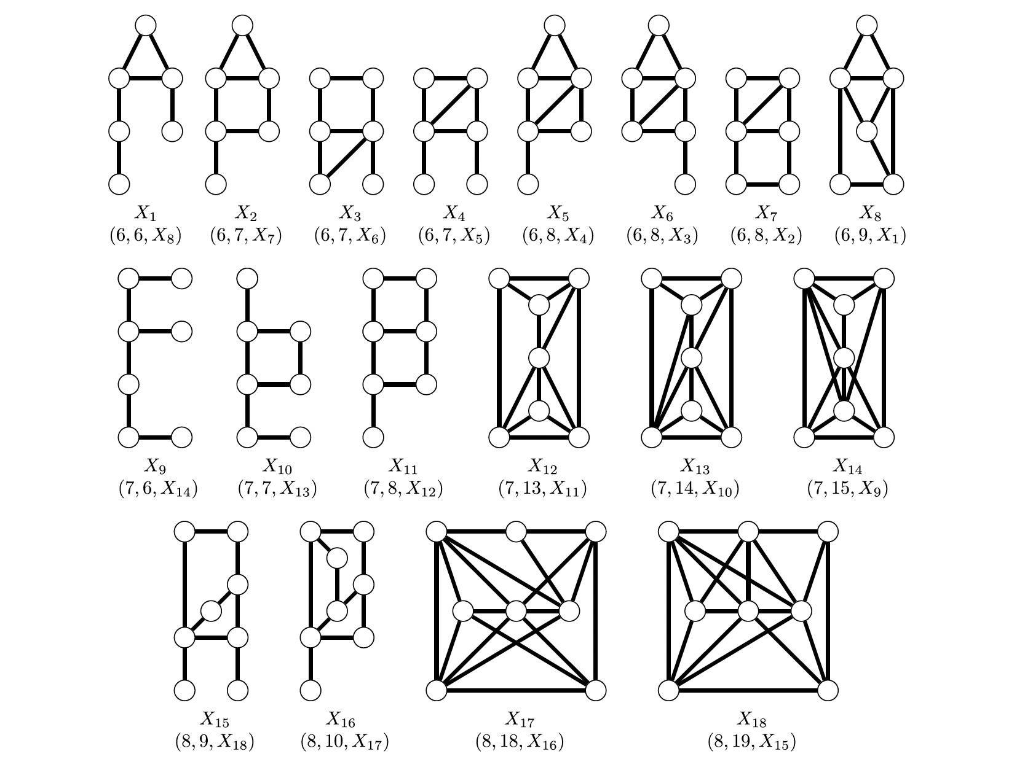
Minimal asymmetric graphs
„An undirected graph G on at least two vertices is minimal asymmetric if G is asymmetric and no proper induced subgraph of G on at least two vertices is asymmetric.“ (Schweitzer, 2016)
Notes:
Complete list of minimal asymmetric graphs.

Slide 5
Packages
Grape
constructing
analysing
JupiterViz
drawing

Slide 6
Two types of questions
Removing
Adding
vertices and edges from minimal asymmetric graphs
Which and how many non trivial symmetries will we get?
vertices and edges to minimal asymmetric graphs
Will any be still asymmetric?

Slide 7
Thank you for your attention

Slide 8
Bibliography
Pascal Schweitzer and Patrick Schweitzer. Minimal asymmetric graphs. Journal of Combinatorial Theory, Series B, 127(4):215227, 2016. [Citované 2021-03-21] Dostupné z https://www.researchgate.net/publication/301896061_Minimal_Asymmetric_Graphs.

