Slide 1

Asymmetric Graphs
Sources
Simona Dubeková

Slide 2
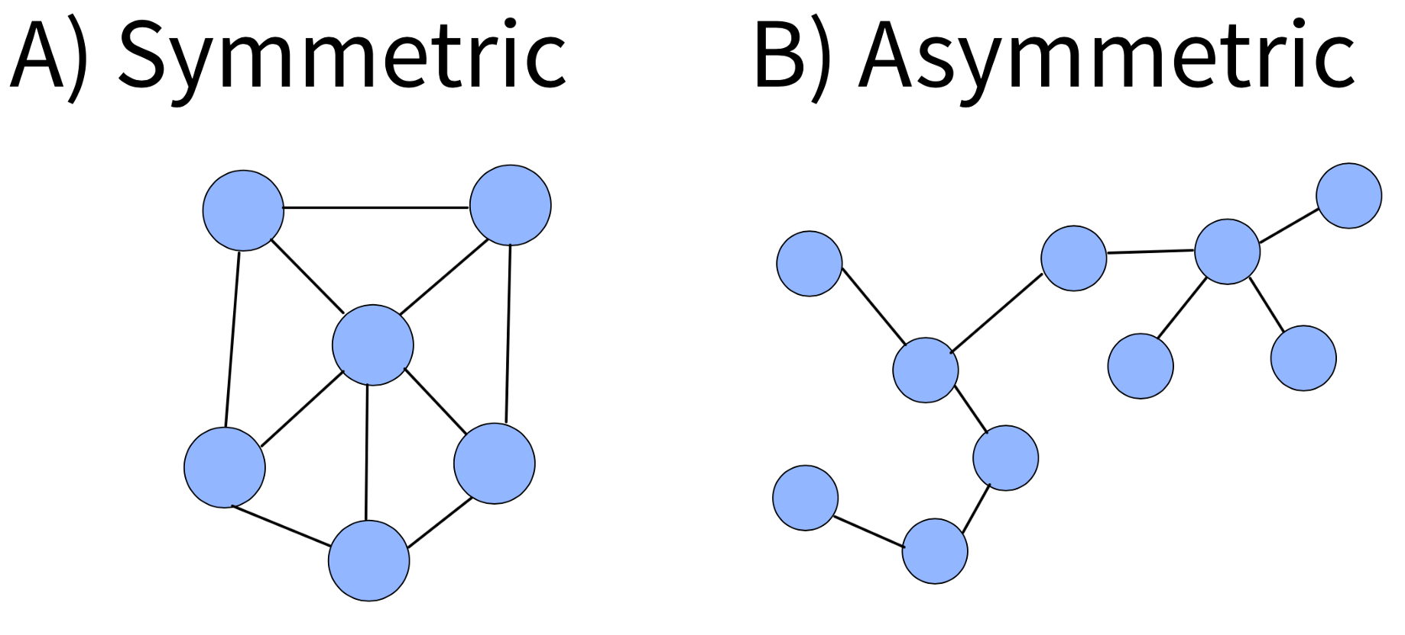
About the Thesis
Notes:
Budem merať stupeň asymetrie asymetrických grafov podľa počtu vrcholov, ktoré z neho musíme odstrániť, aby sme získali graf symetrický.

Slide 3
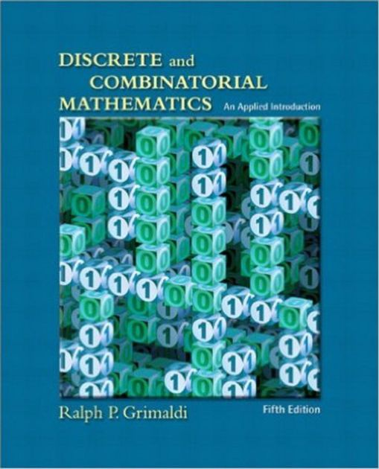

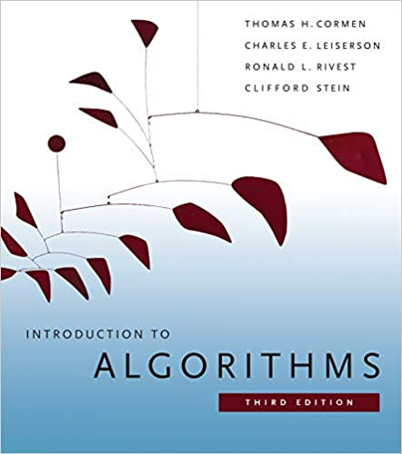
Literature
Ralph P. Grimaldi. Discrete and combinatorial mathematics. Pearson Education, Inc., 2004.
Alexander Stanoyevitch. Discrete Structures with Contemporary Applications. Taylor & Francis Books, 2011.
Thomas H. Cormen, Charles E. Leiserson, Ronald L. Rivest Clifford and Stein. Introduction to Algorithms. Massachusetts Institute of Technology, 2009.

Slide 4

Professional Articles
P. Erdős and A. Rényi. Asymmetric graphs. Acta Mathematica Academiae Scientiarum Hungarica, 14(1):295–315. 1963.
Jaroslav Nešetřil and Gert Sabidussi. Minimal asymmetric graphs of induced length 4. Graphs and Combinatorics, 8(4):343–359. 1992.
Shuji Kijima, Yota Otachi, Toshiki Saitoh and Takeaki Uno. Subgraph isomorphism in graph classes. Discrete Mathematics, 312(21):3164-3173. 2012. [Citované 2021-11-29] Dostupné z https://www.sciencedirect.com/science/article/pii/S0012365X12003160

Slide 5
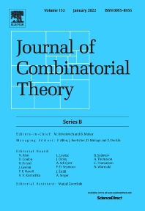
Professional Articles
Pascal Schweitzer and Patrick Schweitzer. Minimal
Asymmetric Graphs. Journal of Combinatorial Theory,
Series B, 127(4):215-227, 2016. [Citované 2021-11-29] Dostupné z https://www.researchgate.net/publication/301896061_Minimal_Asymmetric_Graphs
Robert Jajcay, Tatiana Jajcayová, Nóra Szakács and Mária B. Szendrei. Inverse monoids of partial graph automorphisms. Journal of Algebraic Combinatorics, 53(3):829–849, 2021.
Tatiana B. Jajcayová and Martin Masár. Computer assisted search for graphs with prescribed degrees and cycle structure. In APLIMAT : 16th Conference on Applied Mathematics, pages 694-703. STU, 2017.

Slide 6

Other Bachelor’s Thesis
Martin Masár. Counting cycles in Moore graphs.
FMFI UK Bratislava, 2016.
Michal Slávik. Partial symmetries of graphs.
FMFI UK Bratislava, 2021

Slide 7


Thank You For Your Attention

