Slide 1
Upravovanie záznamu ľudského pohybu a sekvencií snímaných 3D kamerou Prezentácia zdrojov Samuel Piteľ

Slide 2
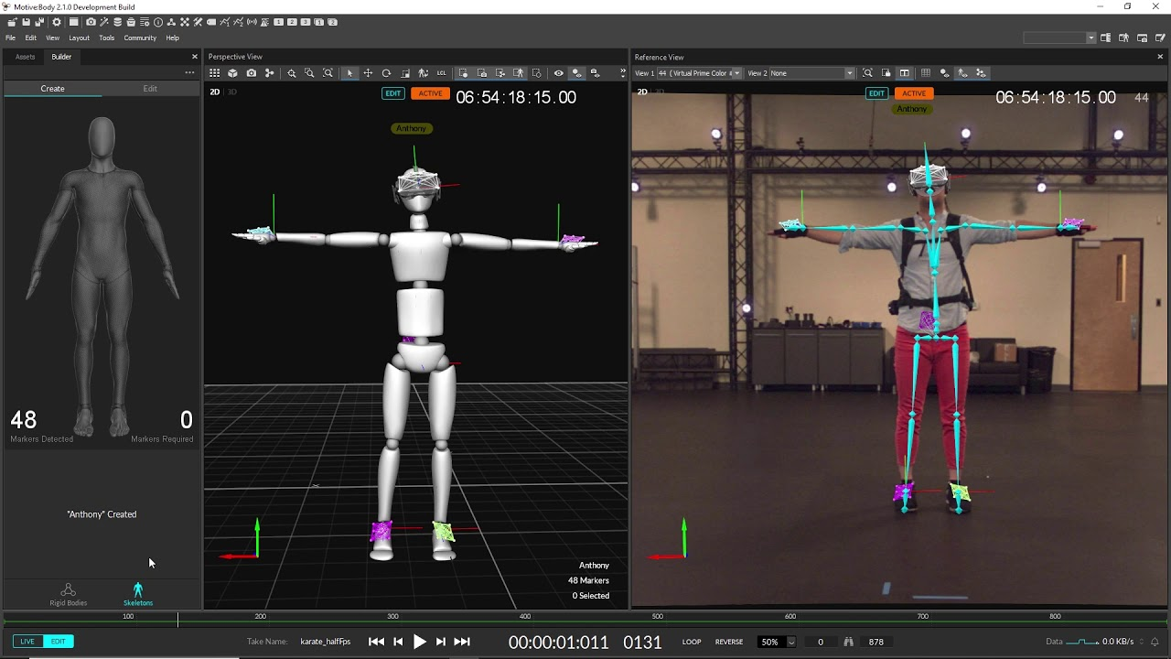
Cieľ bakalárskej práce
Vytvoriť dataset zložený zo synchronizovaných dát pohybu človeka a sekvencie snímkov z 3D kamery
Navrhnúť a implementovať aplikáciu na úpravu nahraných datasetov

Slide 3
Podobne bakalárske práce
Inspection and Editing of 3D Reconstructions in VR: Lukáš Gajdošech
Segmentation and Rendering of Multi-material 3D Scans: Jakub Valent
Capturing​ ​of​ ​Movement​ ​During​ ​Music​ ​Performance: Dana Škorvánková
Porovnanie metód rotácií bodu okolo priamky v 3D: Peter Zborovský
Online modelovanie a prezentovanie 3D objektov: Milan Halabuk

Slide 4
Východiskové odborné práce
Motion Capture Research: 3D Human Pose Recovery Based on RGB Video Sequences, Min 2019 et al., https://doi.org/10.3390/app9173613
MoVi: A large multi-purpose human motion and video dataset, Ghorbani et al. 2021, https://doi.org/10.1371/journal.pone.0253157
Survey on Style in 3D Human Body Motion: Taxonomy, Data, Recognition and its Applications, Ribet et al. 2019, https://hal.archives-ouvertes.fr/hal-02420912/document
Berkeley MHAD: A Comprehensive Multimodal Human Action Database, Ofli et al. 2013, https://openreview.net/pdf?id=TL6wabAZ9
Combining marker-based mocap and RGB-D camera for acquiring high-fidelity hand motion data, Xu et al. 2012, https://www.researchgate.net/publication/262399725_Combining_marker-based_mocap_and_RGB-D_camera_for_acquiring_high-fidelity_hand_motion_data
3D Photography: Full Body 3D Scanning, Zhou et al. 2015, https://www.researchgate.net/publication/265205391_Full_Body_3D_Scanning

Slide 5
Existujúce riešenia
https://www.rokoko.com/integrations/3d-character-animation-in-unreal
https://help.rokoko.com/support/solutions/articles/47001123745-getting-started-streaming-to-autodesk-maya#rokoko-studio-settings-0-3
http://www.valentinkraft.de/portfolio/point-cloud-renderer-for-unreal/
https://pointcloudplugin.com/
https://skeletex.xyz/portfolio/reconstruction/
https://www.unrealengine.com/en-US/

Slide 6
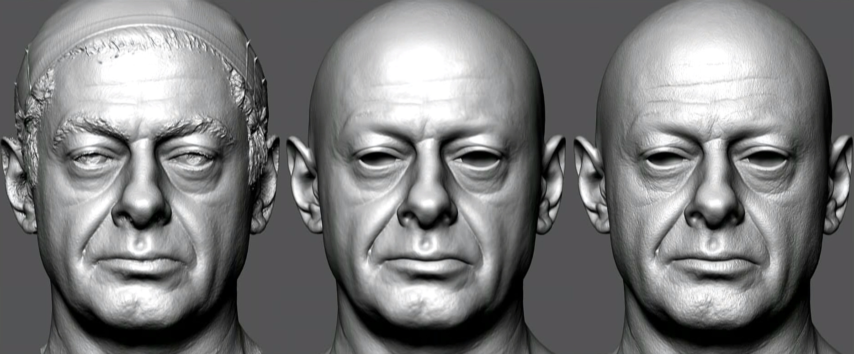
Manuály, učebnice, tutoriály, iné dokumenty
https://docs.unrealengine.com
https://api.unrealengine.com
https://wiki.unrealengine.com
https://www.youtube.com/c/NitrogenDev/
https://www.youtube.com/c/ReubenWardTutorials/
https://www.youtube.com/user/UnrealDevelopmentKit
https://photoneo.com/files/PhoXiControl-QuickInstructionManual.pdf
https://www.youtube.com/watch?v=dgBmw4CXDYY&ab_channel=Rokoko
https://www.youtube.com/watch?v=Asw4C51RH9I&ab_channel=UnrealEngine
https://www.youtube.com/watch?v=R-ZXdAEGbiw&ab_channel=UnrealEngine

Slide 7
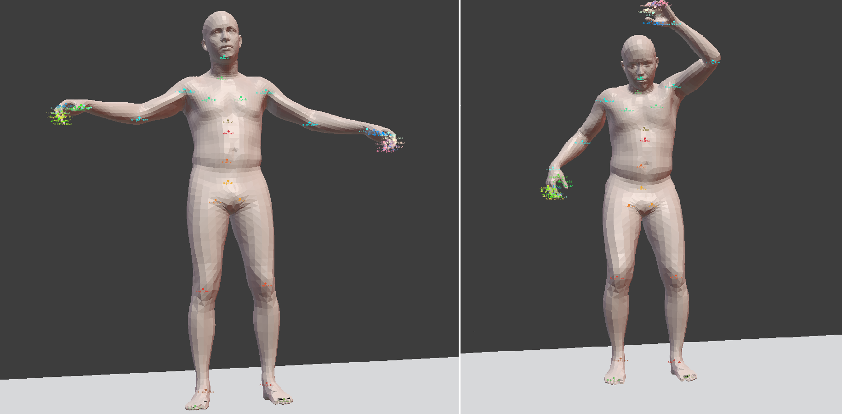
Vstupne udaje (datasety)
https://www.rokoko.com/application/education
https://github.com/zju3dv/EasyMocap
https://github.com/PointCloudLibrary/pcl/tree/master/test

