Slide 1
IBM CERTIFICATIONS PREPARARATION APP
Pavel Semenov

Slide 2
Architecture
AWS Deployment
Client App
REST

Slide 3
Implementation plan
Create DB models
Code endpoints
Protect with authentication
Write API specification
Create Learn, Test and About views
Code question views (including environment simulation)
Implement search

Slide 4
Current progress
DONE:
TODO:
DB models
API endpoints
Basic authorization
Swagger-UI
RAML API specification
Dockerfile containerization
Kubernetes deployment
Certifications List view
Questions List view
Question view (for simple questions)
Learn tab
About tab
Question view (enchanced)
Search implementation
Simulating exam environment (for Kubernetes and OpenShift only)

Slide 5
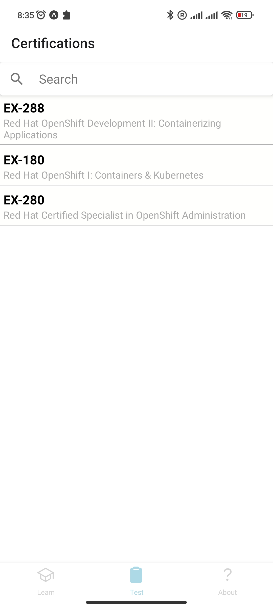
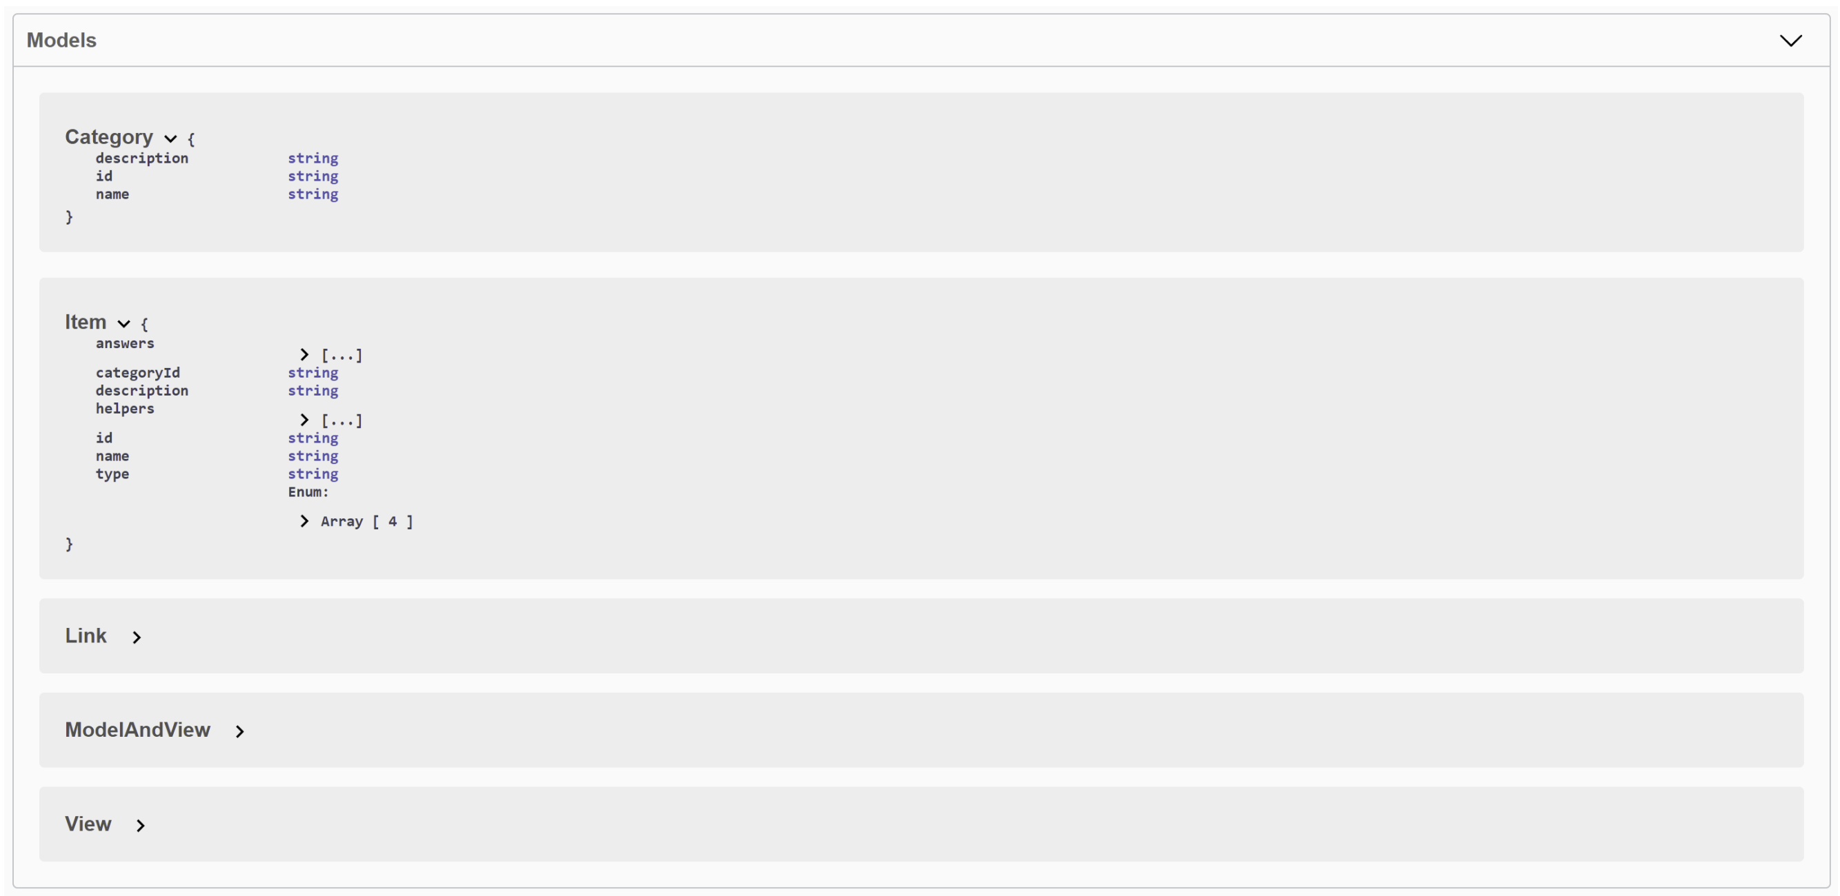
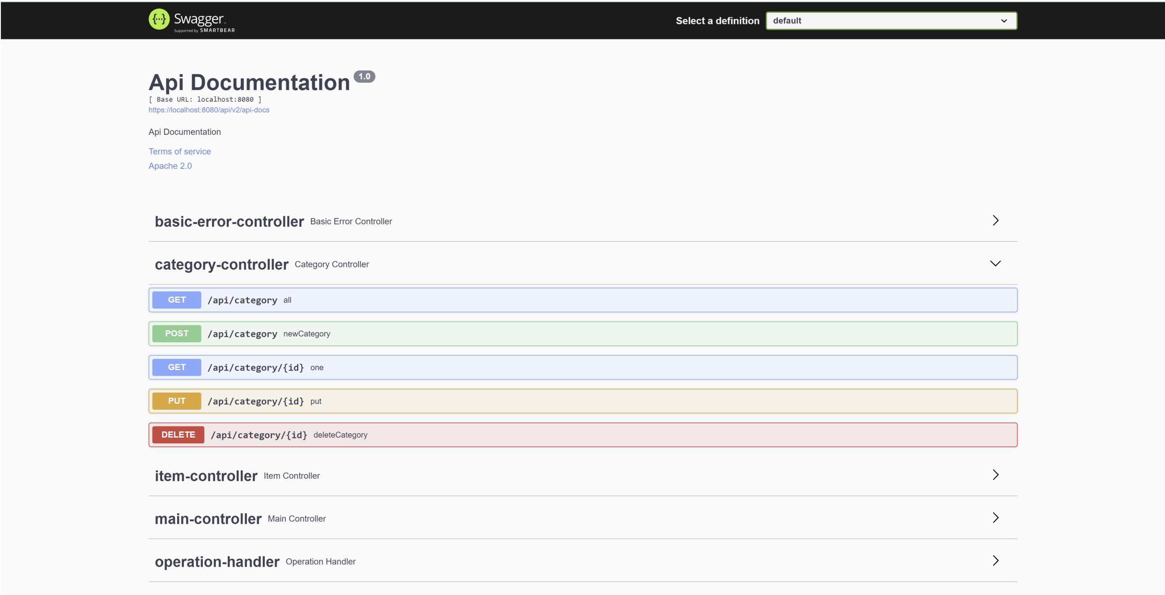
Current progress

Slide 6
Thank you!

