Slide 1
Sources presentation
Pavel Semenov

Slide 2
Contents
Main goals of the project
Similar theses from previous years
Existing similar apps
Sources to be used in the thesis

Slide 3
Goals
provide flexible exercising environment for the preparation for the certifications
minimize the time and effort needed to feel prepared for the certification exam
collect multiple theory sources in one place, so that instead of surfing the internet IBM employees can browse the prepared links in the app
personal: increase proficiency in Java Enterprise and multiplatform development using Spring Boot and React Native respectively

Slide 4
Similar theses
No apps for the certification or the exam preparation were created as a bachelor thesis
on the Faculty of Mathematics, Physics and Informatics of Comenius University.
Bachelor thesis of Martin Reguly
“Interaktívne laboratórium na výučbu programovania” (2019) provides a testing
environment for Python lessons.

Slide 5
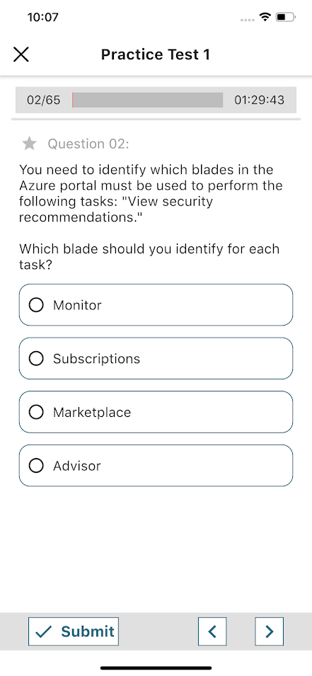
Similar apps
This app provides several practice tests to help prepare for the Microsoft
Azure Fundamentals certification.
Advantages: statistics page, tracking progress for each test
Disadvantages: only Microsoft Azure certifications, lots of ads, only one
type of questions

Slide 6
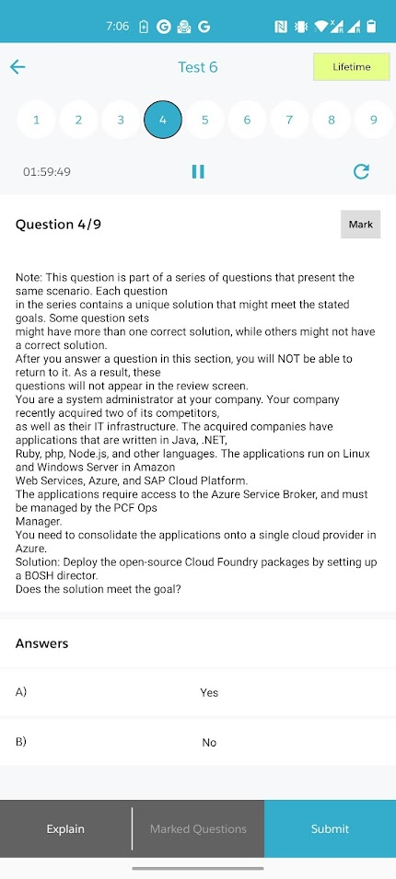
Similar apps
Certification Questions is a free app that allows to take tests for different
certifications.
Advantages: several tests for each certification, results tracking
Disadvantages: no answer field, no automatic answer check

Slide 7
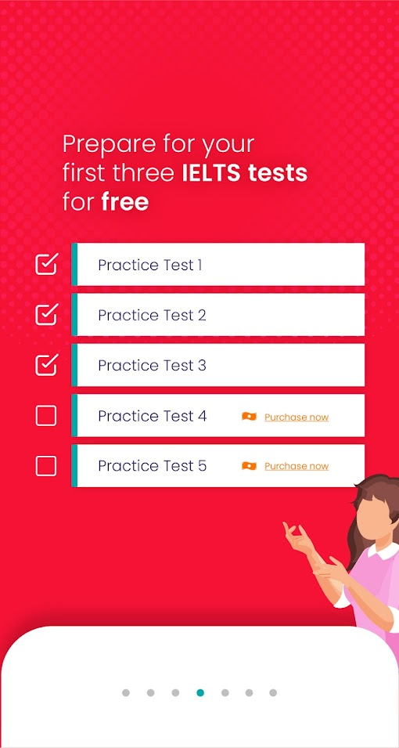
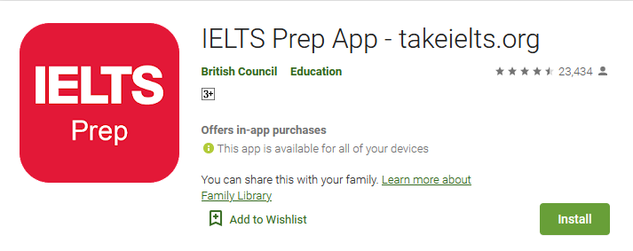
Similar apps
IELTS Prep app – the app developed by British Council for the preparation
to the IELTS exam. Provides lots of practice tests for both Academic and
General categories of tests. Users can also choose to prepare for a specific
test category: Reading, Listening, Writing and Speaking.
Advantages: good categorization
Disadvantages: no test pausing, so you have to complete the whole test
(~2 hrs) at once

Slide 8
Sources
Spring Boot documentation [https://spring.io/projects/spring-boot]
MongoDB documentation [https://docs.mongodb.com/]
React Native documentation [https://reactnative.dev/docs/getting-started]
Expo documentation [https://docs.expo.dev/]
RAML documentation [https://raml.org/]
Swagger UI documentation [https://swagger.io/docs/]
Will be updated throughout the development…

Slide 9
Thanks for your attention.

