Slide 1
APPLICATION DESIGNED TO HELP EMPLOYEES PREPARE FOR VARIOUS CERTIFICATIONS
Author: Pavel Semenov
Supervisor: RNDr. Marek Nagy, PhD.
Consultant: Ing. Pavol Jesenský
Department: FMFI.KAI - Department of Applied Informatics

Slide 2
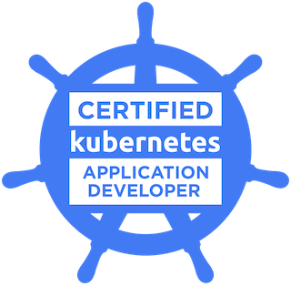
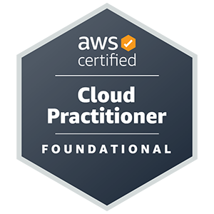
Introduction
Certifications
Motivation
Goals

Slide 3
Technologies
Spring framework (Spring Boot)
React Native
Kubernetes – namespaces, pods, configmaps

Slide 4
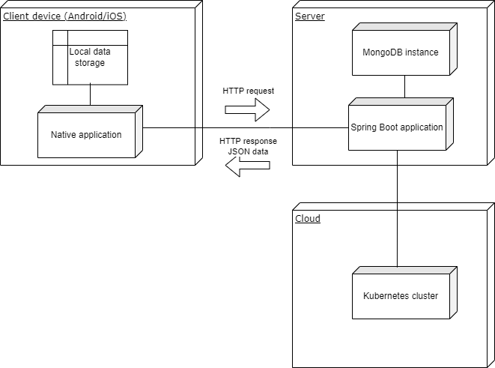
Architecture
Communication via HTTP protocol
Each request is secured by basic authentication
JSON and plain text bodies
Backend manages the Kubernetes cluster using the kubectl tool
Local data storage is used to store the progress for exercises and user id

Slide 5
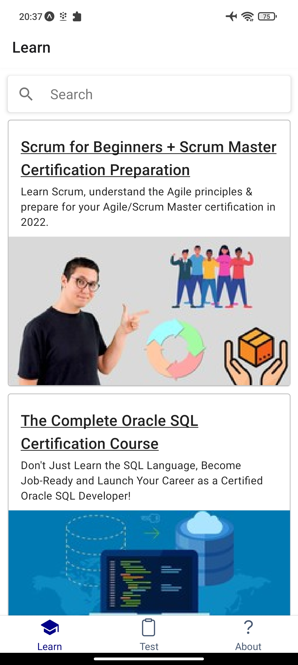
Design
Test tab
Certifications
Navigation
Exercises
Three navigation tabs:
Learn
Test
About
Exercise Start
Tasks
Exercise End

Slide 6
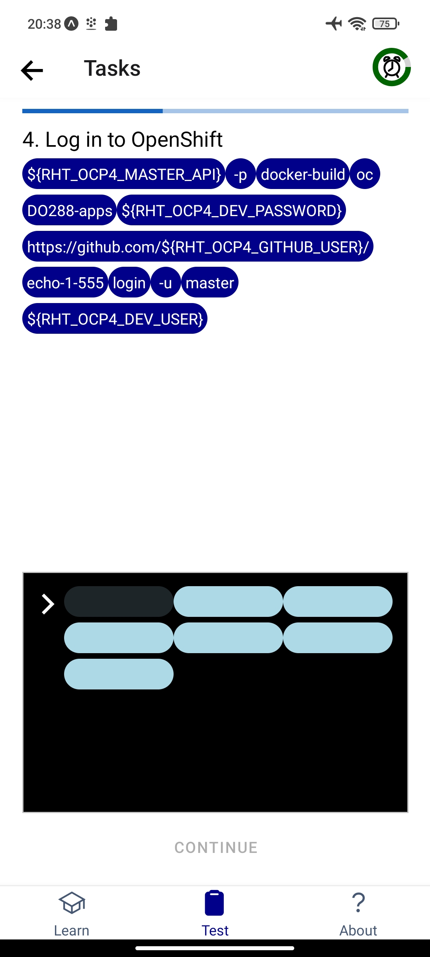
Design
Exercises and tasks
3 types of exercises
5 types of tasks
LAB
TEST
FIELD
Exercises
AUTO
SINGLE-OPTION
TEXT
MULTI-OPTION
EXEC
Tasks
answer is constructed from “bricks”

Slide 7
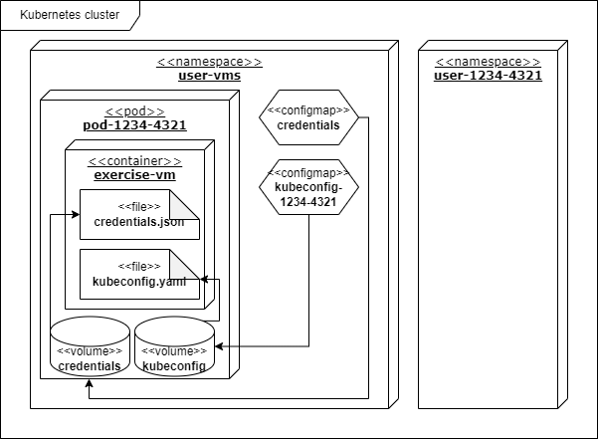
Design
Field exercise backend actions:
Creation of the exercise environment (namespace, confgimap and pod)
Execution of commands inside the pod
Termination of the exercise environment
Field exercises
Command lifecycle
User inputs
the command
The output is displayed to the user
Command is sent in HTTP request to the server
Backend wraps the output into the body of the response
Backend calls the bash script and passes the command to it
Bash script writes it to the output stream
The script executes the command inside the right container
The command produces output in the container

Slide 8
Final app
Video presentation

Slide 9
Core results
Outside of school curriculum technologies studied and used: Kubernetes, React Native, Spring
A way to execute commands composed by unknown authorities safely in separate environment was discovered
App compatible with iOS and Android was developed
“Bricks” idea and implementation
DRILLZ

Slide 10
Conclusion
Add Openshift support to “field” tasks
Improve answer evaluation system
Integrate learning section into the app
Goals achieved
IBM needs and requirements were fulfilled
Further development is in progress
A lot of possibilities to improve the application
Solve iOS issues
Add streaks and goals

Slide 11
THANK YOU

