Slide 1
Spanning trees in graphs
Terézia Strišovská
doc. RNDr. Tatiana Jajcayová, PhD.

Slide 2
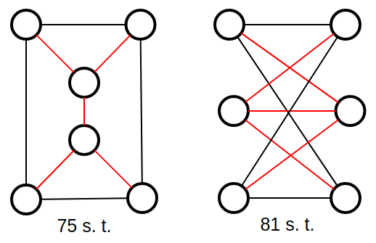
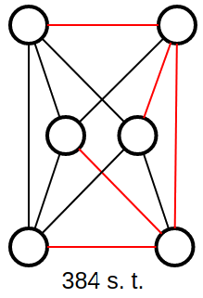
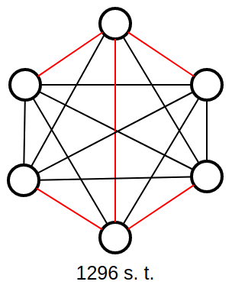
Graphs and spanning trees
undirected simple connected graphs
spanning tree of connected graph G
maximal set of edges of G with no cycles
focus on k-regular graphs
all vertices have k neighbours
regular graphs and their spanning trees

Slide 3
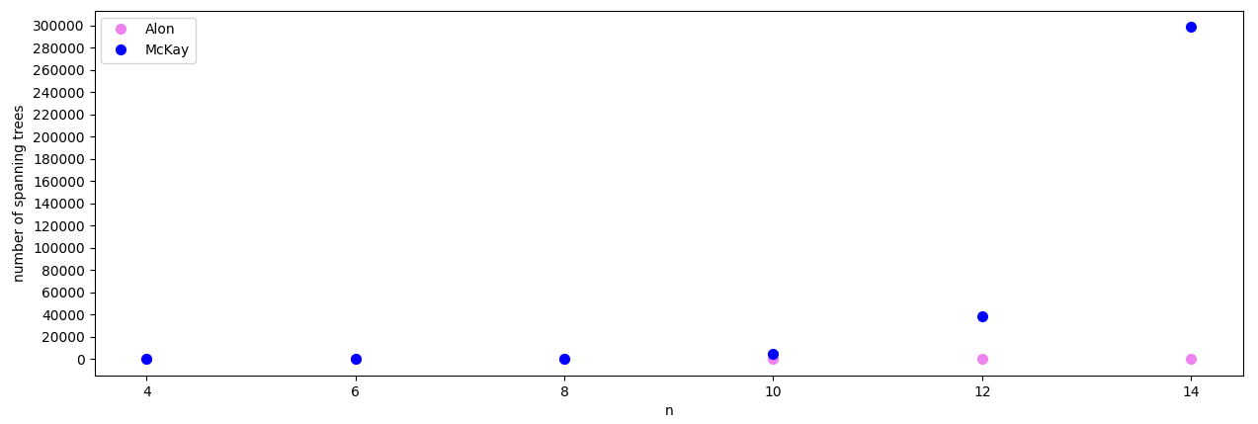
Motivation
easy to count spanning trees in a particular graph, but not in a whole class of graphs → estimations needed
k-regular graphs on n vertices
Noga Alon: The Number of Spanning Trees in Regular Graphs
Brendan McKay: Spanning Trees in Regular Graphs

Slide 4
Experiments
identify graphs with minimum and maximum number of spanning trees in a specified set of graphs
k-regular graphs on n vertices (k= 3; 4)
graphs on n + 1 vertices, n vertices are of degree k₁, one vertex is of degree k₂, k₁ ≠ k₂
compare the numbers of labeled and unlabeled spanning trees in a pair of graphs

Slide 5
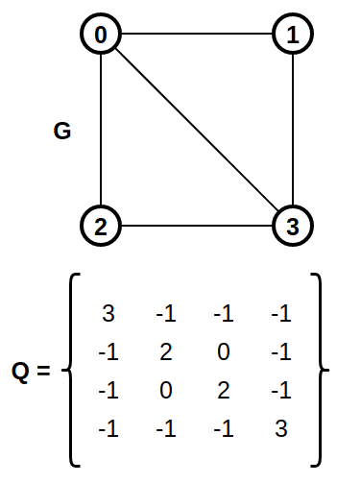
Implementation
graph generation - genreg
graph processing - C++
running experiments - bash scripts
combines graph generation and processing
spanning tree counting - Kirchhoff’s Theorem

Slide 6
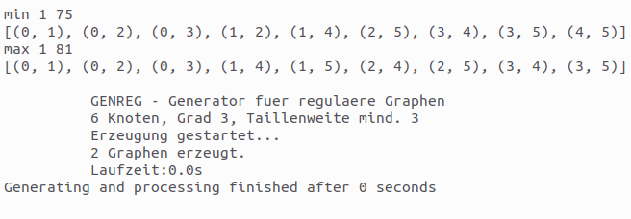
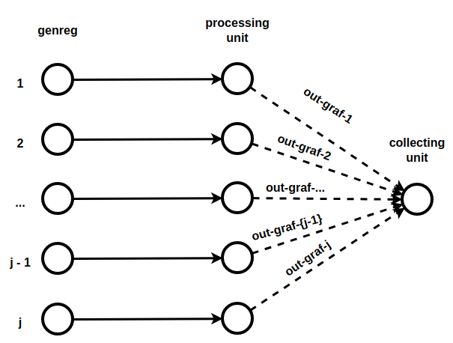
Methods for graph generating and processing
challenges: time and memory
<typeOfGeneration>serial n k []
runs generation and processing of k-regular graphs on n vertices
<typeOfGeneration>paralel j n k []
splits generation and processing into j parts

Slide 7
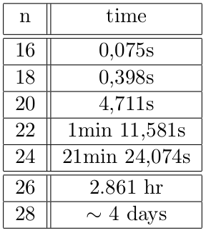
Overview of results
processed sets of graphs graphs
3-regular graphs - on up to 28 vertices (40 497 138 011 graphs)
4-regular graphs - on up to 19 vertices (11 946 487 647 graphs)
hypothesis about 3-regular graphs with minimum and maximum number of spanning trees
estimation for maximum number of spanning trees for 3-regular graphs on up to 42 vertices
generation+processing times of sets of 3-regular graphs on n vertices

Slide 8
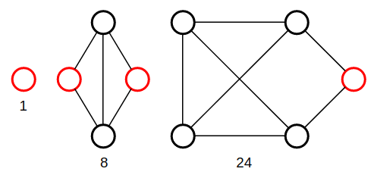
3-regular graphs with minimum number of spanning trees
formed from building blocks determining the number of spanning trees
hypothesis for the number of spanning trees based on iterative construction:
24^2 · (8^(n−2·5) / 4) spanning trees for n = 10 + 4i, i ∈ N
24^3 · (8^(n−3·5 - 1) / 4) spanning trees for n = 16 + 4i , i ∈ N

Slide 9
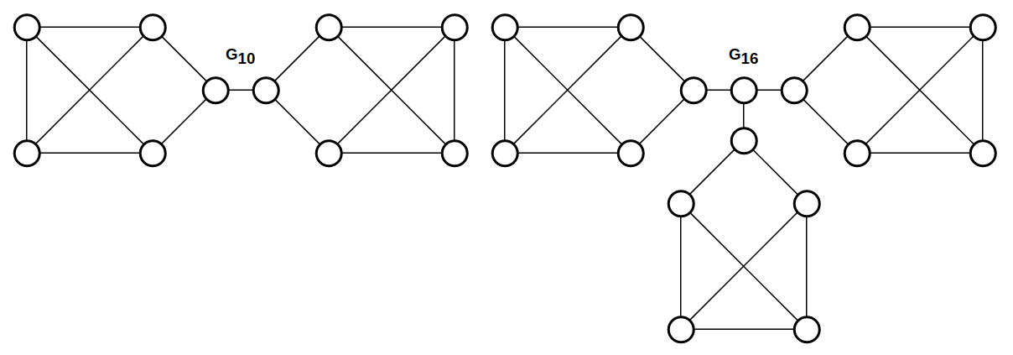
3-regular graphs with minimum number of spanning trees

Slide 10
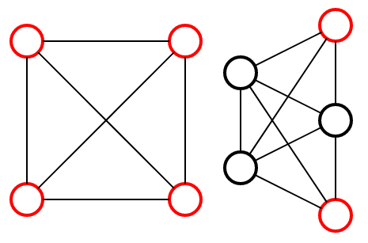
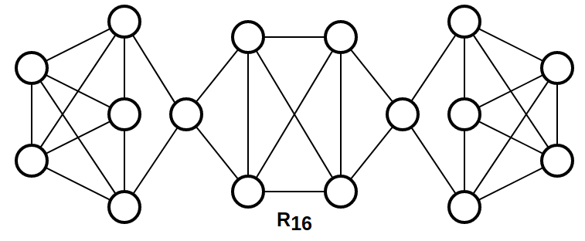
4-regular graphs with minimum number of spanning trees
pair of building blocks + additional vertices
no bridges present → more complex structure of graphs and spanning tree counting

Slide 11
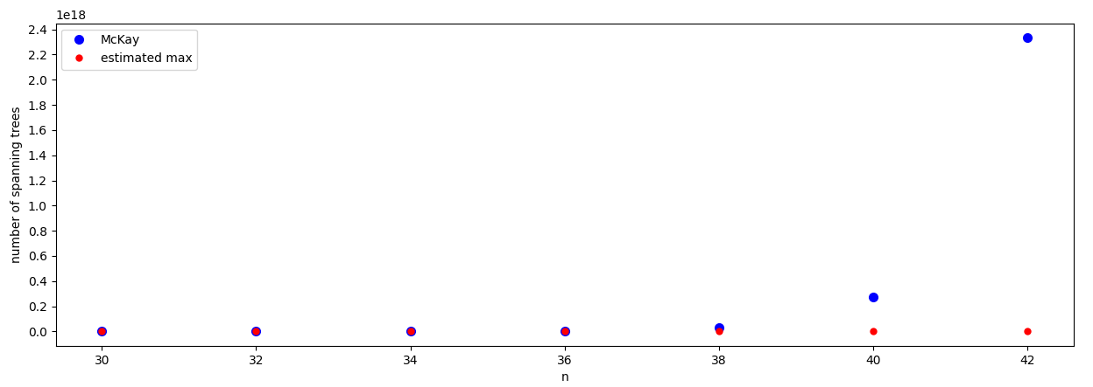
3-regular graphs with maximum number of spanning trees
highest possible girth for the given n (girth - length of the shortest cycle in the graph)
enables for estimations for higher values of n
for n = 4, 6, 10, 14, 24 and 30, the graphs are cages
regular graphs with the least possible number of vertices for a given girth

Slide 12
Main contributions
personal - work with large sets of graphs
if our hypothesis for the minimum number of spanning trees in 3-regular graphs is correct, it is more accurate than Alon’s lower bound
relation between graphs with minimum/maximum number of spanning trees and other areas from graph theory (girth, cages…)

Slide 13
Thank you for your attention

Slide 14
Bibliography
MCKAY B., Spanning Trees in Regular Graphs. Europ. J. Combinatorics (1983) 4.
1983. 149-160.
ALON N., The Number of Spanning Trees in Regular Graphs. Random Struct.
Algorithms 1(2). 1990. 175-182.

