Slide 1
Cloud (Concepts and Services )
András Varga
IBM Consulting

Slide 3
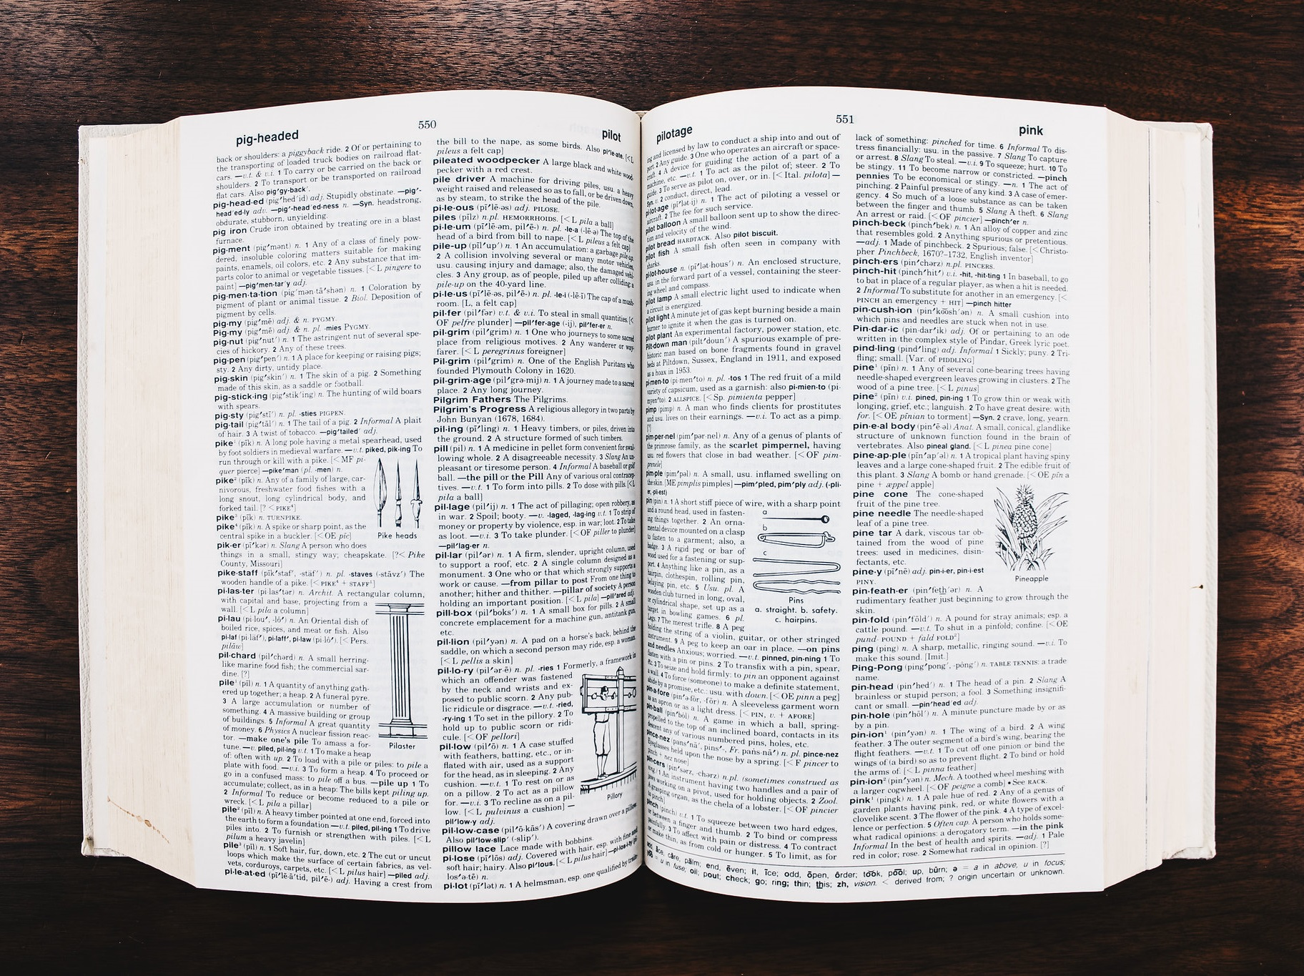
Outline
Basics
Glossary
Money
Decision Making
Services
Data Services
Architecture
Self-Development

Slide 4
Outline
Basics
Glossary
Money
Decision Making
Services
Data Services
Architecture
Self-Development

Slide 5
Hybrid Cloud
Cloud Provider 1
Dedicated
Data Center
Cloud Provider 2

Slide 6
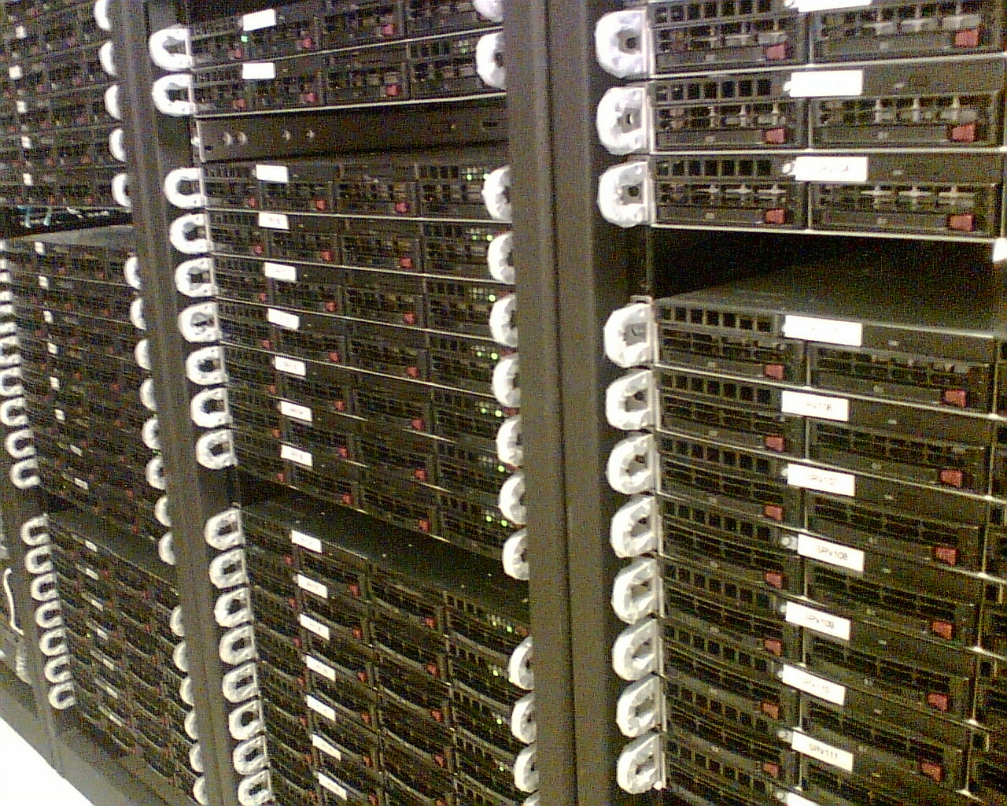
Basics
Virtual Machine
Dedicated
Host
Volume
Fixed Amount
Tags
Persistent Storage
Custom Metadata
For Any Resource

Slide 7
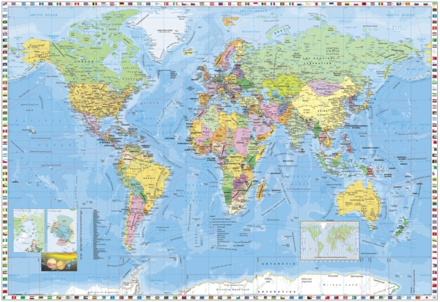
Availability
“The ability to withstand all outages and continue providing
processing capability according to some predefined service level.”
High Availability
Region
Availability Zone
Multi-Region
Multi-AZ

Slide 8
Users
Identity provider (LDAP, AD)
Multi-factor authentication
Secret
+Secret
Single sign-on
Identity and Access Management
Roles

Slide 9
Consistency
Eventually consistent read
Strongly consistent read
A single read from a node might provide old data
Data gets updated in time
All nodes always provide the same data

Slide 10
Scalability vs Elasticity
“The measure of a system’s ability to increase or decrease in
performance in response to changes in application and processing
demands.”
Scalability
“The ability to grow or shrink infrastructure resources dynamically
as needed to adapt to workload changes in an autonomic manner,
maximizing the use of resources.”
Elasticity

Slide 11
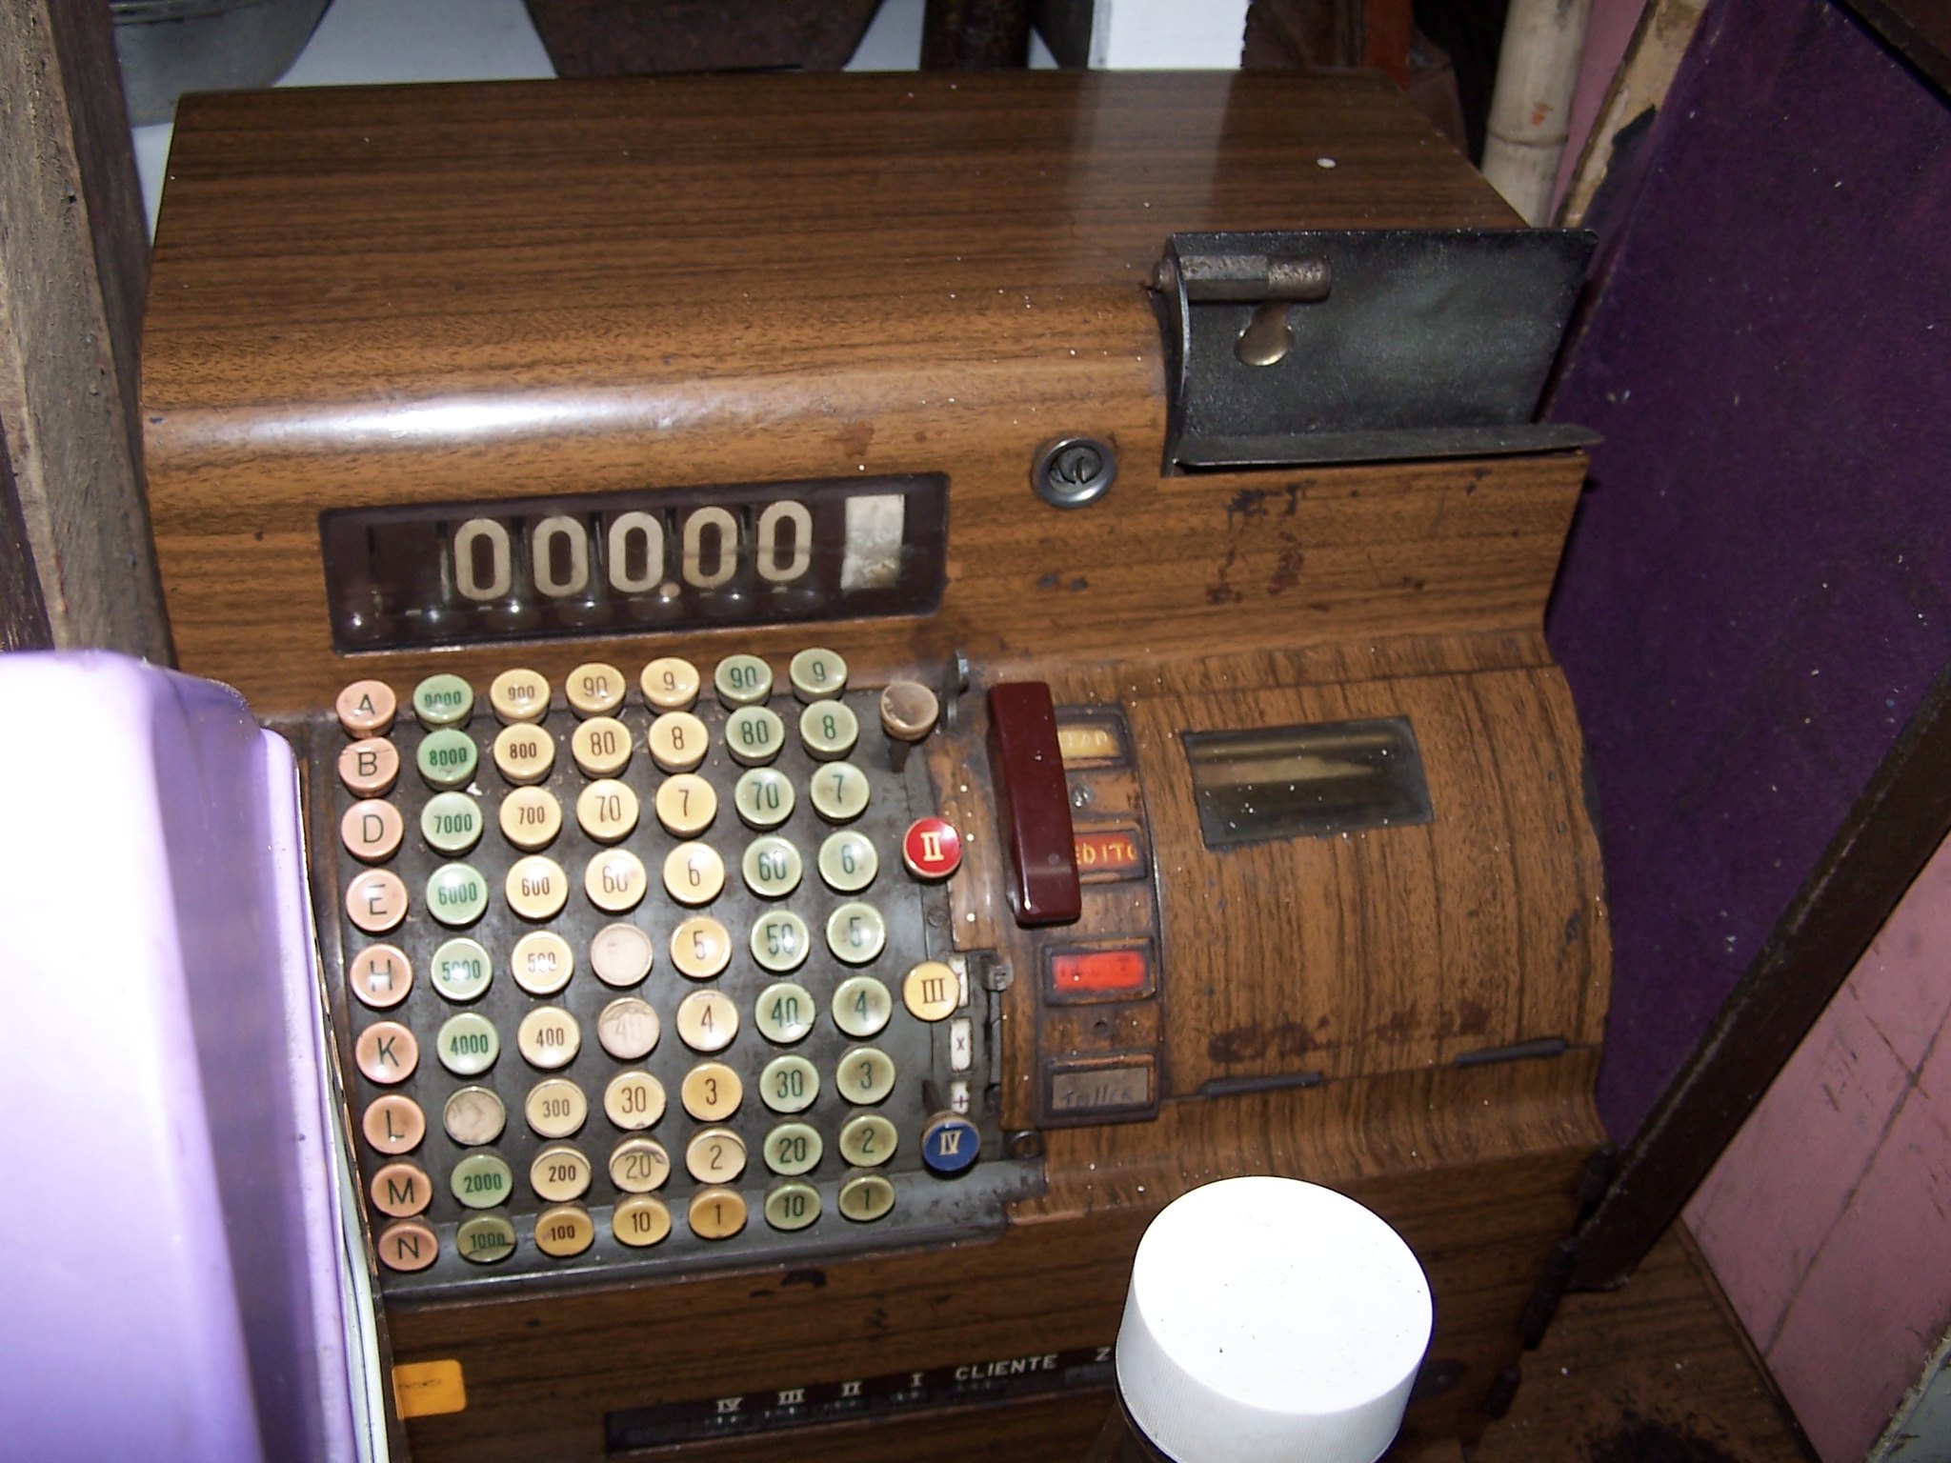
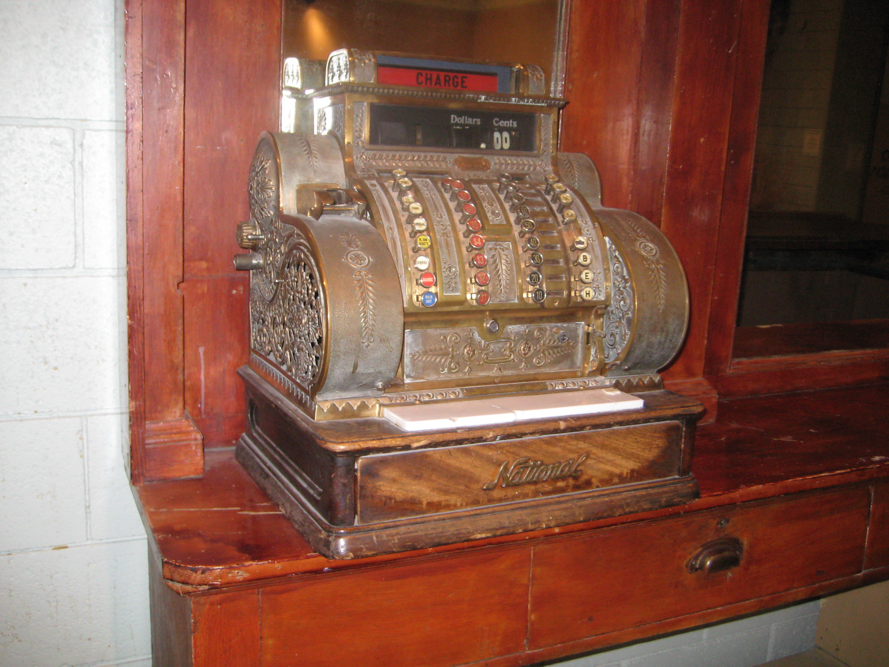
Scalability vs Elasticity

Slide 12
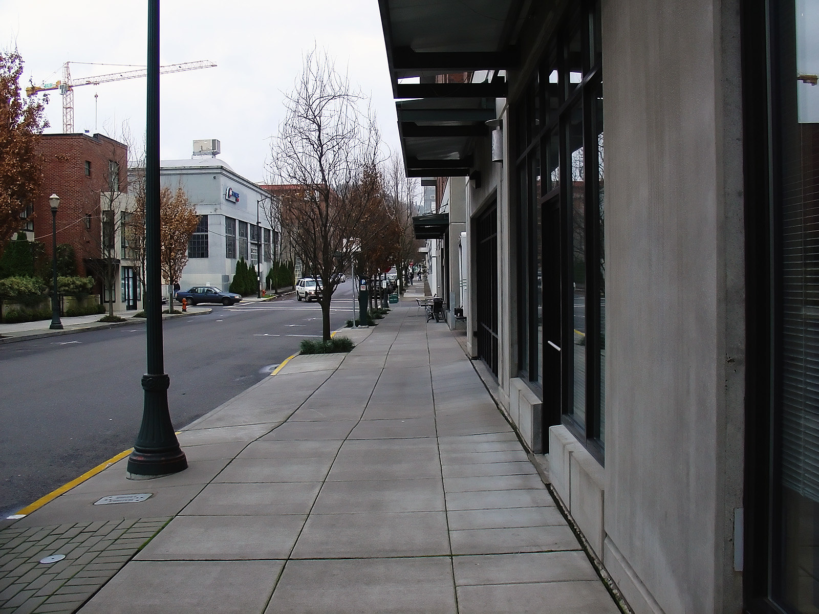
Scalability vs Elasticity
Elastic
Scalability relies on architecture
Hardware support for scaling might take additional planning

Slide 13
Elasticity of Cloud
App2
Free
App1

Slide 14
Outline
Basics
Glossary
Money
Decision Making
Services
Data Services
Architecture
Self-Development

Slide 15
Cloud Costs
Fast
Cheap to onboard
Readily available
Mistakes can cost money
Uncontrolled usage is expensive

Slide 16
Investment & Operations

Slide 17
Investment & Operations

Slide 18
Performance & Expenditure
Cloud and properly scalable/distributed application
Want to double the performance?
It will approximately double to cost as well…

Slide 19
Outline
Basics
Glossary
Money
Decision Making
Services
Data Services
Architecture
Self-Development

Slide 20
Simple Infrastructure
VPC
VPN Gateway
Route 53
Virtual network
VPN Gateway
DNS, Traffic Manager
EC2
Elastic Block Storage
Virtual Machine
Data disk on Blob Storage
Elastic Container Registry
Elastic Kubernetes Service
Azure Container Registry
Azure Kubernetes Service

Slide 21
Object Storage
Key-Value store mimicking a “filesystem”
Supports ACL
mybucket/vdirectory1/another_dir/my_file.txt
/ is a valid character in keys
Accessible via
web requests
mounting as filesystem
S3, Glacier
Blob Storage, Cool Tiers

Slide 22
Databases
RDS
SQL Server included
Database for …
SQL Database
Aurora
Athena
SQL query over DBs and S3 storage
SQL Database serverless
Data Lake Analytics
Provides more services
Serverless
ElastiCache
Cache for Redis

Slide 23
Databases
Fully managed
Fast, often included in streaming architectures
NoSQL
Can support columnar or graph formats
Supported by containers
Xbox Live
Shards
400 kB limit
Indices
DynamoDB
Cosmos DB

Slide 24
Data Warehouse
Scales linearly with data volume
Deployed over a cluster
Massively Parallel Processing
Spectrum enables reading data from S3
Redshift, Redshift Spectrum
Synapse Analytics

Slide 25
Big Data
Databricks
Databricks
EMR
Hive
Spark …
Lake Formation
HDInsight
Hadoop
Spark …
Data Share
Can act as a Hive metastore
Glue
Pipelines
Purview
Data Factory

Slide 26
Streaming
Kinesis
Analytics
Event Hubs
Stream Analytics
SQL support
Kinesis Data Firehose
Managed Streaming for Apache Kafka (MSK)
Kafka in HDInsight

Slide 27
AI & ML
SageMaker
Comprehend
Machine Learning
Cognitive Services for Natural Language
Polly Transcribe
Lex
Speech services
PowerBI integration

Slide 28
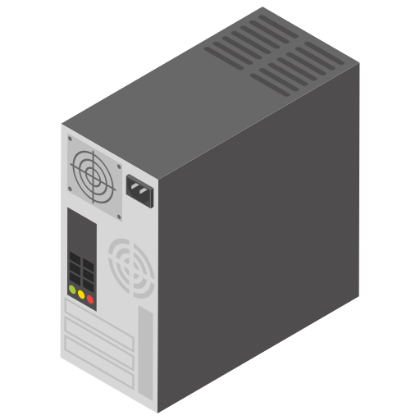
Function as a Service
Supports most common languages
Integrated with other services
Code in S3
Code deployed
Lambda
Azure Functions

Slide 29
Function as a Service
Use Cases:
Interactive website backend
Data validation
Software deployment
Usually acts as a glue between services
Isolated
Limited time
Unknown resources
Lambda
Azure Functions

Slide 30
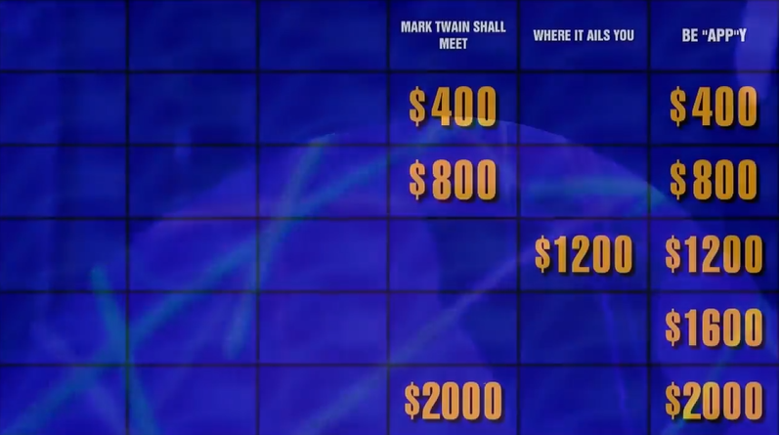
Watson
IBM
Natural Language Processing
2011

Slide 31
Outline
Basics
Glossary
Money
Decision Making
Services
Data Services
Architecture
Self-Development

Slide 32
Reference Architectures
It is hard to create a complex solution by stitching together cloud resources and custom code
Reference architectures
Whitepapers

Slide 33
Certifications

Slide 34
References
Pictures
Sunrise Crane by Wyncliffe (Public Domain)
Dining Room by Steven Miller (CC BY 2.0)
Money by Dustin Moore (CC BY 2.0)
dictionary by Stock Catalog (CC BY 2.0)
wiki servers by Domas Mituzas (CC BY 2.0)
World Map UK by Taka@P.P.R.S (CC BY-SA 2.0)
consistency by Uniconlabs on flaticon.com
arrows by Kalashnyk on flaticon.com
Sidewalk by Simon Malz (CC BY-SA 2.0)
Clouds by Joao Clerigo (CC BY-NC 2.0)
Cashier by Mario Andre Cordero Alfaro (CC BY-NC-ND 2.0)
Old cashier machine by Andi Bharata (CC BY-NC 2.0)
Cashier counter by Aldenn (CC BY-SA 2.0)
Identity card by IconMarketPK on flaticon.com
Search by Freepik on flaticon.com
Cloud by Kiranshastry on flaticon.com
Website by prettycons on flaticon.com
Computer by Freepik on flaticon.com
Coding by Freepik on flaticon.com
Programmer by Freepik on flaticon.com
Minus by Fathema Khanom on flaticon.com
Plus by kliwir art on flaticon.com
Desktop computer by vectorsmarket15 on flaticon.com
Computer case by kliwir art on flaticon.com
Source code by Flat icons on flaticon.com
Sunrise by Elsamuko (CC BY-SA 2.0)
Literature
Amazon AWS
Microsoft Azure
Google Cloud
IBM Cloud
Alibaba Cloud
Oracle Cloud Infrastructure

Slide 35
Thank You

