Slide 1
Docker
András Varga
IBM Consulting

Slide 2
Outline
Motivation
Containers and Docker
Docker Images
Docker Containers
Cluster Management
Architectural Considerations
Best Practices

Slide 3
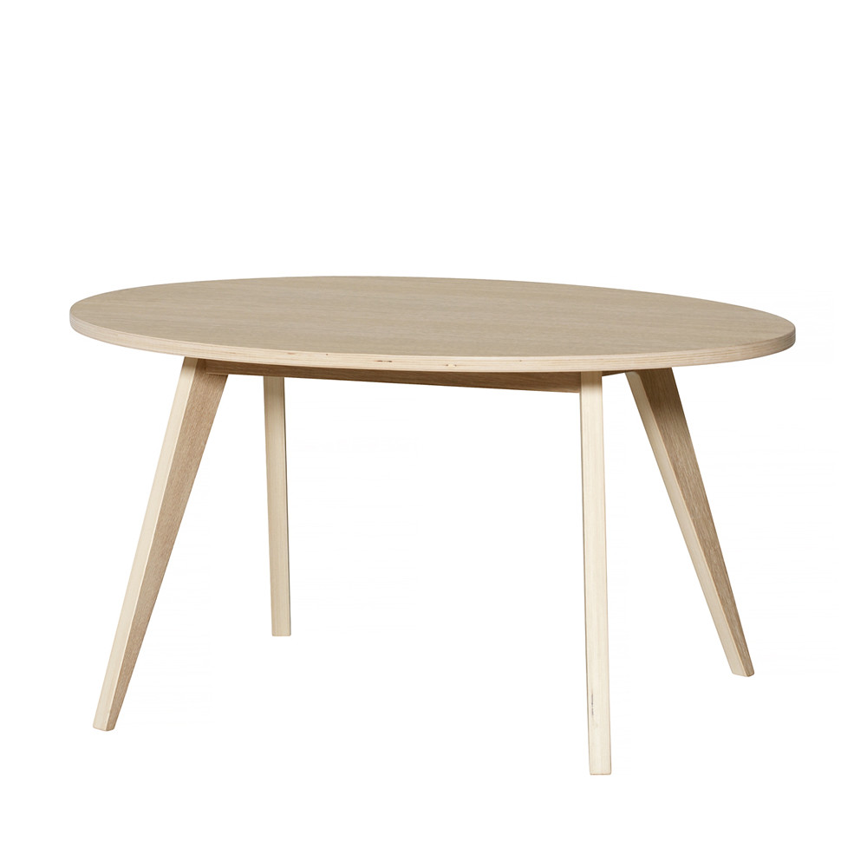
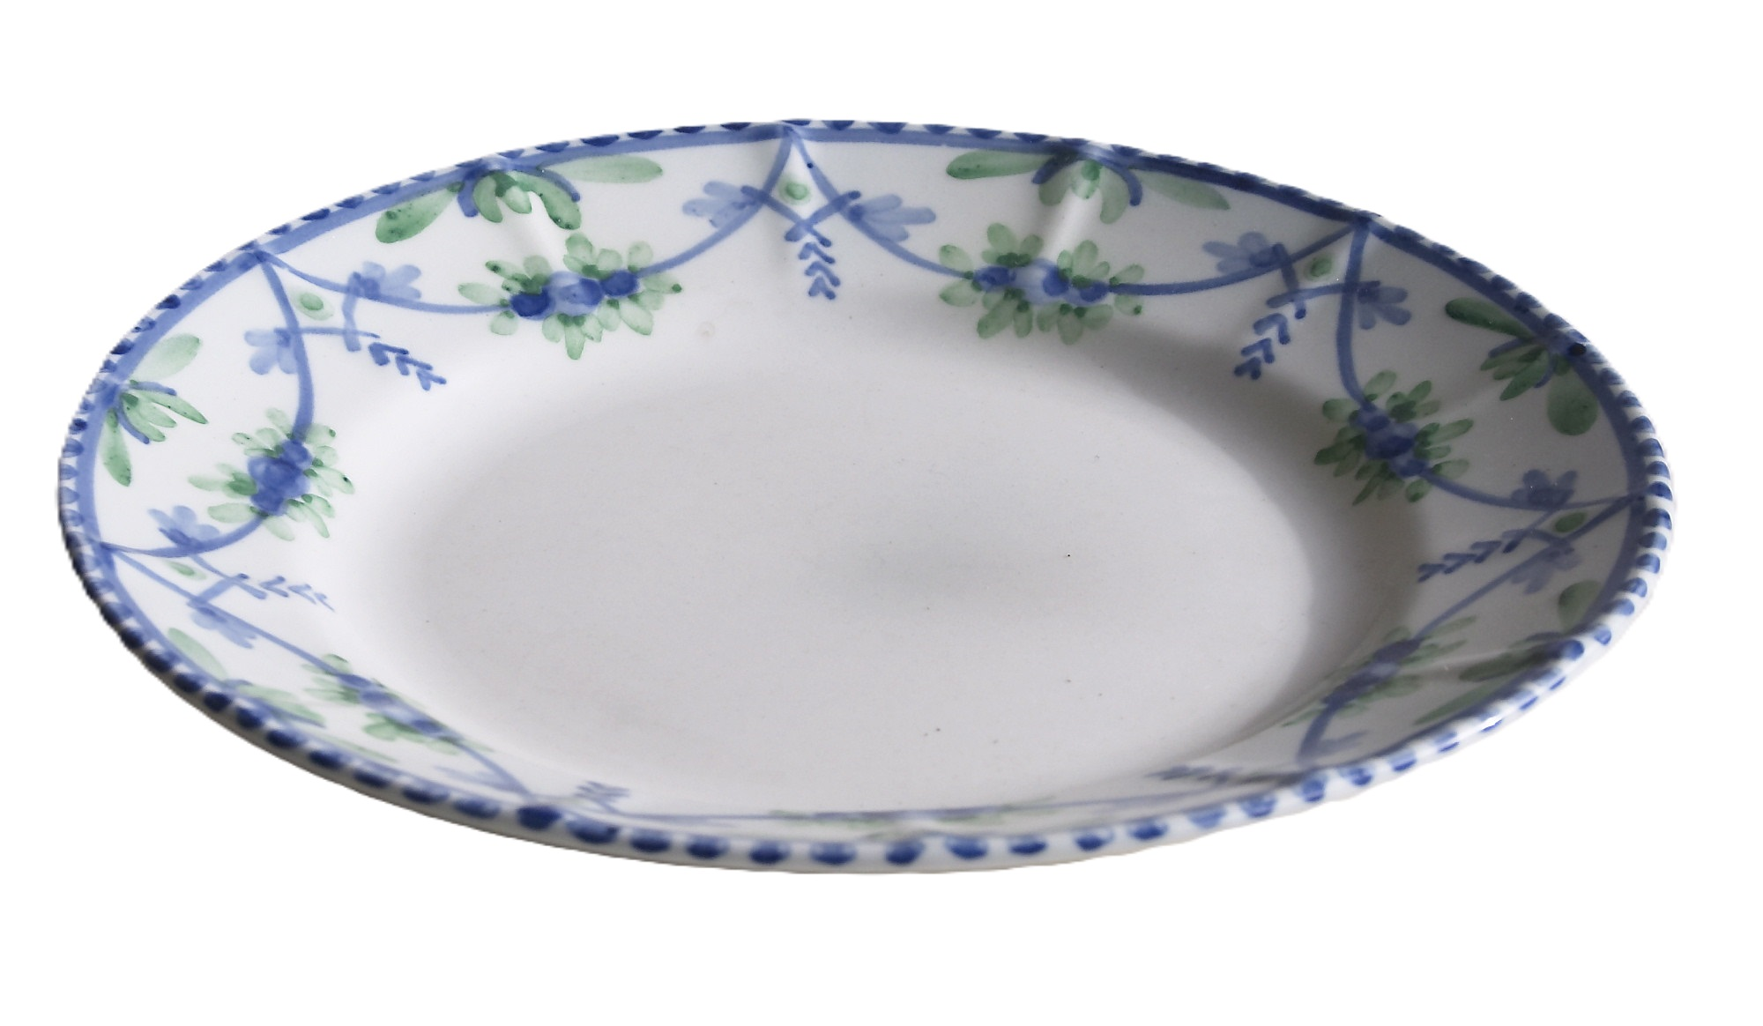

Slide 5
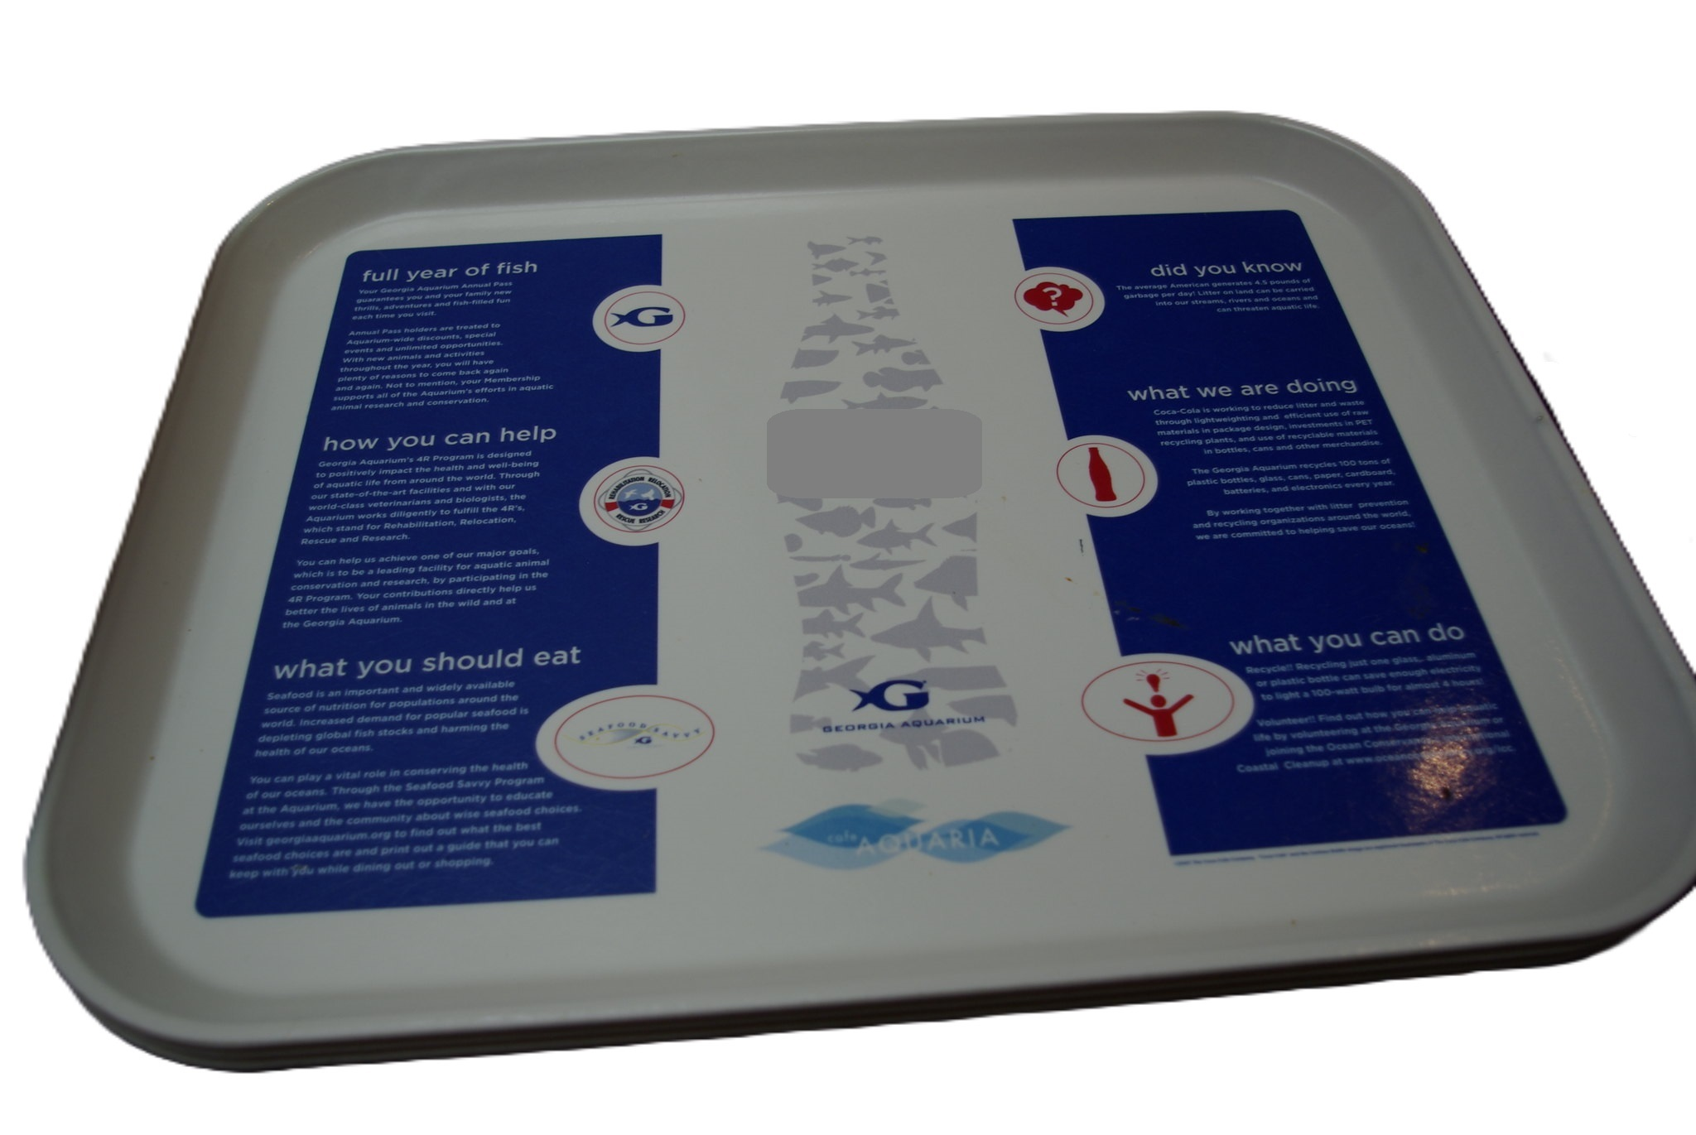

Slide 8
Outline
Motivation
Containers and Docker
Docker Images
Docker Containers
Cluster Management
Architectural Considerations
Best Practices

Slide 9
Containers
Is a sandboxed process on your machine that is isolated form all other processes on the host machine
Portable
Shareable
Lightweight

Slide 10
Containers and VMs
Application
Application
Application
Application
Application
Application
bin/lib
bin/lib
bin/lib
bin/lib
bin/lib
Docker
Operating System
OS
OS
Operating System
Hypervisor
Infrastructure
Infrastructure
Infrastructure
Single Machine
Virtual Machines
Containers

Slide 11
Containers and VMs
Application
Application
Application
Application
Application
bin/lib
bin/lib
bin/lib
bin/lib
bin/lib
Docker
Docker
Operating System
Operating System
Hypervisor
Infrastructure

Slide 12
Business Card
A solution to create and manage containers
Originates from Linux
Simple build and deployment functionality

Slide 13
Alternatives

Slide 14
Outline
Motivation
Containers and Docker
Docker Images
Docker Containers
Cluster Management
Architectural Considerations
Best Practices

Slide 15
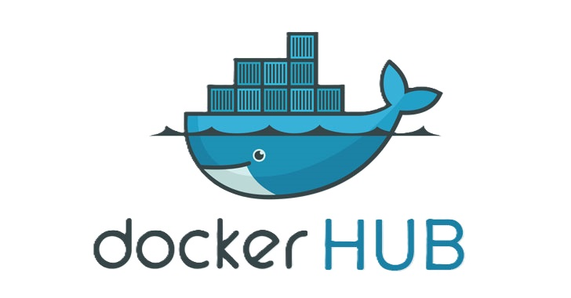
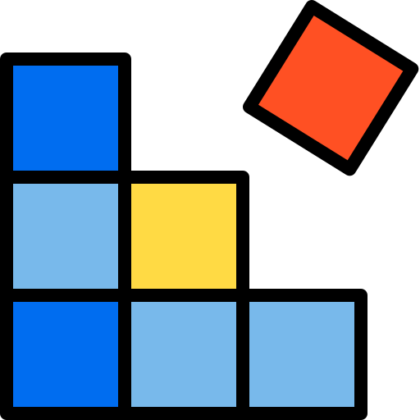
Vocabulary
Dockerfile
Most popular public registry
Built from
Stored in
Started
Registry
Docker Image
Container

Slide 16
Working with an Image
docker build <context>
Directory
Git repo
Tarball
builds
contains
Image
Dockerfile
-f option

Slide 17
Working with an Image
docker push <myname>/<mytag>
-t myname/mytag option
Provides a name and tag to the image
WordCount:v12
Labels
Auxiliary information
author=“absolutely@not.me”
Image
docker pull <name>/<tag>
Default tag is latest

Slide 18
Working with an Image
docker build <context>
Directory
Git repo
Tarball
docker push <myname>/<mytag>
builds
contains
Image
Dockerfile
-f option
docker pull <name>/<tag>

Slide 19
Building an Image
Image
FROM ubuntu
RUN dnf update
RUN dnf install python3
RUN mkdir /app
COPY run.py /app
CMD [“python3”,”/app/run.py”]
bin/lib
Layers
bin/lib update
python3
All layers can be extracted from the image!
/app
/app/run.py
python3 /app/run.py

Slide 20
Re-building an Image
Each layer is stored as an intermediate anonym image
FROM ubuntu
RUN dnf update
RUN dnf install python3
RUN mkdir /app
COPY run.py /app
CMD [“python3”,”/app/run.py”]
bin/lib
bin/lib
bin/lib update
bin/lib update
python3
python3
/app
/app
/app/run.py
/app/run.py
python3 /app/run.py
python3 /app/run.py

Slide 21
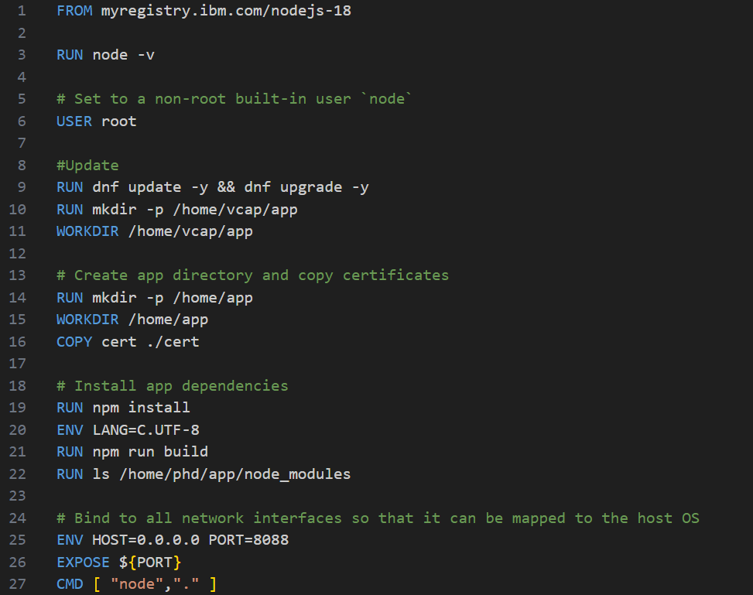
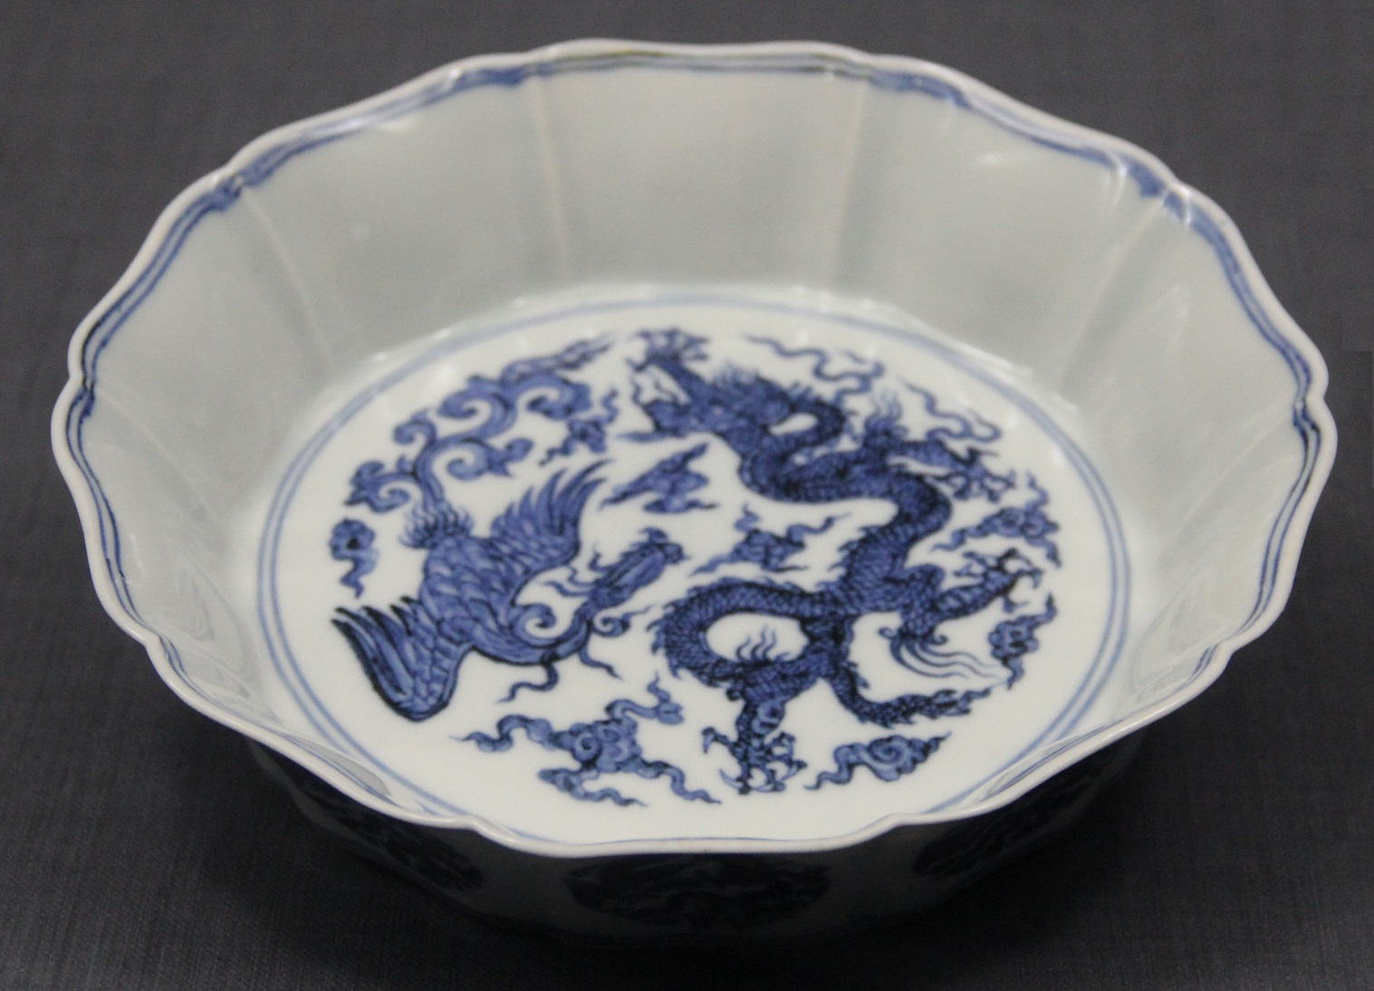
Example Dockerfile

Slide 22
Outline
Motivation
Containers and Docker
Docker Images
Docker Containers
Cluster Management
Architectural Considerations
Best Practices

Slide 23
Containers
docker run –d <image_name>:<tag>
Runtime Changes
python3 /app/run.py
Temporary layer
Created on top of the image
Created on Container startup
Discarded when container stops
/app/run.py
Image
/app
python3
bin/lib updated
Ubuntu bin/lib

Slide 24
Containers
docker run –d <image_name>:<tag>
-v allows mounting persistent directories
Runtime Changes
python3 /app/run.py
/app/run.py
Container
/app
python3
bin/lib updated
Ubuntu bin/lib
Host Filesystem

Slide 25
Containers
docker run –d <image_name>:<tag>
-p connects ports from inside the container to host ports, i.e., opening ports
Runtime Changes
python3 /app/run.py
/app/run.py
Container
/app
python3
bin/lib updated
Ubuntu bin/lib
Host Filesystem

Slide 26
Containers
docker run –d <image_name>:<tag>
-p
Runtime Changes
python3 /app/run.py
/app/run.py
-v
Container
/app
python3
bin/lib updated
Ubuntu bin/lib
Host Filesystem

Slide 27
Docker Network
Application
Docker network
Isolation
Uses iptables
Containers can be reached using their names

Slide 28
Listing Objects
docker images
docker container ls
docker network ls

Slide 29
How Docker Works
cgroups
namespaces
Provides users elevated access inside a given namespace
Isolation
CPU allocation
Memory allocation

Slide 30
Outline
Motivation
Containers and Docker
Docker Images
Docker Containers
Cluster Management
Architectural Considerations
Best Practices

Slide 31
Docker Compose
Handles execution on a single machine
Provides isolation
docker compose
YAML configuration

Slide 32
Cluster Management

Slide 33
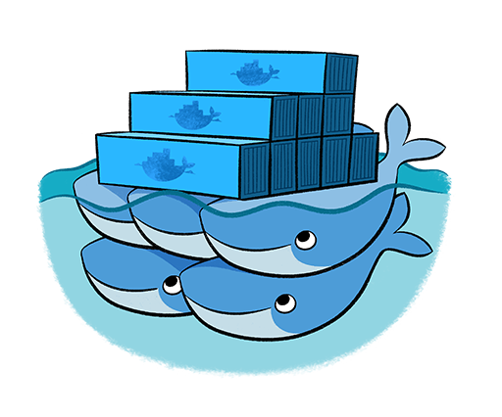
Cluster Managers
Handles Scaling, Self-healing and Load Balancing
Assigns tasks to nodes
Native solution
Generic orchestration tool

Slide 34
Kubernetes
Simplified View
Kubernetes Cluster
Control Plane
scheduler
Kube-api-server
controller
etcd
data
kubelet
kubelet
kubelet
pod
pod
pod
pod
pod
execution
pod
pod
pod
pod
Node
Node
Node

Slide 35
Pods
pod
container
Pod acts as a wrapper for a running container
Several, possibly different containers run in a single pod
Easier network communication
Harder maintenance
pod
container
container

Slide 36
Outline
Motivation
Containers and Docker
Docker Images
Docker Containers
Cluster Management
Architectural Considerations
Best Practices

Slide 37
Microservices
Architectural Pattern
Service 1
Service 2
Service 3
Internal Service
Functionality 1
Functionality 2
Functionality 3
Heavily Utilizes:
Containers
Orchestration
Automation
Aggressive and automated testing

Slide 38
Microservices
Architectural Pattern
Service 1
Service 2
Service 3
Internal Service
Services are usually small, but micro is an over-statement
Each service is developed separately, sometimes by different teams
Complex networking
Managing Databases is cumbersome

Slide 39
Integration and Delivery
Maturity of Software Development
Continuous Integration
Code changes are often pushed into the main codebase and covered with basic tests
Continuous Delivery
Code changes result in a software, which can be released any time
Continuous Deployment
Deployment automation
Testing automation
Improving testing technique
Code changes are released automatically

Slide 40
Pipelines
Build
Release
Usually associated with integration
docker build
Automates the release (delivery) of a software
docker push
docker run
Using Kubernetes

Slide 41
Outline
Motivation
Containers and Docker
Docker Images
Docker Containers
Cluster Management
Architectural Considerations
Best Practices

Slide 42
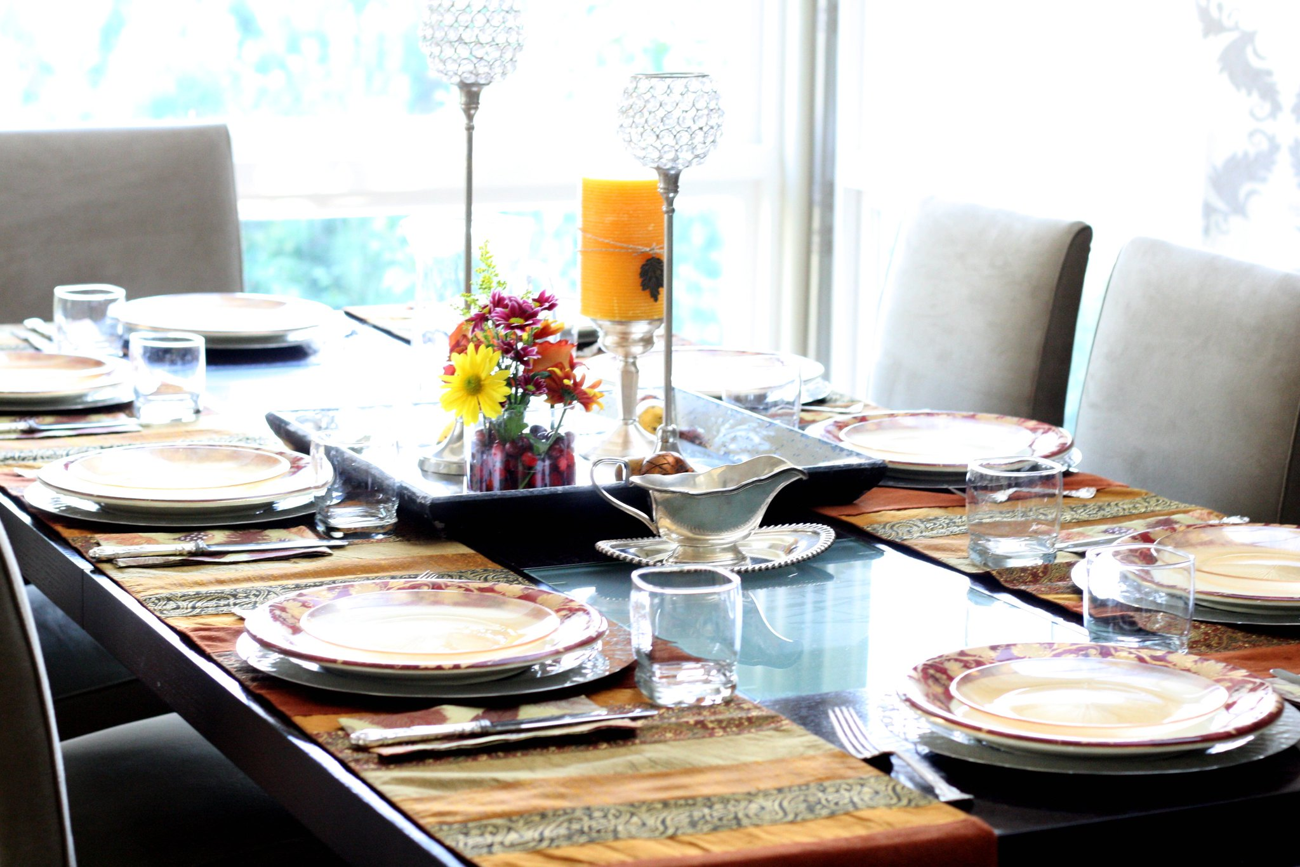
Best Practices
Create ephemeral containers (can be restarted at will)
Use .dockerignore
Install libraries first, add your code later
Sort arguments
Organize layers reasonably

Slide 43
Security
Do NOT install SSH server in container
docker exec, docker attach
Never start from untrustworthy, unknown images
Use a blank OS image, official images
Dockerfiles are open, never hard-code passwords
Use vaults or temporarily mounted config files
Encrypt the image, if needed

Slide 44
References
Pictures
Middagsservise(uzav) by Lindesnes bygdemuseum (CC BY-NC 2.0)
table_enfant_chene_design by björka design (background removed, CC BY-NC-ND 2.0)
Oak FAB Table 2 by sweejak (background removed, CC BY-NC-ND 2.0)
¼ Cup by 8 Kome (background removed, CC BY-NC-ND 2.0)
Lonely fork by markdrasutis (background removed, CC BY-NC 2.0)
20190501_Besteck_023 by Tauralbus (one knife only, CC BY 2.0)
Georgia Aquarium by Samuel Mann (background and logo removed, CC BY 2.0)
Small Box, open by Meathead Movers (CC BY-ND 2.0)
Knife and Fork by Wade Brooks (CC BY-NC 2.0)
Project by Infinite Dendrogram on flaticon.com
Registry by xnimrodx on flaticon.com
Script by Smashicons on flaticon.com
Image by gungyoga04 on flaticon.com
Portfolio by zero_wing on flaticon.com
Root directory by Freepik on flaticon.com
Internet by Talha Dogar on flaticon.com
Ming Porcelain by Gary Todd (Public Domain)
olsen art fork-4 by Lucky Lynda (background removed, CC BY 2.0)
Alarm by Flat Icons on flaticon.com
Ready for espresso (ii) by steven powell (CC BY 2.0)
Hunting Knife by Stefan Mina (CC BY-NC 2.0)
Thanksgiving Table by esimpraim (CC BY-NC-ND 2.0)
Literature
Official Docker Website
Official Docker Documentation
Docker on Git
DockerHub
Encrypted container images for container image security at rest
Kubernetes Official Site
Helm Official Site
OpenShift Official Website
LXD Official Site
Containerd Official Site
Jenkins Official Website
Travis Official Site

Slide 45
Thank You

