Slide 1
Elasticsearch and Others
András Varga
IBM Consulting

Slide 2
Outline
Management
Other Tools
Monitoring
Analytics
Basics
Cluster
Elasticsearch
Under the Hood
Security

Slide 3
Outline
Management
Other Tools
Monitoring
Analytics
Basics
Cluster
Elasticsearch
Under the Hood
Security

Slide 4
Agile
Working software
over comprehensive documentation
Individuals and interactions over processes and tools
Responding to change over following a plan
Customer collaboration over contract negotiation
Source: https://agilemanifesto.org

Slide 5
Agile
Iterative software development framework
Based on Twelve principles
Often coupled with fail-fast strategy
scrum.org
Source: https://agilemanifesto.org

Slide 6
Code and Workitems
Source: https://git-scm.com https://github.com https://www.atlassian.com/software/jira https://monday.com https://trello.com

Slide 7
DevOps
Development
Maintenance

Slide 8
DevOps
Development
Maintenance
Relies on monitoring, logging and early warnings

Slide 9
DevOps
Dev
Dev
Dev
Dev
Ops
Ops
Ops
Ops
To allow infrastructure management in this manner it must be defined as code
Infrastructure as code

Slide 10
Infrastructure as Code
Source: https://saltproject.io/index.html https://www.chef.io https://www.puppet.com https://www.terraform.io https://www.redhat.com/ansible

Slide 11
Integration and Delivery
Maturity of Software Development
Continuous Integration
Code changes are often pushed into the main codebase and covered with basic tests
Continuous Delivery
Code changes result in a software, which can be released any time
Continuous Deployment
Deployment automation
Testing automation
Improving testing technique
Code changes are released automatically

Slide 12
Pipelines
Merge into codebase
Compile
Test
Configure
Deploy
Test
Build
Release
Artifact
Development
Unit Testing
Running Application

Slide 13
Testing
Merge into codebase
Compile
Test
Configure
Deploy
Test
Build
Release
Artifact
Development
Unit Testing
Running Application
Source Code
Running Application

Slide 14
Data Mesh
Zhamak Dehghani, 2022
Organizational Change for Enterprises
Aims to de-centralize data processing
Many tools claim to support Data Mesh
BUT the Self-Serve Data Platform part is not implemented fully
Source: https://www.oreilly.com/library/view/data-mesh/9781492092384

Slide 15
Data Mesh
Extremely Simplified View
Sales
Analytics
Marketing
Business
Distribution
Source: https://www.oreilly.com/library/view/data-mesh/9781492092384

Slide 16
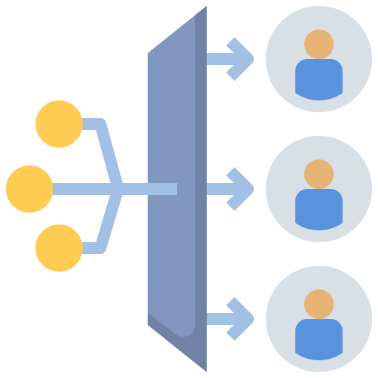
Data Mesh
Business
Extremely Simplified View
Self-serve platform
Sales
Data as a product
Marketing
Distribution
Source: https://www.oreilly.com/library/view/data-mesh/9781492092384

Slide 17
Outline
Management
Other Tools
Monitoring
Analytics
Basics
Cluster
Elasticsearch
Under the Hood
Security

Slide 18
Monitoring
Source: https://www.zabbix.com https://prometheus.io https://www.datadoghq.com

Slide 19
Logging
ELK Stack
Source: https://www.elastic.co

Slide 20
Outline
Management
Other Tools
Monitoring
Analytics
Basics
Cluster
Elasticsearch
Under the Hood
Security

Slide 21
Data Platforms
Store
Manage
Process
Visualize
Fault Tolerant
Distributed
Cloud Support
Source: https://www.databricks.com https://www.snowflake.com https://www.cloudera.com

Slide 22
Data Platforms
Source: https://www.databricks.com https://www.snowflake.com https://www.cloudera.com

Slide 23
Visualization and Insights
Visualization
ML Support
Create Dashboards
Create Reports
Source: https://www.tableau.com https://www.microsoft.com/en-us/power-platform/products/power-bi https://www.qlik.com/us/products/qlik-sense

Slide 24
Visualization and Insights
Source: https://www.tableau.com https://www.microsoft.com/en-us/power-platform/products/power-bi https://www.qlik.com/us/products/qlik-sense

Slide 25
Zeppelin
Apache Foundation
Notebook
Analytics
Web-based
Collaborative
SQL, Scala, Python, R, …
Source: https://zeppelin.apache.org

Slide 26
Outline
Management
Other Tools
Monitoring
Analytics
Basics
Cluster
Elasticsearch
Under the Hood
Security

Slide 27
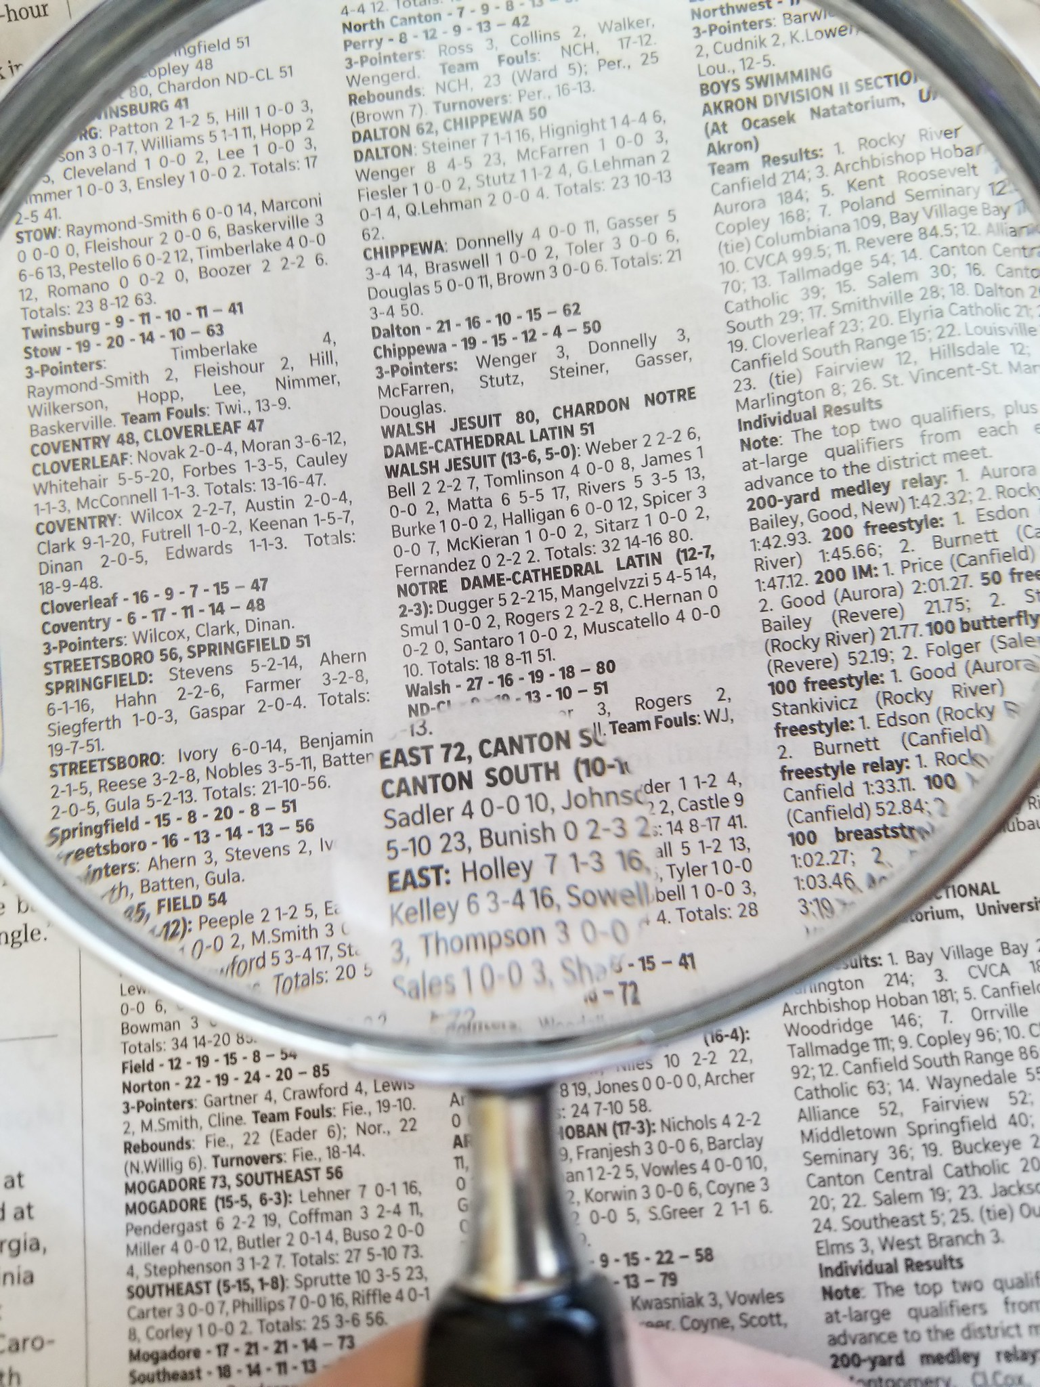
Elasticsearch
A distributed document store, a search and analytics engine
Index
Client supports several languages
Spark, Hive, …
REST API
SQL
Query DSL

Slide 28
Documents
Index
JSON Documents
Key – Value
Key – Value
Key – Value
Key – Value
Key – Value
Indexing
(Storing)
Mapping of types defines how data is stored
Auto-detection of schema
Schema
Index

Slide 29
Index Example
students
{
“surname”: “Smith”,
“firstname”: “Harry”,
“uid”: 158425,
“class”: “5B”,
“year_of_birth”: 1998,
“description”: “A nice long comment”
}

Slide 30
SQL Query
{
“surname”: “Smith”,
“firstname”: “Harry”,
“uid”: 158425,
“class”: “5B”,
“year_of_birth”: 1998,
“description”: “A nice long comment”
}
SELECT uid, description
FROM “students*”
WHERE “firstname” = ‘Harry’
Only one identifier allowed,
Wildcards are allowed
“” identifier
‘’ literal

Slide 31
Query DSL
{
“surname”: “Smith”,
“firstname”: “Harry”,
“uid”: 158425,
“class”: “5B”,
“year_of_birth”: 1998,
“description”: “A nice long comment”
}
“query”: {
“bool”: {
“must”: [{“match”: {“surname”: “Smith”}}],
“filter”: [{“term”: {“firstname”: “Harry”}}]
}
}
Enables Scoring and Filtering Documents
Ranges of values can be filtered

Slide 32
Outline
Management
Other Tools
Monitoring
Analytics
Basics
Cluster
Elasticsearch
Under the Hood
Security

Slide 33
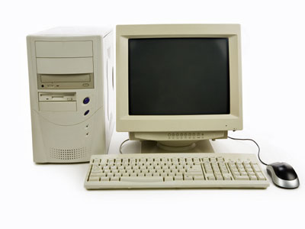
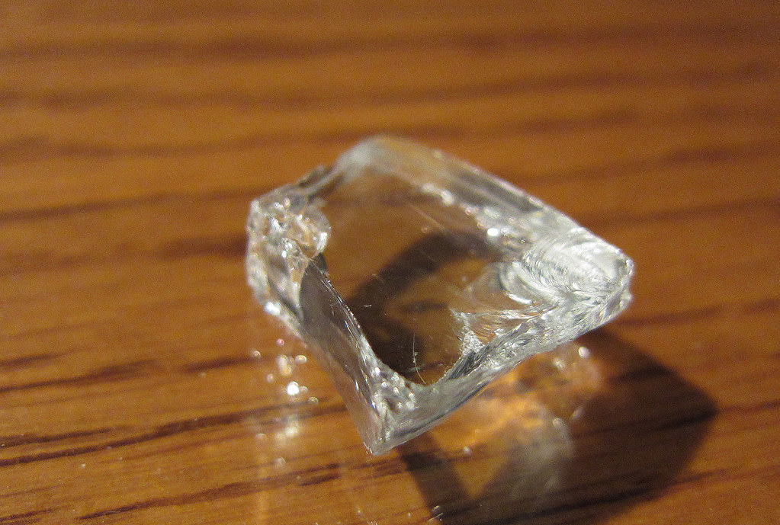
Shards
Shards
Configurable size
Stored multiple times
Primary
Replicas
Index is a logical structure

Slide 34
Shards
Oversharding: Too many shards on the cluster
Shrinking Index: Reducing the number of shards
Deleting documents retains shards
Sharding Strategy

Slide 35
Node Types
Master
Data
Manages the cluster
Elected from master eligible nodes
Holds data
Hot > Warm > Cold
Index Lifecycle Management

Slide 36
Node - Shard Allocation
Shards are stored on data nodes
Based on their temperature
Nodes have unique names, indices can be allocated to certain nodes

Slide 37
New Node in the Cluster
Enrollment
token
Starts storing replica shards

Slide 38
Outline
Management
Other Tools
Monitoring
Analytics
Basics
Cluster
Elasticsearch
Under the Hood
Security

Slide 39
Inverted Index
Inverted index is a data structure containing a mapping from the
content (words/phrases) to its location in a set of files.
Auxiliary information can be added
Number of occurrences
Place of occurrence (title, abstract, body, …)
Efficiently compressible

Slide 40
Example
This apple is red
This pear is green
We have a green car, like our bike
Our cat is gray and our dog is white

Slide 41
Example
This apple is red
This pear is green
This
Apple
Is
Green
Our
We have a green car, like our bike
Our cat is gray and our dog is white

Slide 42
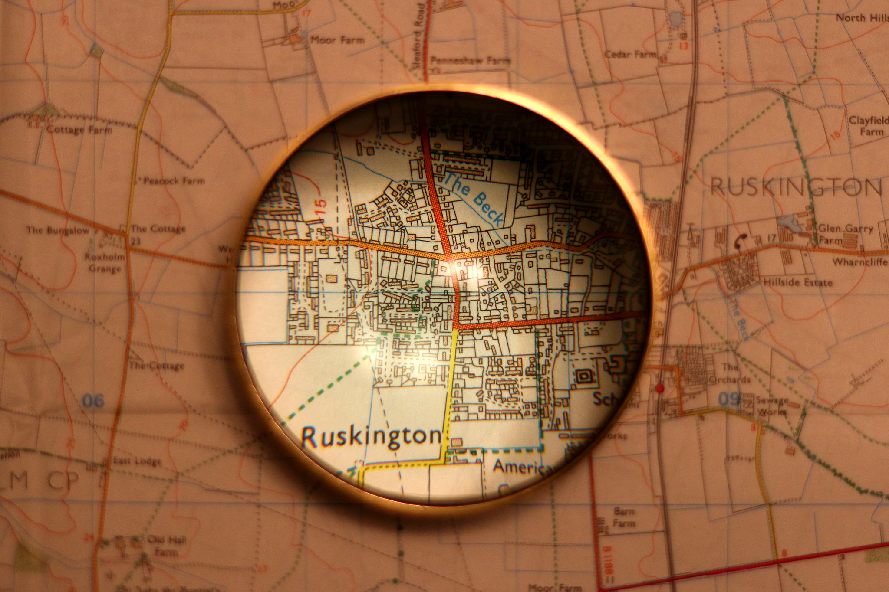
Bkd-Tree
Block k-d tree
Only the leaves are written to disk
Indexing a N-dimensional space
Recursively created

Slide 43
Bkd-Tree Creation
Leaf size = 2
A
A
B
B
C
D
D
E
F
G
E
F
H
G
H
I
C
I

Slide 44
Bkd-Tree Query
Trade tree size and creation speed to query inefficiency
Check against boundaries
Leaf size = 2
A
?
A
B
B
?
C
D
?
D
E
F
G
E
F
H
G
H
?
I
All points inside the leaf are checked linearly
C
I

Slide 45
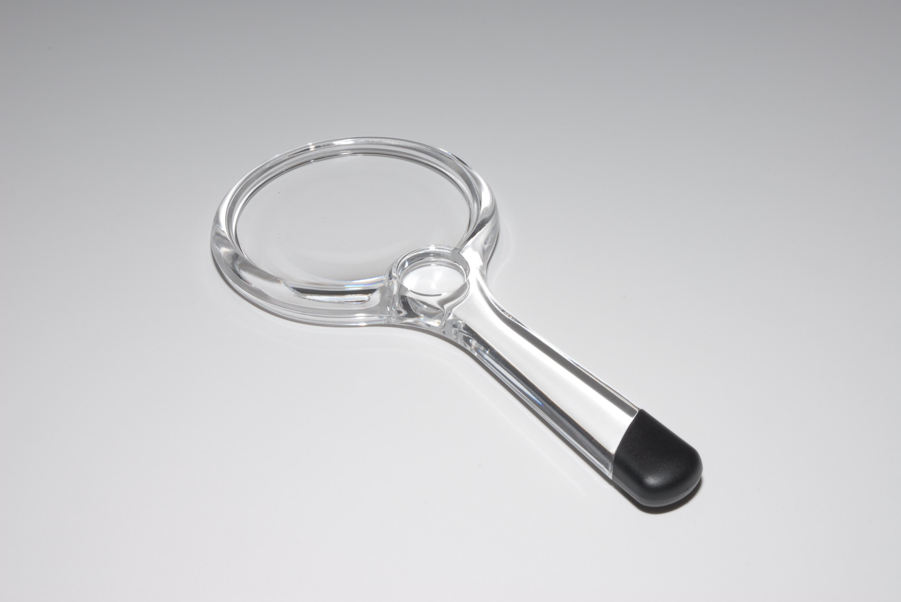
Finding Numbers
1 dimensional Bkd-tree is used to find numbers
It becomes a slightly randomized binary search tree

Slide 46
Outline
Management
Other Tools
Monitoring
Analytics
Basics
Cluster
Elasticsearch
Under the Hood
Security

Slide 47
Security & Auditing
Roles
Index-level access
Document and Field-level access
Users assume roles
LDAP support
JSON logs
Disabled by default
Verbosity can be adjusted

Slide 48
References
Pictures
Source code by Flat Icons on flaticon.com
Product development by Iconjam on flaticon.com
Chat by flatart_icons on flaticon.com
Application by Flat Icons on flaticon.com
Desktop by Freepik on flaticon.com
Data-center by vectorsmarket15 on flaticon.com
Girl by Creartive on flaticon.com
Man by Creartive on flaticon.com
Man by kostop on flaticon.com
People by Good Ware on flaticon.com
Youth by Freepik on flaticon.com
Team by juicy_fish on flaticon.com
Database by Freepik on flaticon.com
Database Management by Design Circle on flaticon.com
Database by Parzival’ 1997 on flaticon.com
vintage 4’’ magnifying glass – using bifocal lens
by veisha (CC BY-NC-ND 2.0)
Home by Kevin Doncaster (CC BY 2.0)
2196-book-magnifying-glass by BU Rennes 2 (Public Domain)
File by Creatype on flaticon.com
Document by smalllikeeart on flaticon.com
Google_docs by Freepik on flaticon.com
Checklist by Freepik on flaticon.com
Pin by srip on flaticon.com
Role Playing game by Freepik on flaticon.com
Programmer by Freepik on flaticon.com
Wood by Freepik on flaticon.com
Magnifying Glass by Thomas (CC BY-NC 2.0)
Shard of Glass by Alan Light (CC BY 2.0)
old computer by Jeff Dray (CC BY 2.0)
HMS computer by kitschweb (CC BY-ND 2.0)
Document by juicy_fish on flaticon.com
Prioritize by juicy_fish on flaticon.com
Mini magnifying glass by Ricky Willis (CC BY-NC 2.0)
Literature
Elasticsearch Official Page by Elastic
Inverted files versus signature files for text indexing
by Zobel, Moffat and Ramamohanarao; ACM
Bkd-Tree: A Dynamic Scalable kd-Tree
by Procopiuc, Agarwal, Arge and Vitter; Springer

Slide 49
Thank You

