Slide 1
Apache Hadoop
András Varga
IBM Consulting

Slide 2
Business
Card
One of the first big data processing frameworks
Distributed computation and filesystem
Open source
Built on top of commodity hardware

Slide 3
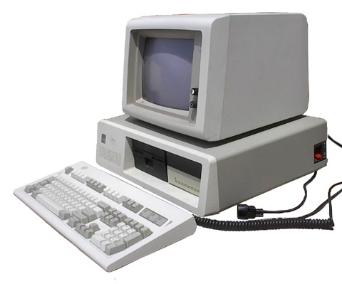
Commodity Hardware
Several cheap computers working together in a network
With big volumes of data the network becomes the bottleneck
Fast network devices are expensive
Hundreds of nodes can cooperate
Failures are anticipated

Slide 4
Organization of Computers
node
node
cluster

Slide 5
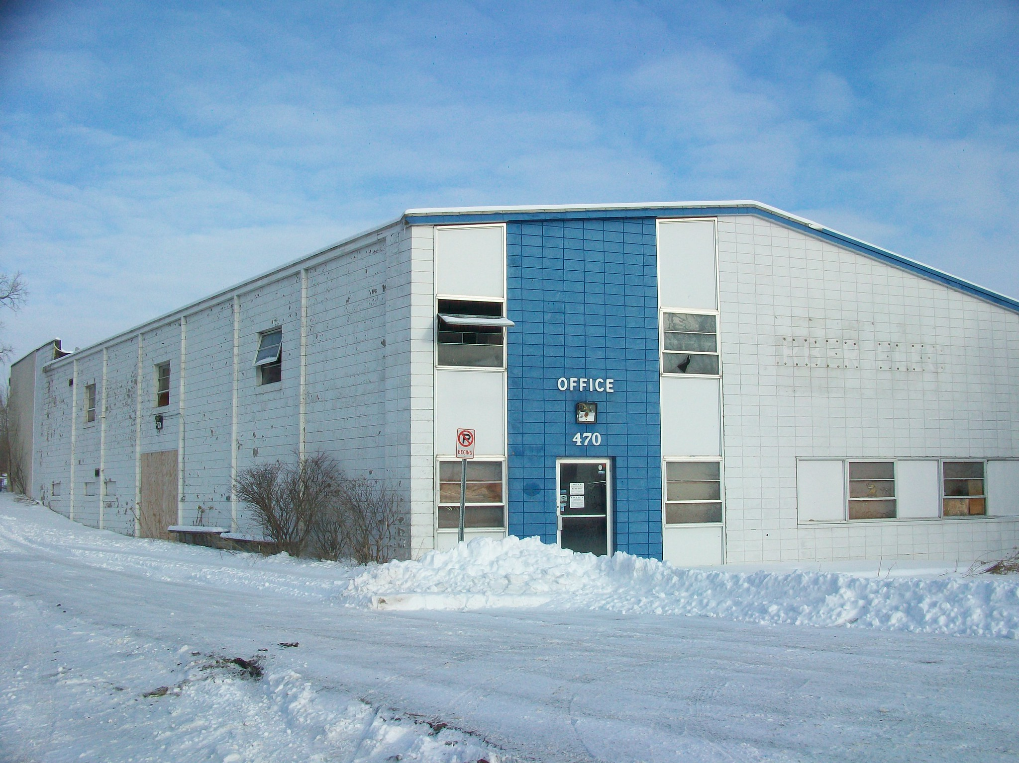
Organization of Computers
node
data center
node
cluster

Slide 6
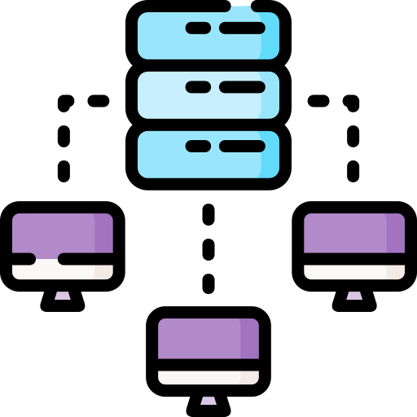
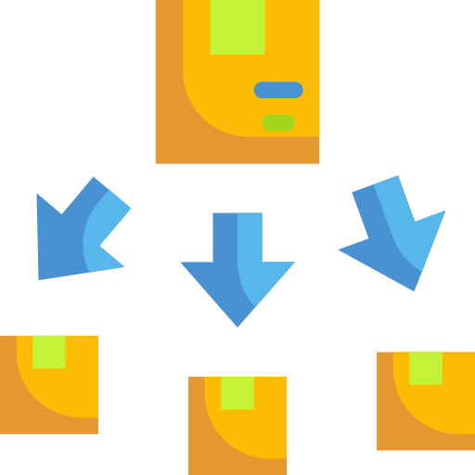
Hadoop
Distributed
File System
MapReduce V1
Theory
Hadoop
Execution
Engine
Programming
Framework
YARN
MapReduce Concept

Slide 7
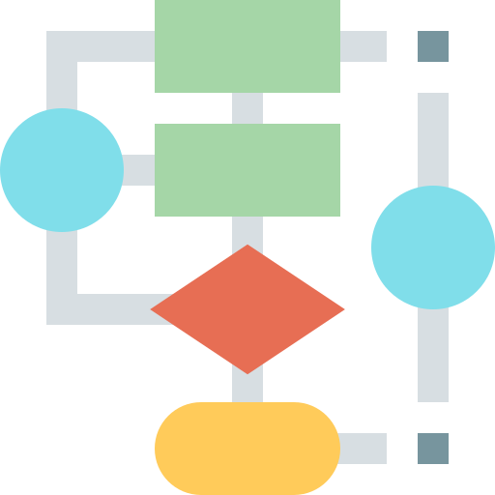
Outline
Distributed
File System
MapReduce V1
Theory
Hadoop
Execution
Engine
Programming
Framework
YARN
MapReduce Concept
Algorithms

Slide 8
Outline
Distributed
File System
MapReduce V1
Theory
Hadoop
Execution
Engine
Programming
Framework
YARN
MapReduce Concept
Algorithms

Slide 9
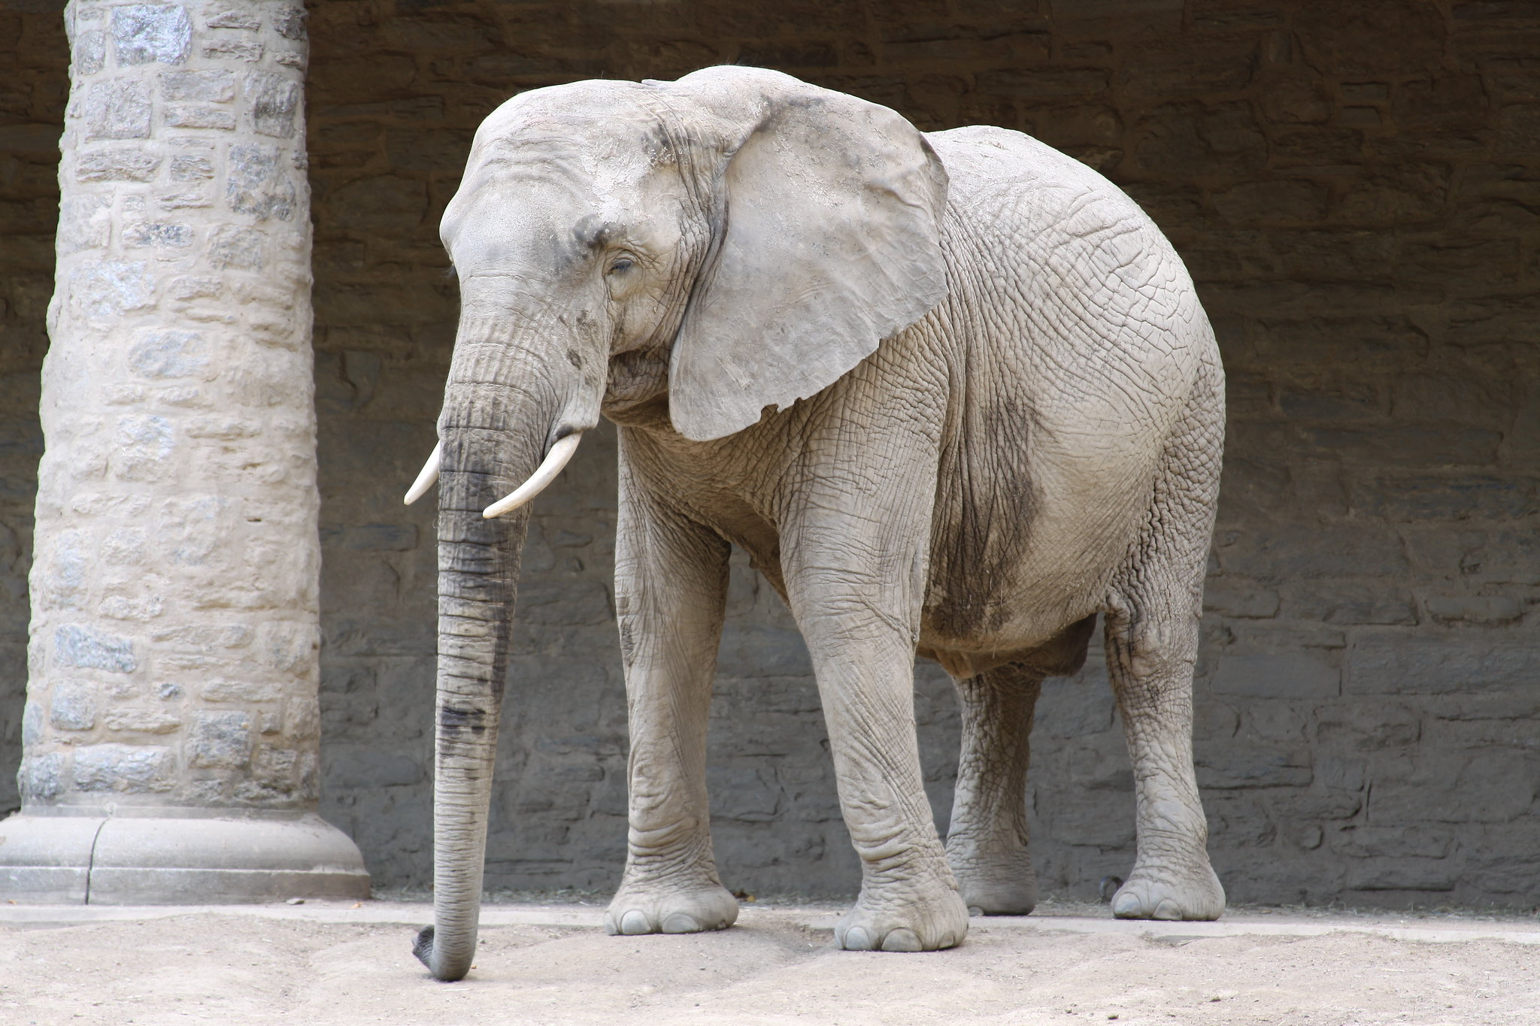
Distributed File System
Securely store files on a cluster made of commodity hardware
Google File
System (GFS)
Hadoop Distributed File System (HDFS)
Large files
Appending files << Rewriting
Sequential reads << Seeks

Slide 10
Distributed File System
Securely store files on a cluster made of commodity hardware
Google File
System (GFS)
Hadoop Distributed File System (HDFS)
Concurrent changes (mutations)
Concurrent Users
File Permissions only prevent unintended changes
Not POSIX-compliant

Slide 11
Google File System
Read, Write, Modify
Single GFS master
Chunkservers
Client
Input File
GFS Cluster

Slide 12
Client
Accessing the cluster
Interact with GFS master for metadata
Data bearing communication goes directly to chunkservers
Can be (and often is) hosted on chunkservers

Slide 13
Files
Files are divided into fixed-size chunks (sometimes blocks)
Chunks are larger than OS blocks (e.g. 128 MB)
Chunks are stored in 3 replicas
Globally unique chunk handle created by master upon creation (64 bit)

Slide 14
Chunkservers
Stores chunks of files
Handles data bearing communication directly with clients
Responses to master’s heartbeat

Slide 15
GFS Master
File and chunk namespaces
Mapping from files to chunks
Location of each chunk’s replicas
Maintains system metadata
Garbage collection
Organizes chunk migration between chunkservers
Sends out heartbeat to monitor the health of the cluster

Slide 16
GFS Master
File and chunk namespaces and
file to chunk mappings
are stored on a hard drive with logging mutations in the operational log
Chunk locations are not stored, but collected during startup (or when a new chunkserver appears)

Slide 17
Store a New File

Slide 18
Store a New File

Slide 19
Store a New File

Slide 20
Reading a File

Slide 21
File Mutation
Namespace mutations (e.g., file creation) are atomic
Master grants a lease to a chunkserver for a given chunk (primary)
Chunk version number is used to distinguish between up-to-date and outdated replicas
Data mutations handled by chunkservers
Primary is responsible for serialization of changes

Slide 22
File Mutation

Slide 23
Mutation With Unavailable Node

Slide 24
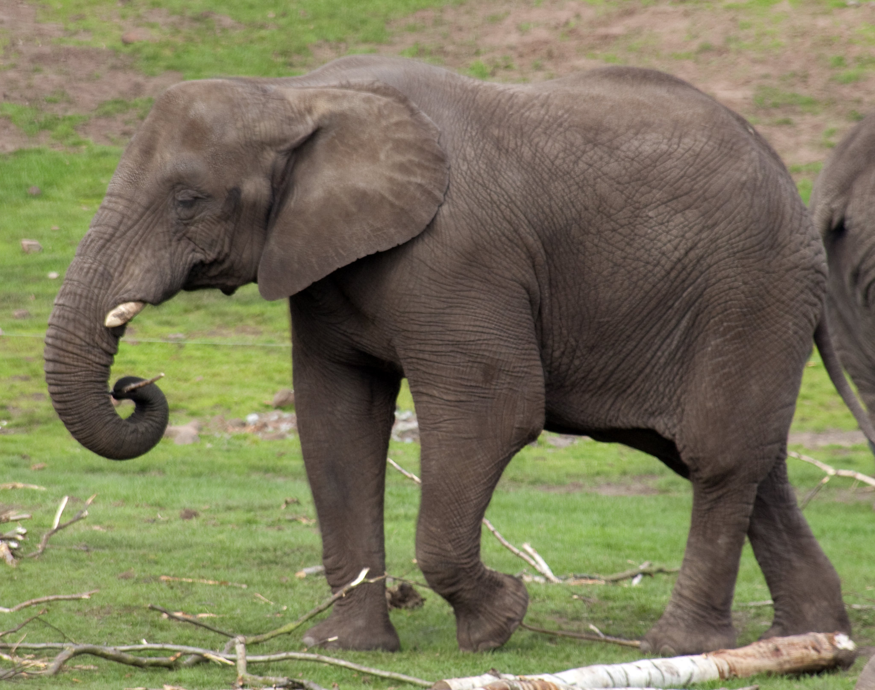
HDFS
GFS master <=> Namenode
Chunkserver <=> Datanode
In HDFS nodes are organized into racks

Slide 25
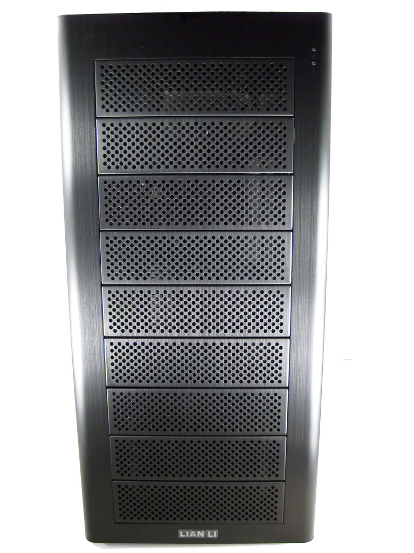
HDFS Racks
Rack
Rack
HDFS Cluster

Slide 26
Namenode Failure
“In large-scale distributed systems, simultaneously providing
consistency, availability, and partition tolerance is impossible.”
Brewer’s CAP Theorem

Slide 27
Namenode Failure
Partitioning is unavoidable
Trade-off: availability vs consistency
Single master node provides consistency
Namenode failure becomes a single point of failure
Multiple master nodes provide high-availability

Slide 28
Outline
Distributed
File System
MapReduce V1
Theory
Hadoop
Execution
Engine
Programming
Framework
YARN
MapReduce Concept
Algorithms

Slide 29
MapReduce Concept
Divide and Conquer approach
Independent sub-problems can be executed
In parallel
On different worker nodes
The result of sub-problems must be combined

Slide 30
Interaction With DFS
Both DFS and MapReduce are distributed
Their roots are unrelated
MapReduce does not require a DFS, but it can benefit from it as seen later

Slide 31
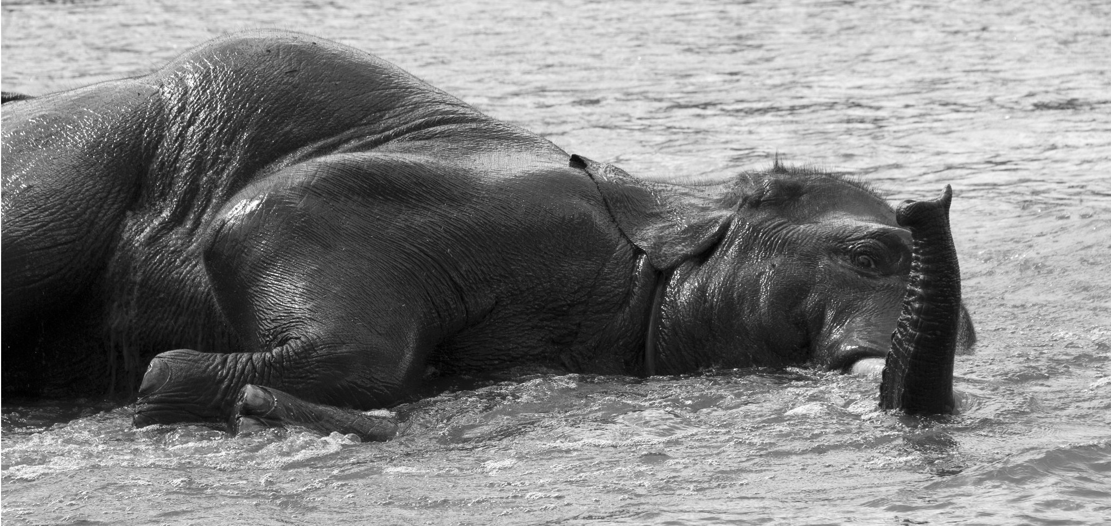
Inspiration for MapReduce
High-order functions can take other functions as arguments or return them as result

Slide 32
Function map
f
f
f
f
f
f
Argument: function f with one parameter

Slide 33
Function fold
g
g
g
. . .
g
Argument: function g with two parameters + initial value

Slide 34
Example map-fold
Sum of squares for a list of numbers
0
f
2
4
4
$$f\left(x\right)=x^{2}$$
g
5
25
29
$$g\left(x,y\right)=x+y$$
g
2
4
33
$$Initial value:0$$
4
16
49
1
1
50
0
0
50
3
9
59
6
36
g
95

Slide 35
Example map-fold
Sum of squares for a list of numbers
$$f\left(x\right)=x^{2}$$
$$g\left(x,y\right)=x+y$$
$$map(λx.x^{2})$$
$$Initial value:0$$
$$fold (λxλy.x+y)$$
$$Initial value:0$$

Slide 36
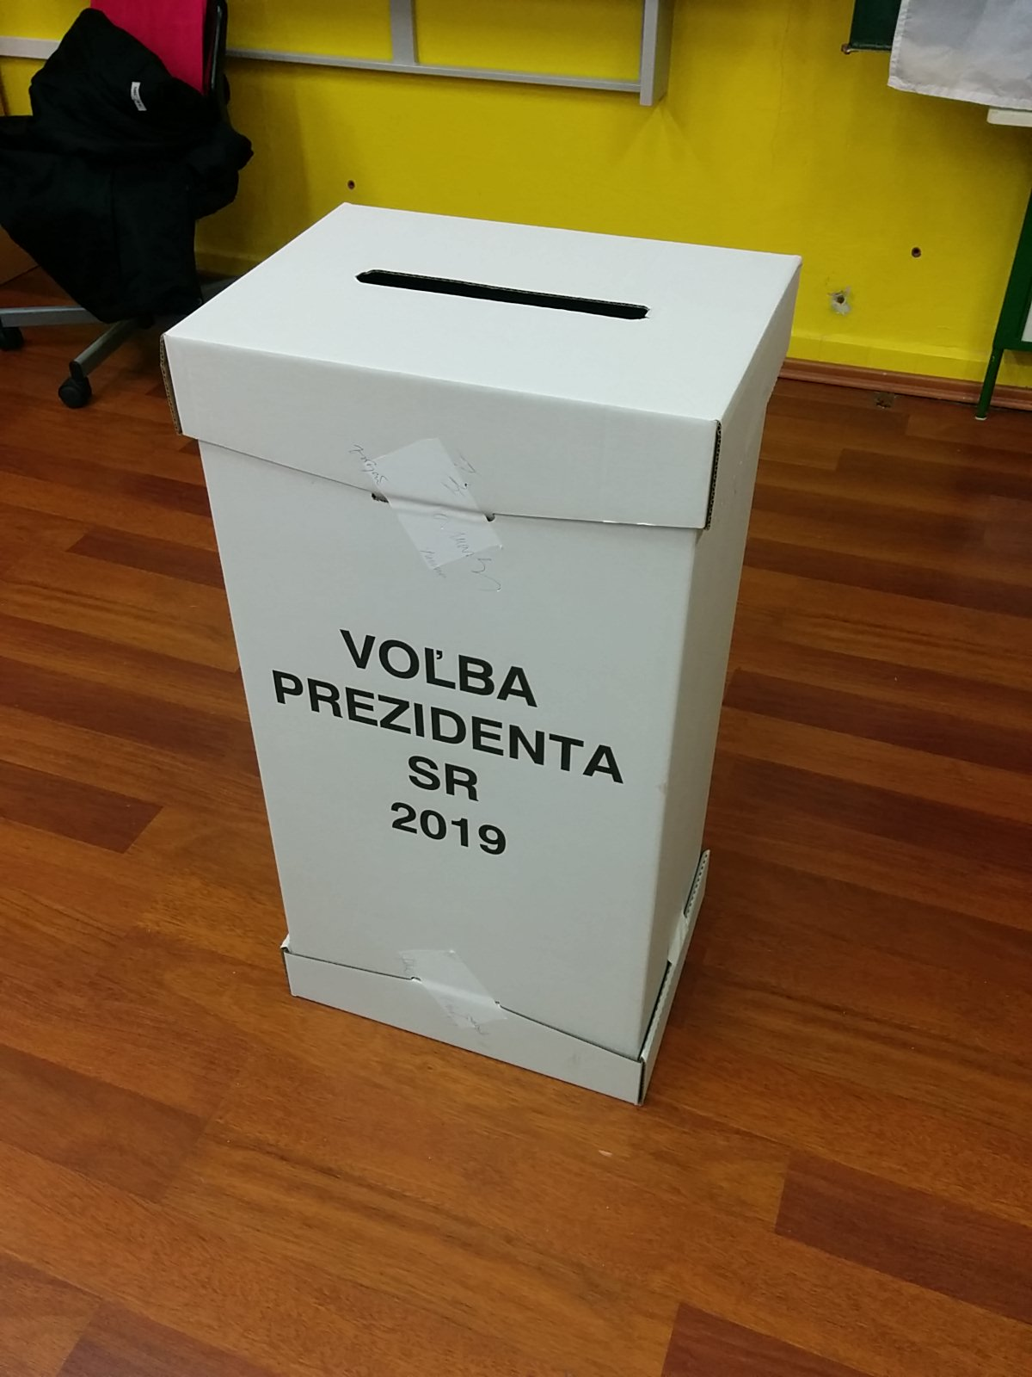
Real-World
Example

Slide 37
Outline
Distributed
File System
MapReduce V1
Theory
Hadoop
Execution
Engine
Programming
Framework
YARN
MapReduce Concept
Algorithms

Slide 38
High-level Overview
Similarly to map-fold, MapReduce consists of two steps:
Apply a computation on all data set separately/in parallel
Apply aggregation over the intermediate results
These two steps are executed by the framework, programmers provide the functions to be executed (as f and g in the example above)

Slide 39
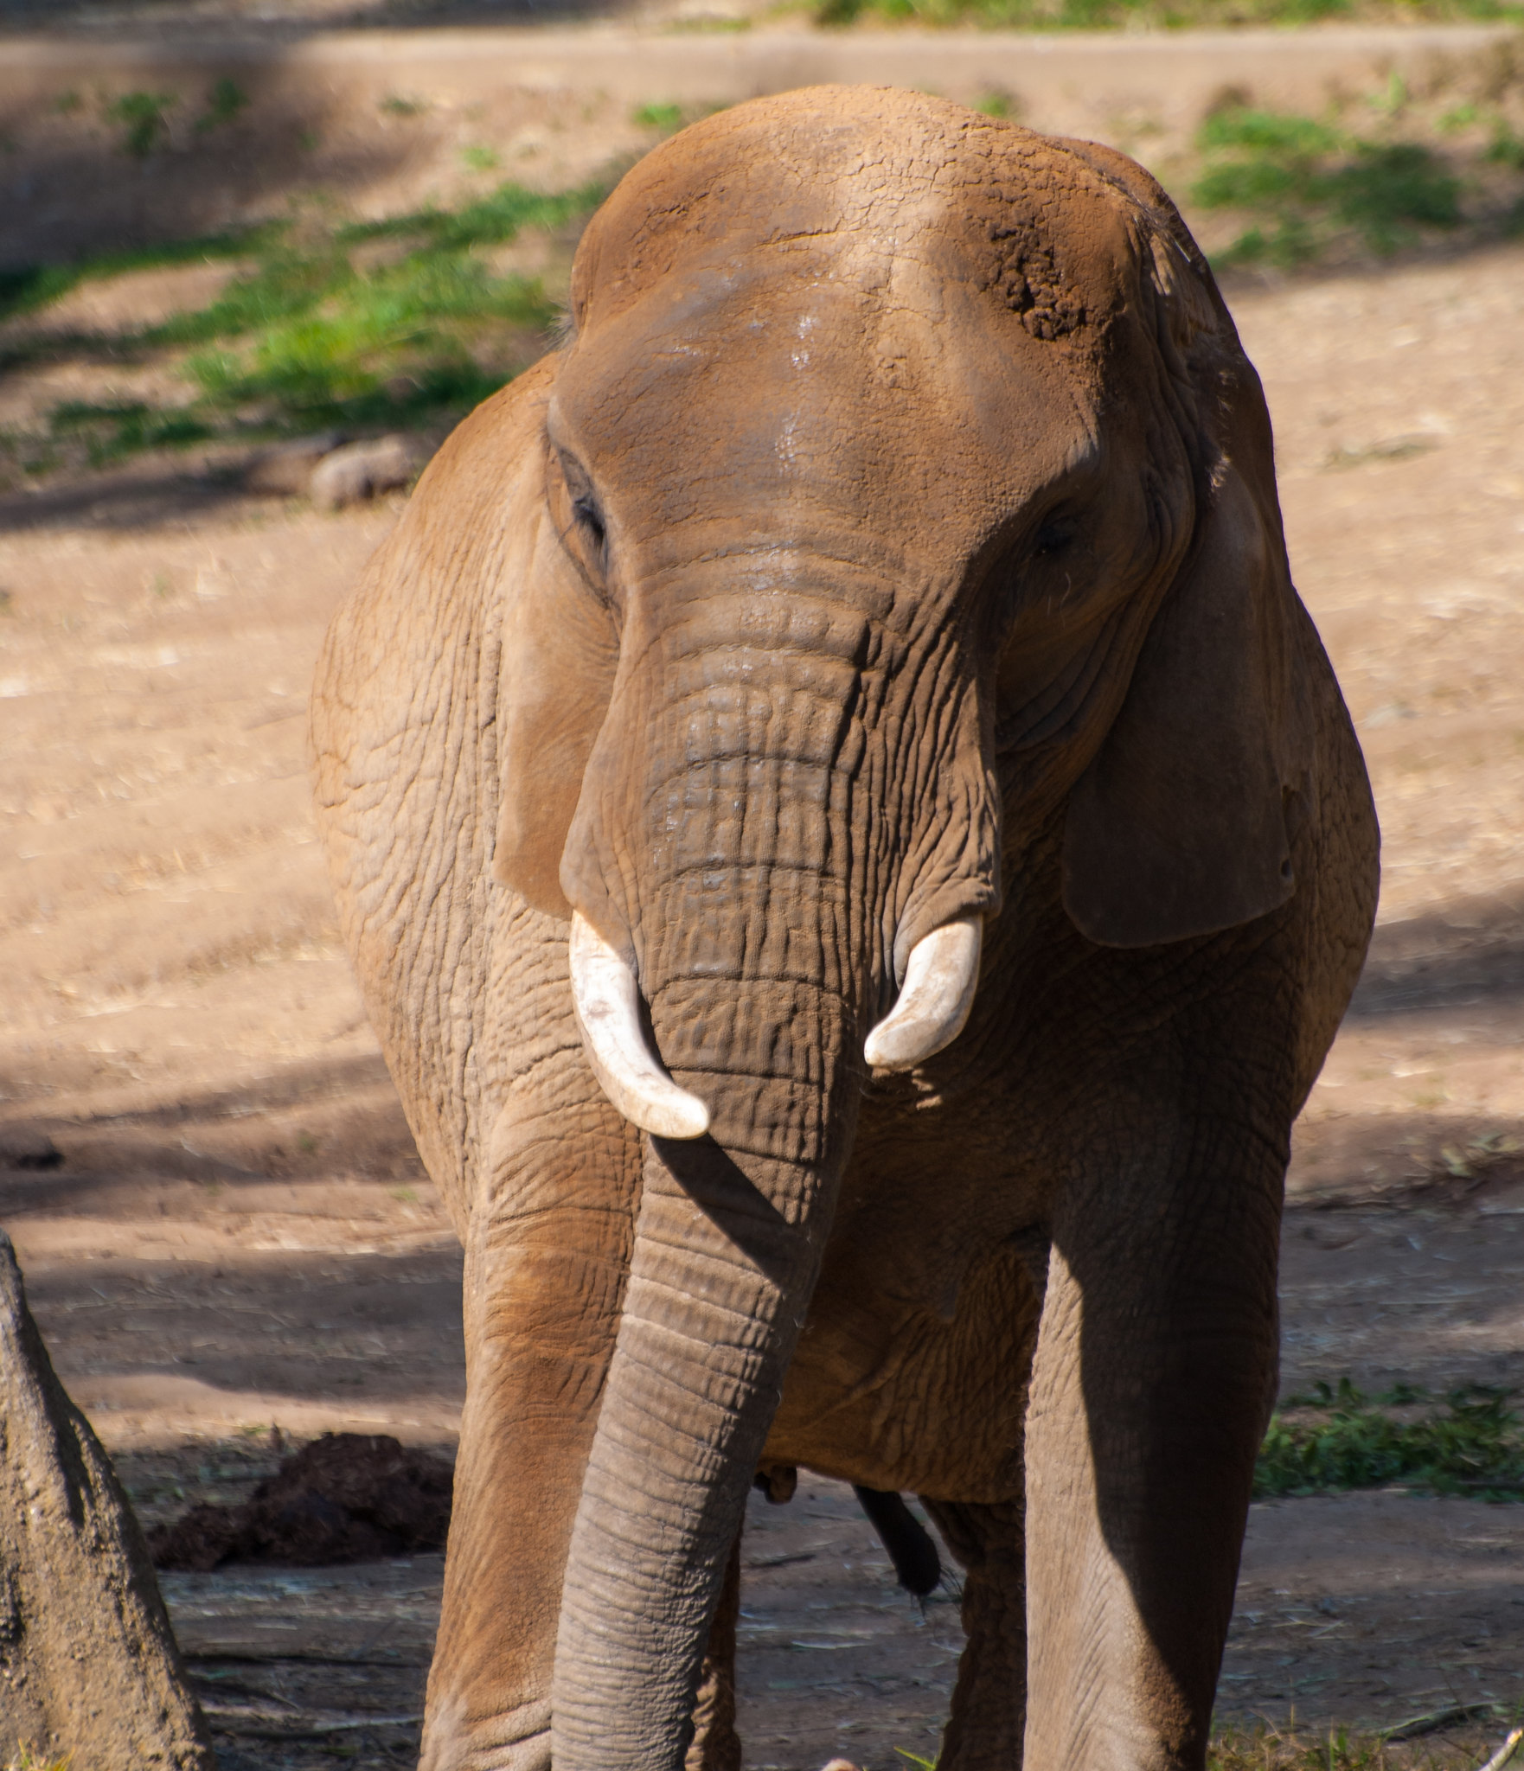
Basic Data Structure
string, integer, floating point, …
tuple, list, array, …
Key
Value
Web Page url HTML content
File filename content
Directory location list of filenames
Graphs vertex list of neighbors

Slide 40
Mapper and Reducer
mapper
reducer
Every input key-value pair (possibly from multiple files)
$\left(k_{1},v_{1}\right)\underset{→}{}[\left(k_{2},v_{2}\right)]$
Applied to all values associated with a given key to create output key-value pairs
$\left(k_{2},{[v}_{2}]\right)\underset{→}{}\left[\left(k_{3},v_{3}\right)\right]$
Distributed “group by”

Slide 41
Simplified Schema
A
α
B
β
C
γ
D
δ
E
ε
F
ζ
mapper
mapper
mapper
mapper
Not preserved
a
1
b
6
c
4
c
3
a
5
b
2
c
8
Aggregate values by keys
Shuffle Sort
a
1
5
b
6
2
c
4
8
3
Sorted by keys
reducer
reducer
reducer
Stored in a dedicated file for each reducer
X
5
Y
6
Z
8

Slide 42
Combiners
Shuffle Sort waits for all mappers to finish
For shorter mappers this frees up time to locally aggregate values before Shuffle Sort
Aggregating before Shuffle Sort helps performance (less copying)
This local aggregation is called a Combiner
Optional (may not run at all)
Sees results from one mapper only (runs on the same node)
Correctness of the algorithm can NOT rely on it
It may not finish reading the entire input

Slide 43
Schema with Combiners
A
α
B
β
C
γ
D
δ
E
ε
F
ζ
mapper
mapper
mapper
mapper
a
1
b
6
c
4
c
3
a
5
b
2
c
8
Shuffle Sort
a
1
5
b
6
2
c
4
8
3
reducer
reducer
reducer
X
5
Y
6
Z
8

Slide 44
Schema with Combiners
A
α
B
β
C
γ
D
δ
E
ε
F
ζ
mapper
mapper
mapper
mapper
a
1
b
6
c
4
c
3
a
5
b
2
c
8
combiner
combiner
combiner
combiner
a
1
b
6
c
4
a
5
b
2
c
8
Shuffle Sort
a
1
5
b
6
2
c
4
8
3
reducer
reducer
reducer
X
5
Y
6
Z
8

Slide 45
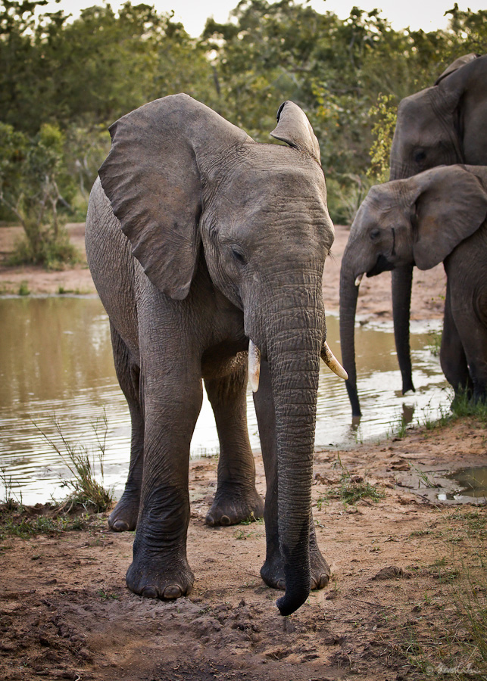
Partitioner
Specifies which key-value pair is sent to which reducer
Keys are processed in a sorted order
Default method:
k is the key, h is a hash function
there are r reducers with IDs: 0, 1, …, (r-1)
$reducer=h\left(k\right) modulo r$

Slide 46
Detailed Schema
A
α
B
β
C
γ
D
δ
E
ε
F
ζ
mapper
mapper
mapper
mapper
a
1
b
6
c
4
c
3
a
5
b
2
c
8
combiner
combiner
combiner
combiner
a
1
b
6
c
4
a
5
b
2
c
8
Shuffle Sort
a
1
5
b
6
2
c
4
8
reducer
reducer
reducer
X
5
Y
6
Z
8

Slide 47
Detailed Schema
A
α
B
β
C
γ
D
δ
E
ε
F
ζ
mapper
mapper
mapper
mapper
a
1
b
6
c
4
c
3
a
5
b
2
c
8
combiner
combiner
combiner
combiner
a
1
b
6
c
4
a
5
b
2
c
8
partitioner
partitioner
partitioner
partitioner
Shuffle Sort
a
1
5
b
6
2
c
4
8
reducer
reducer
reducer
X
5
Y
6
Z
8

Slide 48
Outline
Distributed
File System
MapReduce V1
Theory
Hadoop
Execution
Engine
Programming
Framework
YARN
MapReduce Concept
Algorithms

Slide 49
Execution Framework
Submission node
Code submission
Where to run the code
How to run it
How to track failures
Code split from execution framework

Slide 50
Tasks
Number of tasks can surpass the capacity of the cluster
Mapper
Combiner
Partitioner
Task queue
Reducer
Different users can compete for resources

Slide 51
Data-Code Co-location
Submit
Move the code to data!

Slide 52
Speculative Execution
straggler
mapper
mapper
mapper
Map phase takes as long as the longest Map task
Shuffle Sort
reducer
reducer
Reduce phase takes as long as the longest Reduce task
straggler

Slide 53
Speculative Execution
straggler
mapper
mapper
mapper
Execute all tasks in multiple copies and finish all copies when one instance of the task finishes
Shuffle Sort
reducer
reducer
More efficient for Mappers
Solves problem with insufficient hardware
straggler

Slide 54
Speculative Execution
Submit

Slide 55
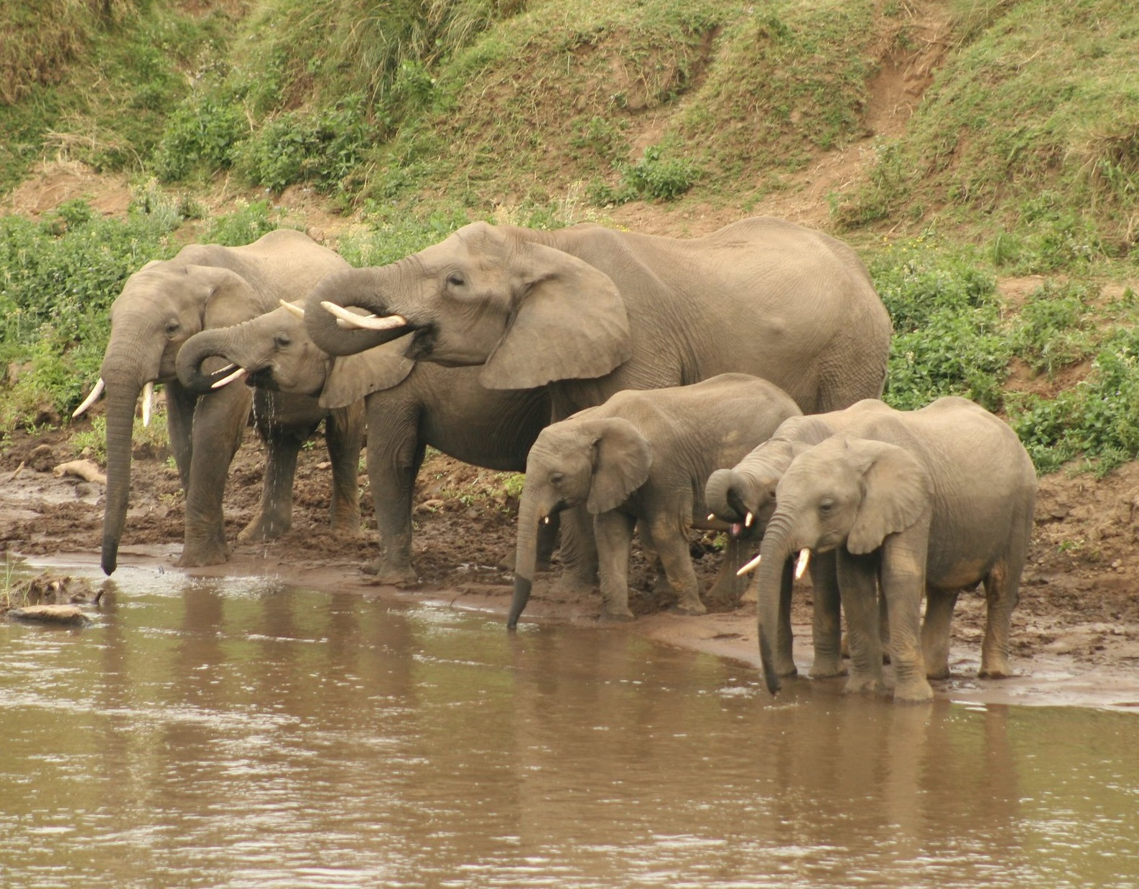
Synchronization
Shuffle sort is a natural barrier
m Mapers
r Reducers
mr distinct copy operations

Slide 56
MapReduce V1
Datanode
Namenode
Namenode
Jobtracker
Job Submission
Tasktracker

Slide 57
MapReduce V1

Slide 58
Limitation
One JobTracker » Scalability
JobTracker has two responsibilities
Resource management
Task coordination
Limited to MapReduce tasks

Slide 59
Outline
Distributed
File System
MapReduce V1
Theory
Hadoop
Execution
Engine
Programming
Framework
YARN
MapReduce Concept
Algorithms

Slide 60
YARN Design
Jobtracker
Tasktracker
Manages tasks for
a given application
(speculative execution)
Manages cluster
resources
Generalization
Resource
Manager
Application
Manager
Nodemanager

Slide 61
YARN Execution

Slide 62
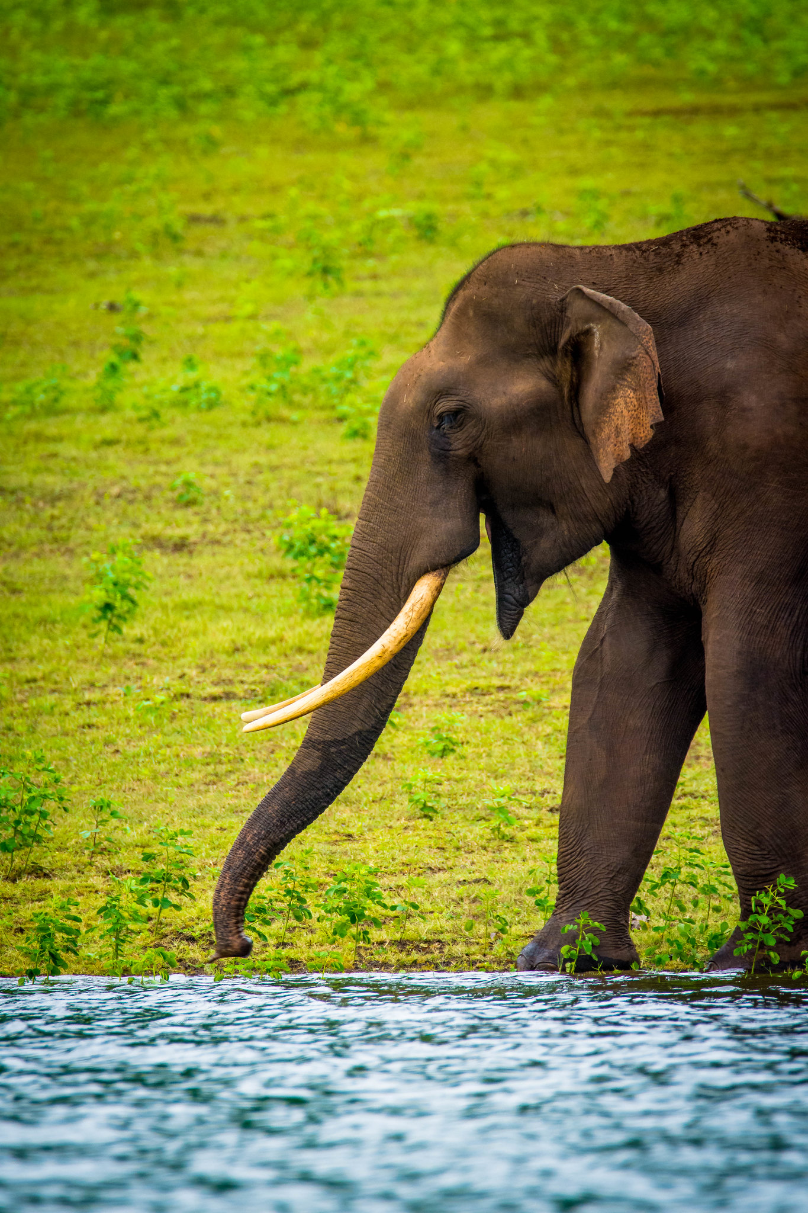
YARN Properties
Application manager is no longer the bottleneck
Containers are general purpose
Resource Manager is the bottleneck
High Availability

Slide 63
Outline
Distributed
File System
MapReduce V1
Theory
Hadoop
Execution
Engine
Programming
Framework
YARN
MapReduce Concept
Algorithms

Slide 64
WordCount
The “Hello World!” of MapReduce
Count the number of occurrences of each word in a file/set of files

Slide 65
WordCount
mapper
mapper
mapper
Horse
1
Horse
1
Cat
1
Bear
1
Parrot
1
Bear
1
Horse
1
Parrot
1
Parrot
1
Shuffle Sort
Bear
1
1
Cat
1
Horse
1
1
1
Parrot
1
1
1
reducer
reducer
Bear
2
Cat
1
Horse
3
Parrot
3

Slide 66
WordCount
mapper
mapper
mapper
Horse
1
Horse
1
Cat
1
Bear
1
Parrot
1
Bear
1
Horse
1
Parrot
1
Parrot
1
combiner
combiner
combiner
Horse
2
Parrot
1
Bear
1
Parrot
2
Shuffle Sort
Bear
1
1
Cat
1
Horse
2
1
Parrot
1
2
reducer
reducer
Bear
2
Cat
1
Horse
3
Parrot
3

Slide 67
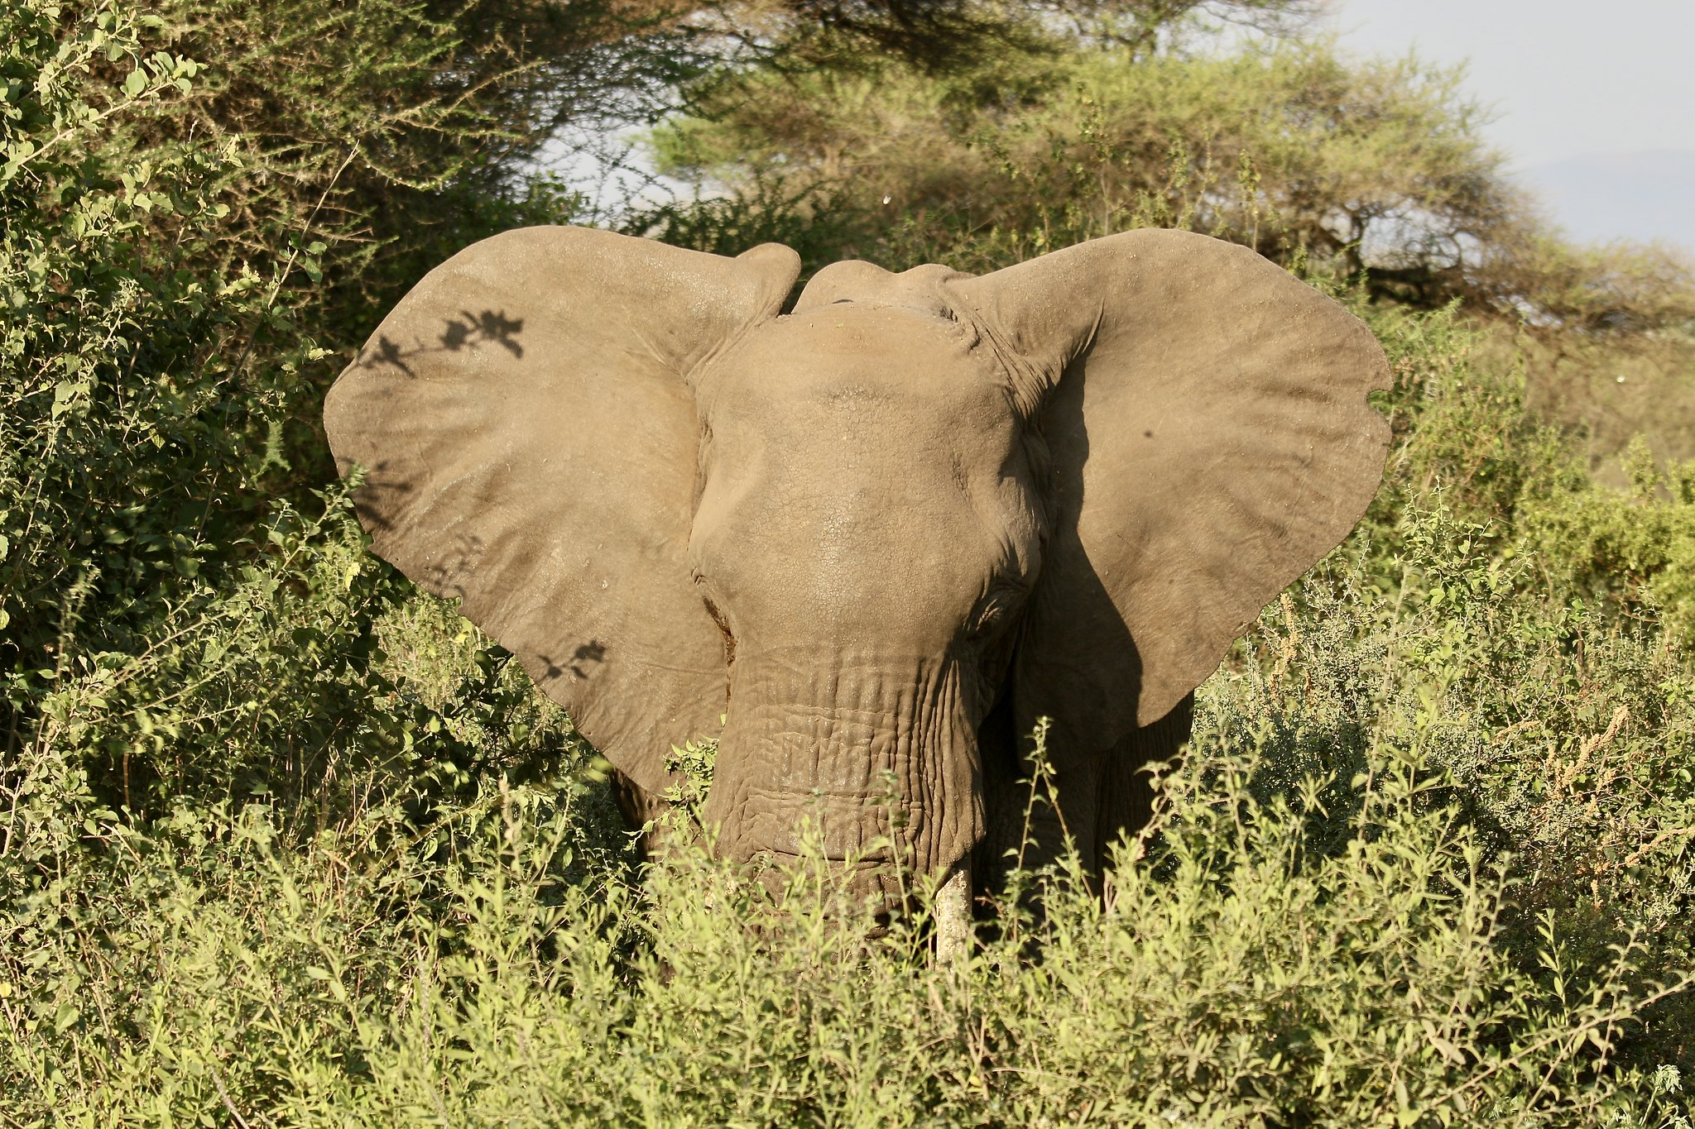
Secondary Sorting
Shuffle sort phase sorts keys
Can we efficiently sort values?
Google MapReduce have an option to set secondary sorting of values

Slide 68
Secondary Sorting
Key
Value
Sort value
Rest of values
Key
Sort value
Rest of values
partitioner
Shuffle Sort
Key
Sort value
Rest of values
Sorted
Key
Sort value
Rest of values
Sorted

Slide 69
Representing Graphs
Data exists in a context of an underlying network
Examples:
Social graphs
URLs
Transportation

Slide 70
Representing Graphs
Adjacency matrix becomes huge for large networks
For large networks it is sparse
Graph representations:
Adjacency matrix
Incidence matrix
Edge list
Adjacency lists

Slide 71
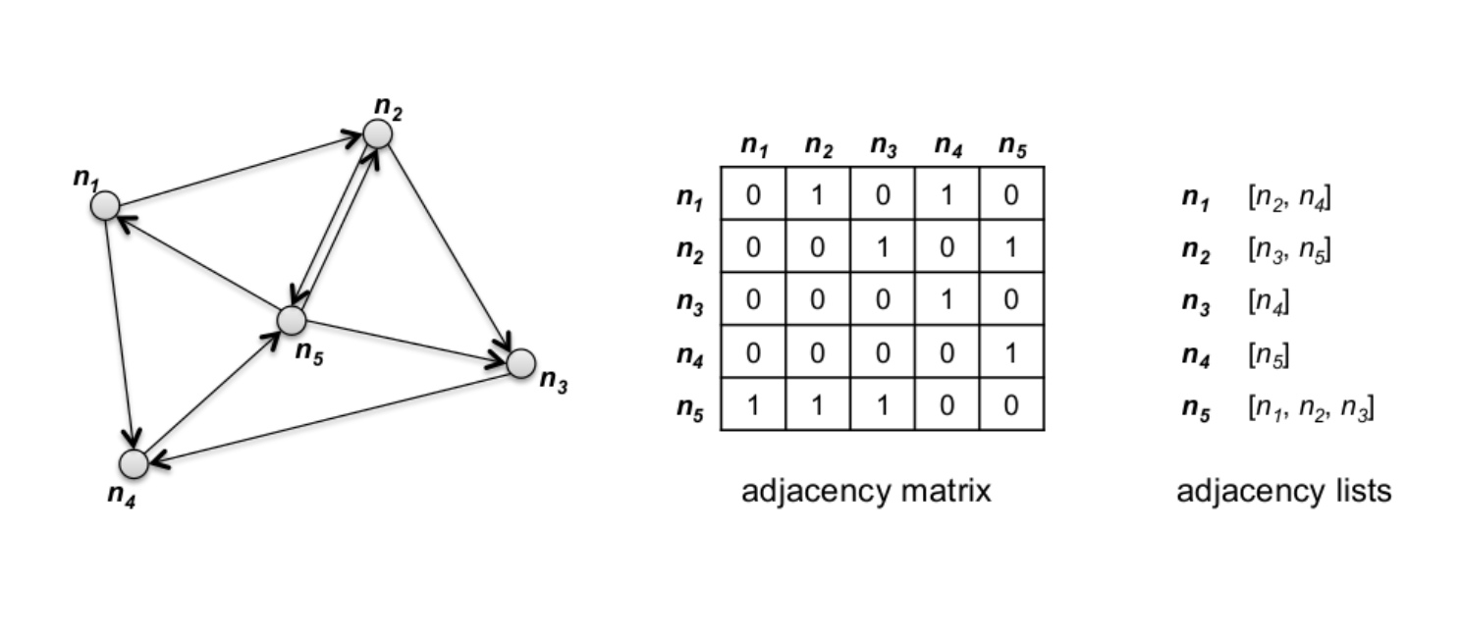
Adjacency Lists

Slide 72
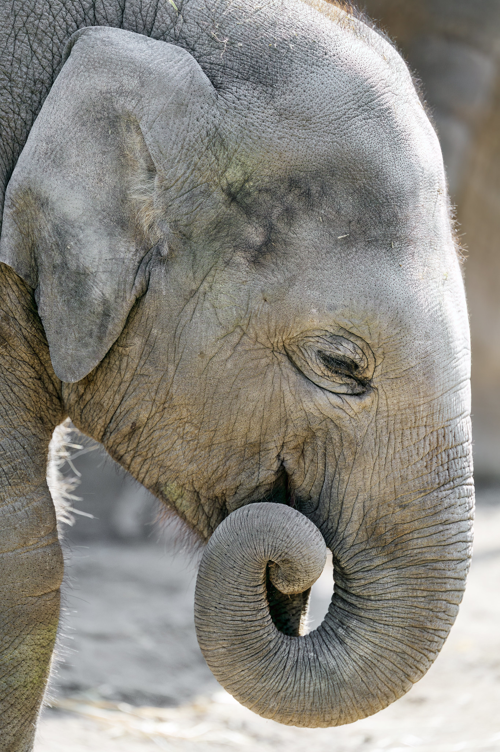
References
Pictures
IBM PC Computer by Luke Jones (CC BY 2.0)
old computer by Jeff Dray (CC BY 2.0)
HMS computer by kitschweb (CC BY-ND 2.0)
abandoned by Ruin Raider (CC BY-NC-ND 2.0)
Folder by Freepik on flaticon.com
Operational System by Design Circle on flaticon.com
Browser by Smashicons on flaticon.com
Theory by Dewi Sari on flaticon.com
Distribution by wanicon on flaticon.com
Cogwheel by Three musketeers on flaticon.com
Cluster Computing by Freepik on flaticon.com
Algorithm by Pixelmeetup on flaticon.com
Kubernetes-icon-color by Jmeybohm (CC 4.0)
Elephant by Jim, the Photographer (CC BY 2.0)
04_Thinkpad_P72_Hero_Rear_facing_left
by BTNHD Production (CC BY-NC-ND 2.0)
Word by Roman Káčerek on flaticon.com
Elephant by Tony Hisgett (CC BY 2.0)
Lian Li PC-A17 by jermainemaree (CC BY 2.0)
elephant bath by Andrea Hale (CC BY-NC 2.0)
Ballot box for the 2019 presidential elections
in Slovakia. by Matej Grochal (CC BY-SA 4.0)
The Big Question Mark Sculpture by Martin Pettitt (CC BY 2.0)
Elephant by Ed Bierman (CC BY 2.0)
Elephants by Steven Tan (CC BY-NC-ND 2.0)
javascript by Freepik on flaticon.com
task by Prosymbols on flaticon.com
creature by Vector Squad on flaticon.com
rabbit by dDara on flaticon.com
Elephant herd drinkning by colinjackson1972 (CC BY-NC 2.0)
SHU_4532 by Subharnab Majumdar (CC BY 2.0)
Ghost by Freepik on flaticon.com
Elephant by Bintangbis (CC BY-NC 2.0)
Baby elephant with curled trunk
by Tambako The Jaguar (CC BY-ND 2.0)
Literature
Data-Intensive Text Processing with MapReduce
by J. Lin and C. Dyer
Hadoop Official Webpage by Apache
cognitiveclass.ai
Giraph Official Webpage by Apache
The Google File System, ACM, 2003
by S. Ghemawat, H. Gobioff and S.-T. Leung

Slide 73
Thank You

