Slide 1
Apache Hive
András Varga
IBM Consulting

Slide 2
Business Card
The Apache Hive is a distributed, fault-tolerant data warehouse system that enables analytics at a massive scale and facilitates reading, writing, and managing petabytes of data residing in distributed storage using SQL.

Slide 3
Business Card
Originally created by Facebook
Supports standards DB connectors (e.g. JDBC)
Provides a procedural language named HPL-SQL

Slide 4
Interesting Properties
Hive does not directly store data
Five does not store metadata
Hive does not execute data manipulation directly

Slide 5
Outline
Data Formats
Data Model
Hive Architecture
Access to Data
Install and Configure
Joins in MapReduce

Slide 6
Outline
Data Formats
Data Model
Hive Architecture
Access to Data
Install and Configure
Joins in MapReduce

Slide 7
Structured Data
Manufacturer | Model | Production Start Year | Was mass-produced? | Produced
Peugeot | Type BP1 | 1913 | Yes | 3 095
Ford Motor Company | Model T | 1908 | Yes | 14 689 525
Mercedes-Benz | W31 type G4 | 1934 | No | 57
Source: Wikipedia

Slide 8
Column-Oriented Organization
Long string attributes are chained allowing efficient compression
Dense-packing (packing three values into 1 byte): 110
Peugeot, Ford Motor Company, Mercedes-Benz
Type BP1, Model T, W31 type G4
1913, 1908, 1934
Yes, Yes, No
3 095, 14 689 525, 57
Aggregation over a value requires few seeks (searches) and bulk loads

Slide 9
Support of Columnar Formats
More efficient for Data Warehousing than row-oriented organization
Supported by all major database management systems
Different data related file formats exist in columnar organization:
Apache Parquet
Apache ORC

Slide 10
Parquet
Apache Parquet is an open source, column-oriented data file format designed for efficient data storage and retrieval
Optimized for large data sets
Data stored in tables
Metadata is stored with data

Slide 11
Parquet Table
A1
B1
C1
A2
B2
C2
A1
A2
A3
A4
A5
A6
A3
B3
C3
B1
B2
B3
B4
B5
B6
A4
B4
C4
C1
C2
C3
C4
C5
C6
A5
B5
C5
A6
B6
C6

Slide 12
Parquet Table
A1
B1
C1
A2
B2
C2
A1
A2
A3
A4
A5
A6
B1
B2
B3
B4
A3
B3
C3
B5
B6
C1
C2
C3
C4
C5
C6
A4
B4
C4
A5
B5
C5
A6
B6
C6

Slide 13
Parquet Table
Row Group
A1
B1
C1
Column chunk
A2
B2
C2
A1
A2
A3
A4
A5
A6
A3
B3
C3
B1
B2
B3
B4
B5
B6
A4
B4
C4
C1
C2
C3
C4
C5
C6
A5
B5
C5
A6
B6
C6

Slide 14
Parquet Table
Row Group
A1
B1
C1
A2
B2
C2
A1
A2
B1
B2
C1
C2
A3
B3
C3
A3
A4
B3
B4
C3
C4
A4
B4
C4
A5
A6
B5
B6
C5
C6
A5
B5
C5
A6
B6
C6

Slide 15
Parquet Table
Row Group
A1
B1
C1
3 Column chunks
A2
B2
C2
A1
A2
B1
B2
C1
C2
A3
A4
B3
B4
C3
C4
A5
A6
B5
B6
C5
C6
A3
B3
C3
Encoding
Compression
A4
B4
C4
A5
B5
C5
Only the required row groups are read
A6
B6
C6

Slide 16
Parquet Table
Table
Row Group
Column Chunk
Page
Row Group 1
Row Group 2
A1
A2
B1
B2
C1
C2
A3
A4
B3
B4
C3
C4
Table Schema
RG1
RG2
Column chunks
Column chunks
Pages – Indivisible part of a column chunk for encoding and compression

Slide 17
Parquet Table
Table
Row Group
Column Chunk
Page
Row Group 1
Row Group 2
A1
A2
B1
B2
C1
C2
A3
A4
B3
B4
C3
C4
Table Schema
RG1
RG2
Column chunks
Column chunks
Metadata
Data written first to allow writing in one pass

Slide 18
Delta Lake
e.g., implemented as libraries
Delta Lake is an open-source storage framework that enables building a format agnostic Lakehouse architecture with compute engines
Uses Parquet to store data
ACID transactions
Time travel

Slide 19
Time Travel
Enables seeing data in a specified moment
Timestamp
Version

Slide 20
Time Travel
Transaction Log
Data
Change
Change
Change
Checkpoint
Version

Slide 21
Time Travel
Transaction Log
Data
Change
Change
Change
Cumulative Changes
Checkpoint
Version

Slide 22
Iceberg
The open table format for analytic datasets.
compares to Delta lake

Slide 23
Iceberg Capabilities
Time Travel
Hidden Partitioning
Data Compaction
Full Schema Evolution
Adding Column
Renaming
Deleting Column
…

Slide 24
Outline
Data Formats
Data Model
Hive Architecture
Access to Data
Install and Configure
Joins in MapReduce

Slide 25
Data Types
Common Data Types are supported
Integer
String
etc.
Complex Types can be defined
Arrays
Structs (JSON)
Maps
Unions

Slide 26
Data Storage
Human Readable Formats supported
csv
tsv
Columnar (Splittable) File Formats are also supported
Parquet
ORC

Slide 27
Data Organization
Buckets
Partitions
Table
Buckets
Partitions
Buckets

Slide 28
Data Organization
Buckets
Partitions
Table
Buckets
Partitions
Buckets
Structured similarly to any other relational system
Stored as a directory
External tables can be defined based on already existing files

Slide 29
Data Organization
Buckets
Partitions
Table
Buckets
Partitions
Buckets
Each table can have one or more partition key
Partition Keys determine how data is physically organized
Entries related to key P having value V are stored in the <table location>/P=V directory

Slide 30
Data Organization
Buckets
Partitions
Table
Buckets
Partitions
Buckets
Entries in a partition are divided based on their hashes into buckets
Buckets are stored as files in the partition directory
Bucket files can be used to sample partitions

Slide 31
Outline
Data Formats
Data Model
Hive Architecture
Access to Data
Install and Configure
Joins in MapReduce

Slide 32
High-level Architecture
Hive
HDFS
Hadoop

Slide 33
High-level Architecture
Hive
HDFS
Hadoop

Slide 34
Architecture
Executes the plan created by a compiler
DAG
Execution Engine
Resource
Manager
UI
Driver
DDL
DML
Parses the input/query
Optimizes query using rel. algebra
Type checking
Creates a MapReduce based execution plan
Namenode
Compiler
Metastore
Stores metadata about HIVE tables, types, serializers
Classic ACID compliant DBMS, e.g., MariaDB

Slide 35
Architecture
Execution Engine
Resource
Manager
UI
Driver
DDL
Namenode
Compiler
Metastore

Slide 36
Architecture
Execution Engine
Resource
Manager
UI
Driver
DML
Namenode
Compiler
Metastore

Slide 37
Outline
Data Formats
Data Model
Hive Architecture
Access to Data
Install and Configure
Joins in MapReduce

Slide 38
DDL Statements
DDLs work with usual SQL syntax
Including Indices
Table storage option needs to be specified
STORED AS <keyword>
TEXTFILE, ORC, PARQUET, JSONFILE, etc.

Slide 39
External Tables
CREATE EXTERNAL TABLE LOCATION <hdfs path>
CREATE EXTERNAL TABLE LOCATION <S3 path>
Integrate

Slide 40
Transactions
Adding data
LOAD DATA
Or using standard INSERT syntax
Changing data based on UPDATE/DELETE syntax
ACID transactions on row level
Bulk loads are expected

Slide 41
Querying
EXPLAIN command allows verification of the execution plan
Standard SELECT syntax
Partition pruning
Data Sampling
HIVE only reads those partitions, which are related to the query
Data can be sampled for testing TABLESAMPLE
Bucket based sampling
Block based sampling (percentage based)

Slide 42
Outline
Data Formats
Data Model
Hive Architecture
Access to Data
Install and Configure
Joins in MapReduce

Slide 43
Install
hive-site.xml
hive.default.fileformat
hadoop.bin.path
hadoop.config.dir
hive.execution.engine
javax.jdo.option.Connection*
Unpack the package
Build from source
Docker Image
bin/hive

Slide 44
CLI
beeline
set, reset configuration
execute dfs command
execute SQL command
Beeline is a general CLI, not coupled to the installation, it needs to connect to the Hive server

Slide 45
Outline
Data Formats
Data Model
Hive Architecture
Access to Data
Install and Configure
Joins in MapReduce

Slide 46
Table Structure
Join Key | ID | Values
K1 | S1 | VS1
K2 | S2 | VS2
K3 | S3 | VS3
K4 | S4 | VS4
K5 | S5 | VS5
K6 | S6 | VS6
K7 | S7 | VS7
Join Key | ID | Values
K2 | T1 | VT1
K5 | T2 | VT2
K8 | T3 | VT3
K1 | T4 | VT4
K1 | T5 | VT5
K6 | T6 | VT6
K3 | T7 | VT

Slide 47
Reduce Side Join
Emits input record-by-record
mapper
mapper
mapper
K1
T4, VT4
. . .
K1
S1, VS1
K3
S3, VS3
K5
S5, VS5
K5
T2, VT2
K2
S2, VS2
K4
S4, VS4
K2
T1, VT1
K8
T3, VT3
K1
T5, VT5
Shuffle Sort
K1
S1, VS1
T4, VT4
T5, VT5
K5
T2, VT2
S5, VS5
. . .
Sorts input by tables
Keeps orange rows in memory
Joins in purple rows
Problem: Scalability (Memory)
reducer
reducer
K1
S1, VS1
T4, VT4
K1
S1, VS1
T5, VT5
K5
S5, VS5
T2, VT2
. . .

Slide 48
Reduce Side Join
Simple algorithm with scalability problems
Sorting can be done during the shuffle sort phase
When the first table is small (e.g. a small dimension) it can be useful

Slide 49
Map Side Join
Tables are partitioned by the same key
Mappers merge-join the two tables
Reducers do not need to compute anything
Both join methods are simplistic in nature, Hive uses much more efficient approaches

Slide 50
Map Side Join
K1
K3
K4
K5
K6
K8
mapper
mapper
mapper
Merge joins inputs
K1
S1, VS1
T4, VT4
K1
S1, VS1
T5, VT5
K5
S5, VS5
T2, VT2
. . .
Shuffle Sort
. . .
K1
S1, VS1
T4, VT4
K1
S1, VS1
T5, VT5
K5
S5, VS5
T2, VT2
reducer
reducer

Slide 51
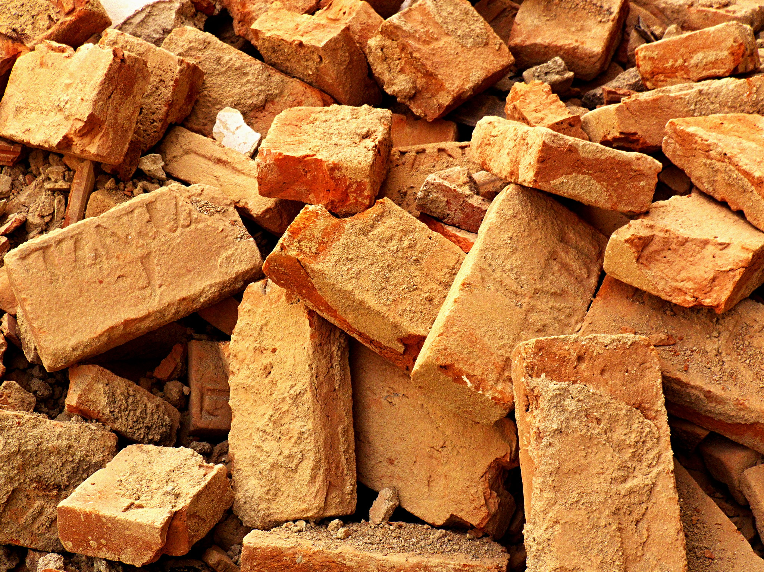
References
Pictures
Questions? by socialBedia (CC BY-NC-ND 2.0)
Sign of things to come… by Octoberation (Public Domain)
Lomo Old Bricks 3 by linuxbear (CC BY 2.0)
Ghost by Freepik on flaticon.com
Database by vectorsmarket15 on flaticon.com
Json by Muhammed Andy on flaticon.com
Parquet by kerismaker on flaticon.com
Flag by redempticon on flaticon.com
Brick Wall by Hakan Dahlstrom (CC BY 2.0)
Bricks & Stones by M Rasoulov (CC BY-NC 2.0)
Data-file by Good Ware on flaticon.com
0000_IM_0429 by WarOnTomato (CC BY 2.0)
Unpacking by Aranagraphics on flaticon.com
Maintenance by Dewi Sari on flaticon.com
Audio-controls by rcherem on flaticon.com
Command-line by Flat Icons on flaticon.com
lost bricks by fen-tastic (CC BY-ND 2.0)
Some Old Bricks by Jaroslav A. Polák (Public Domain)
Literature
Data-Intensive Text Processing with MapReduce by J. Lin and C. Dyer
Hive Official Webpage by Apache
cognitiveclass.ai
Hive Official Wiki by Apache
Official Hive Docker Image on DockerHub
Hive connector with Amazon S3 by Starburst
Spark and Hive integration by Cloudera
Hive to use Spark as Execution Engine manual by Confluence
Presto Official Site by Apache
Iceberg Official Site by Apache
Parquet Official Site by Apache
Delta Lake: High-Performance ACID Table Storage
Over Cloud Object Stores by Databricks

Slide 52
Business Card
Fast and Reliable SQL Engine for Data Analytics and the Open Lakehouse

Slide 53
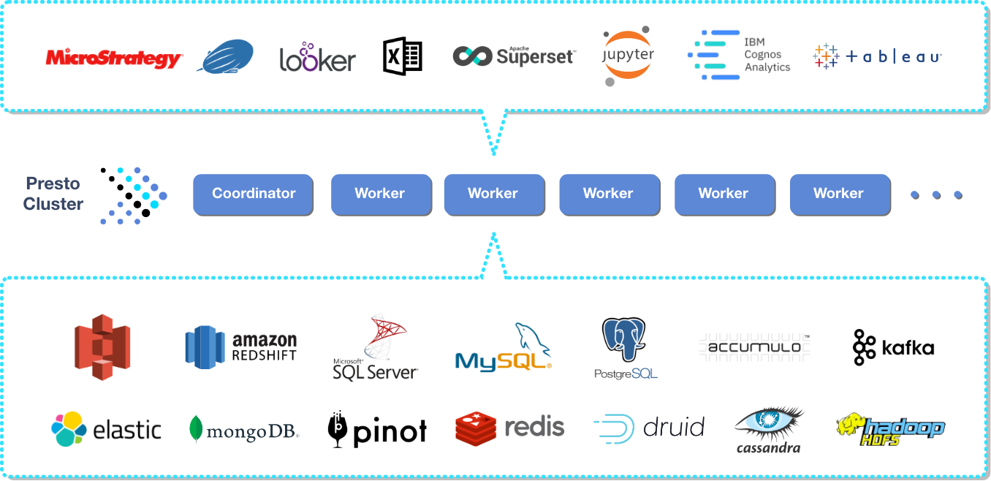
Presto Overview

Slide 54
Current Use of SQL
Spark, including stream analytics
Hive
Elasticsearch: text processing
Delta lake
Iceberg
Presto
Relational DBMS

Slide 55
Thank You

