Slide 1
Introduction to Data Analytics
András Varga
IBM Consulting

Slide 2
PHD
12

Slide 3
Course Details
Time allocation:
Credits:
Teachers:
Evaluation:
Grading Scheme:
2P/1C
4
András Varga, PhD. RNDr. Jana Kostičová, PhD.
2 projects - 20% each
Final exam – 60 %
A – 90% B – 80%
C – 70% D – 60%
E – 50%

Slide 4
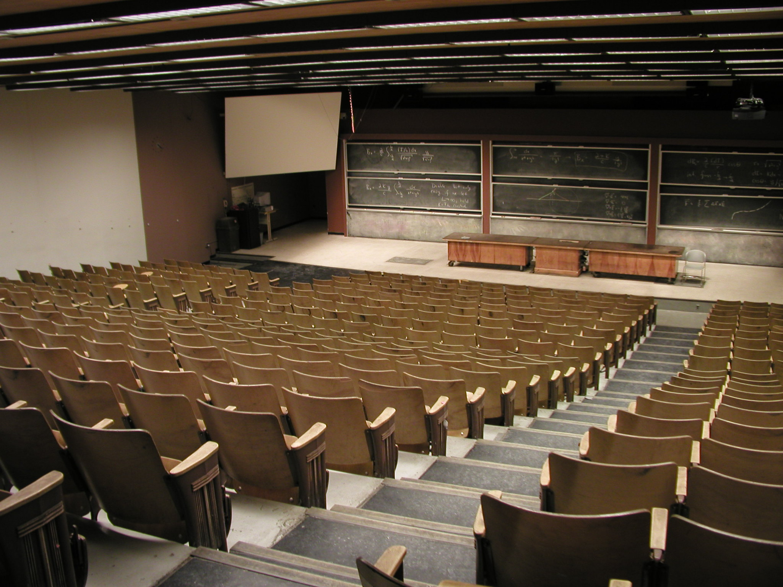
Course Details

Slide 5
http://www.st.fmph.uniba.sk/~varga52/analyza_dat/

Slide 7
Outline
What data means?
History of data
Basic properties of data
Big Data
Cloud and its impact on data
Open discussion

Slide 8
Outline
What data means?
History of data
Basic properties of data
Big Data
Cloud and its impact on data
Open discussion

Slide 9
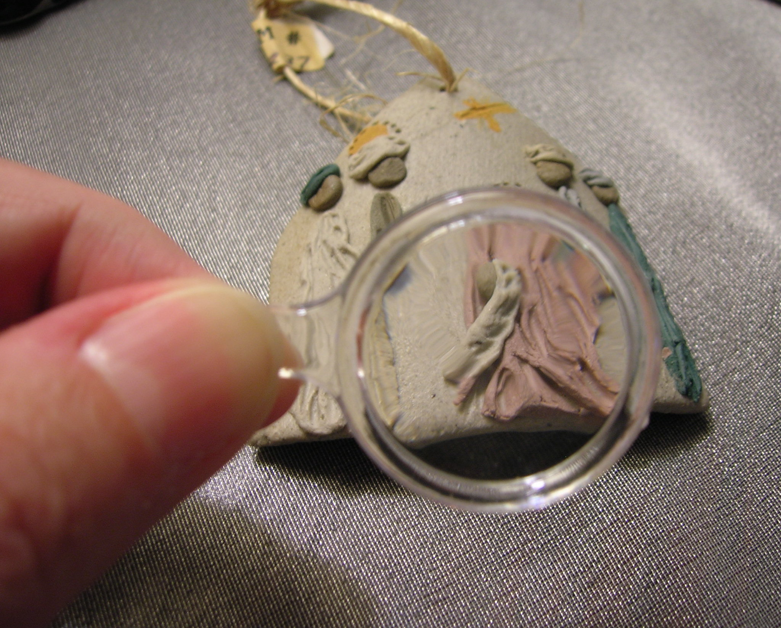
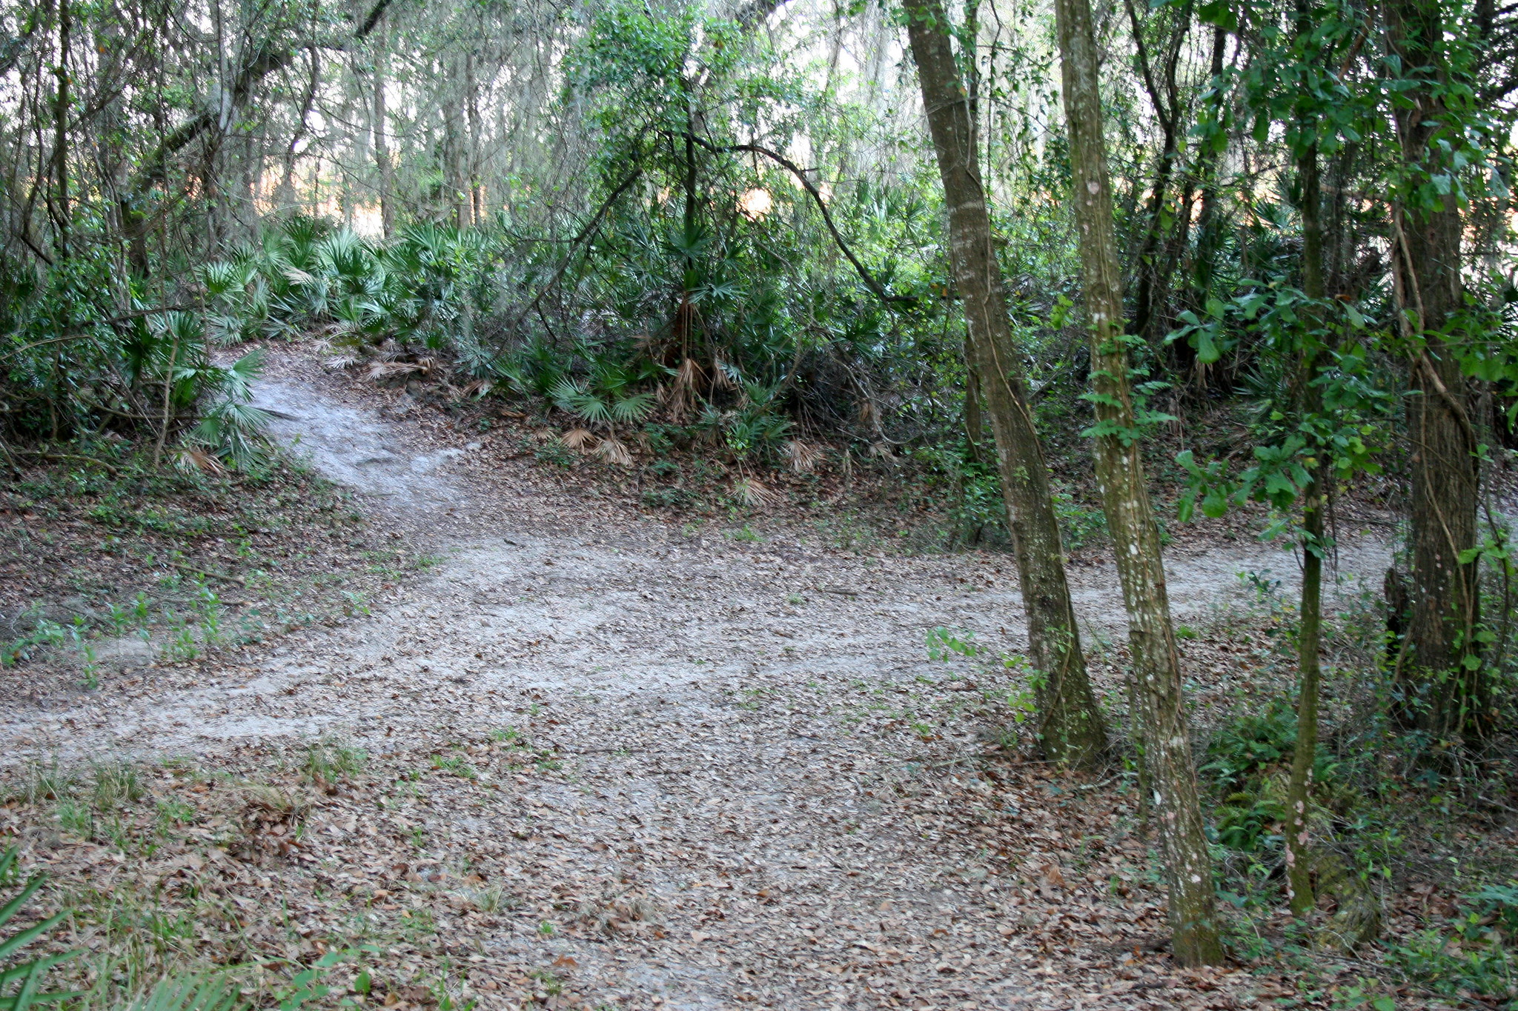
What data means?
information
data
data

Slide 10
What data means?
data
datum
dō, dare, dedī, datum

Slide 11
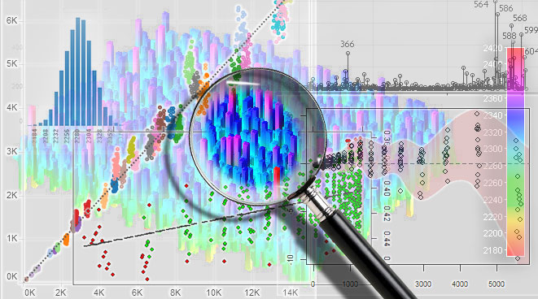
What data means?
data analysis

Slide 12
How much data is out there?
IDC: 64,2 ZB
(2020)

Slide 13
Outline
What data means?
History of data
Basic properties of data
Big Data
Cloud and its impact on data
Open discussion

Slide 14
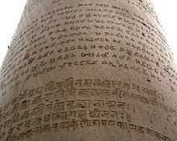
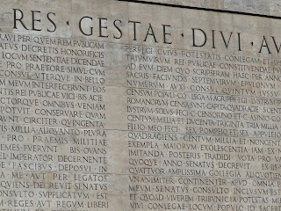
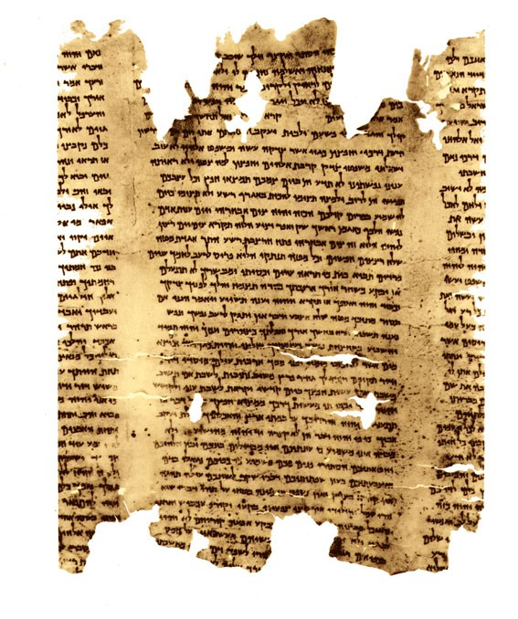
History of
Data
3rd century
BCE
3rd century
BCE
1st century
CE

Slide 15
History of
Data
1944
Fermont Rider
1970
Edgar F. Codd
“Information Explosion”
US university libraries
Doubling in size
Every 16 years
Relational database
SQL
1967
Marron, de Maine

Slide 16
History of
Data
Data Warehouse
Star Schema
1997
Michael Lesk
Terradata System
1986
After 2000 we may reach a
world where an average
piece of information is
never looked at by human
1980’s
Terradata delivers
the first parallel
database system
with 1TB storage
1996
Ralph Kimball

Slide 17
History of
Data
2003
Ghemawat, Gobioff,
Leung
2009
Hey, Tansley,
Tolle
“Big Data”
MapReduce Framework
The Forth Paradigm
1999
Bryson, Kenwright,
Cox, Ellsworth,
Haimes
Google File
System
2008
Dean, Ghemawat

Slide 18
Outline
What data means?
History of data
Basic properties of data
Big Data
Cloud and its impact on data
Open discussion

Slide 19
Data Organization
Data Set
Database
DBMS
Data

Slide 20
Database Management System
DBMS are software used to efficiently store, update, organize and query data

Slide 21
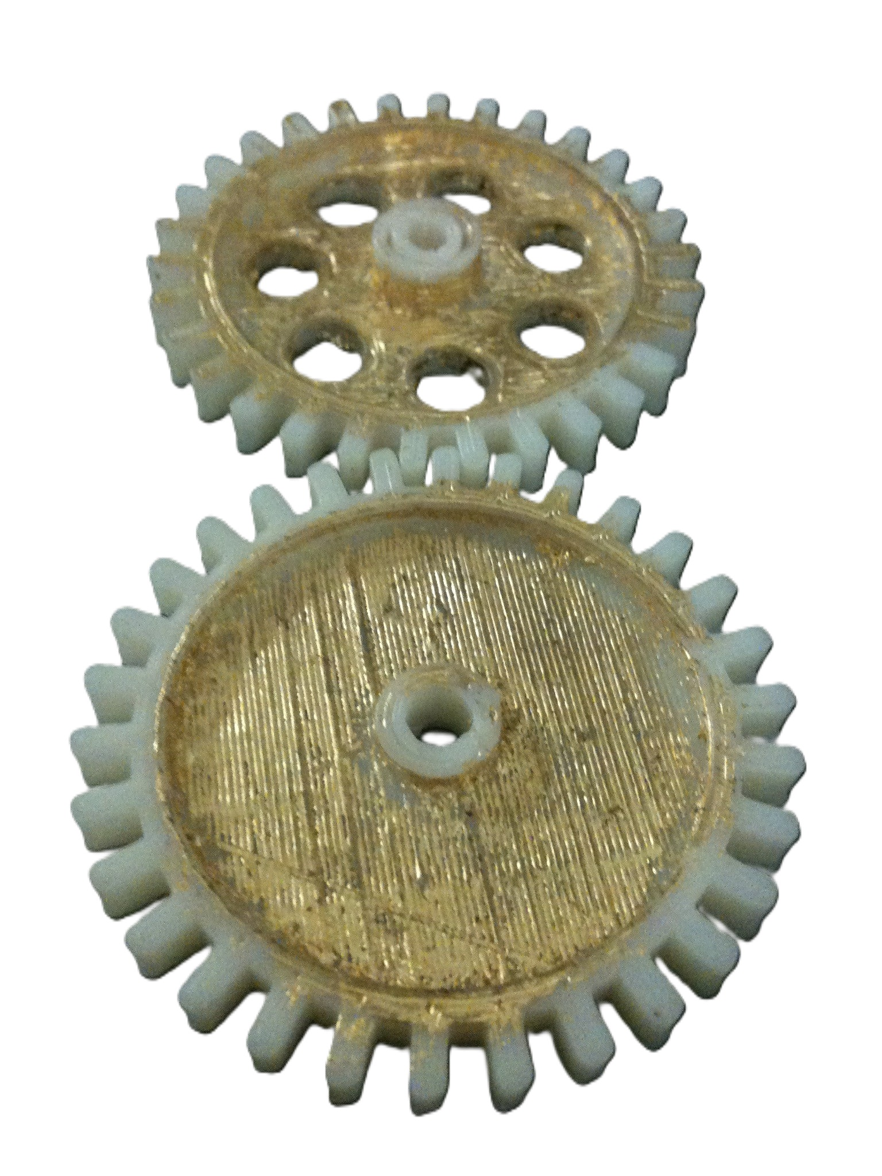
Data Storage

Slide 22
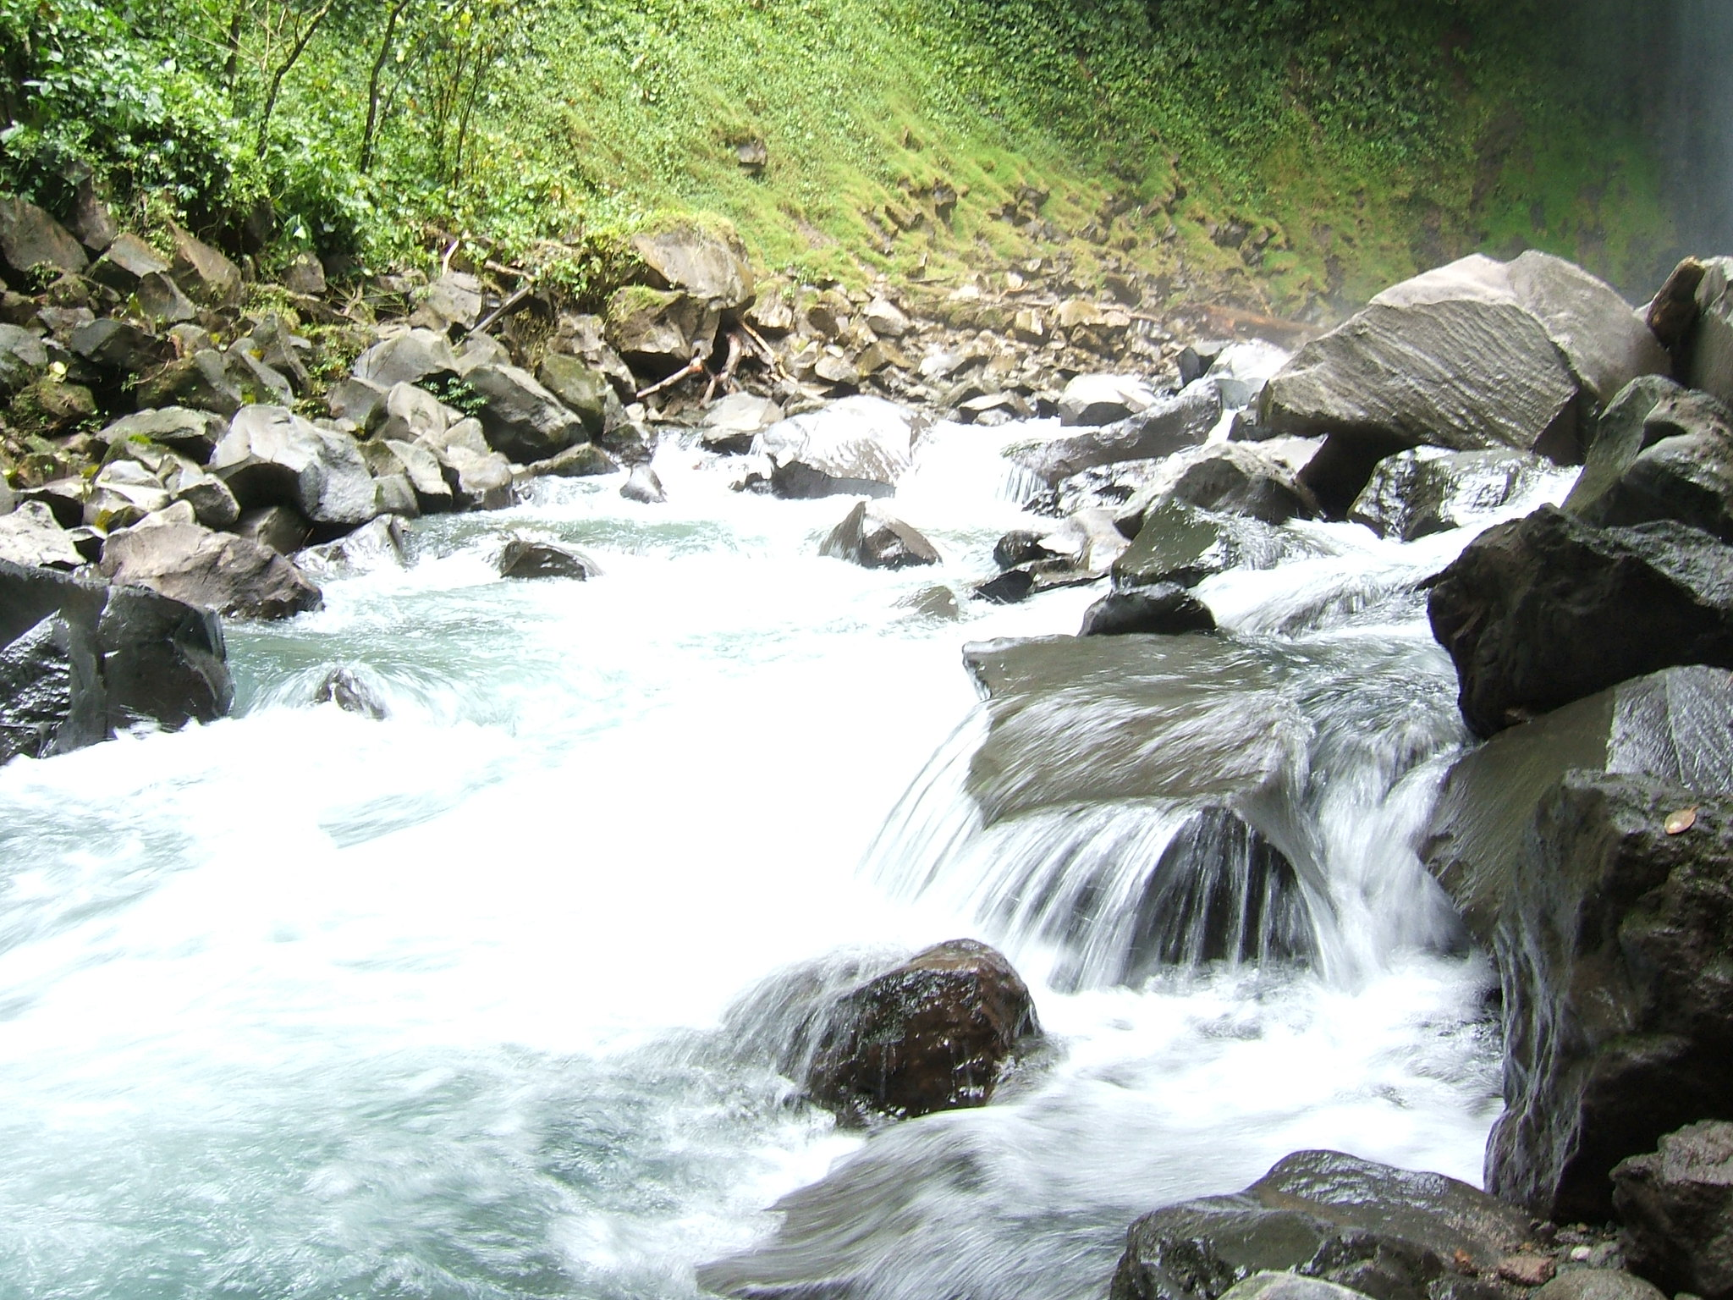
Data Streams
Transmitting continuous flow of data
Continuous processing
Records often represent events
Timely response

Slide 23
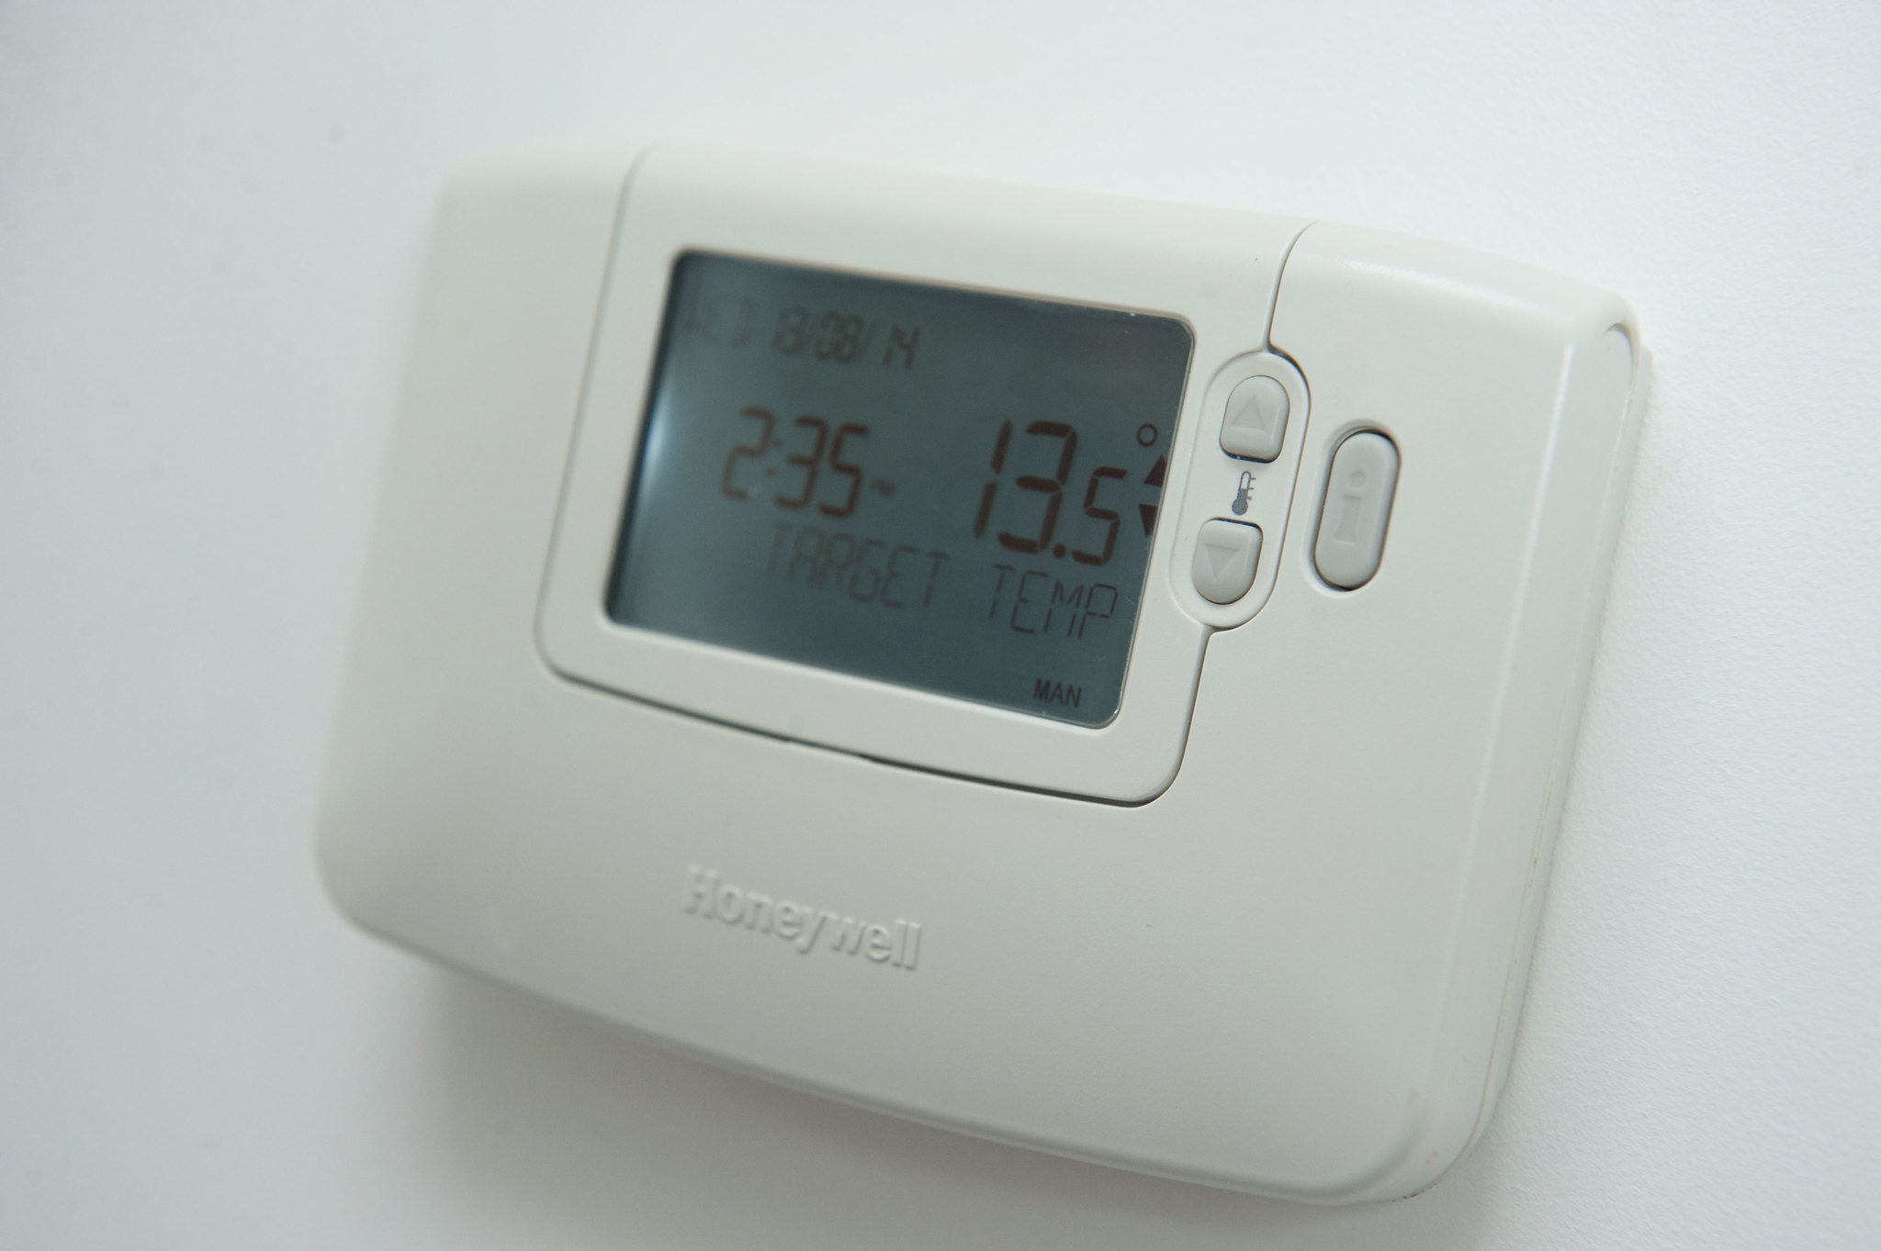
Sources of Data

Slide 24
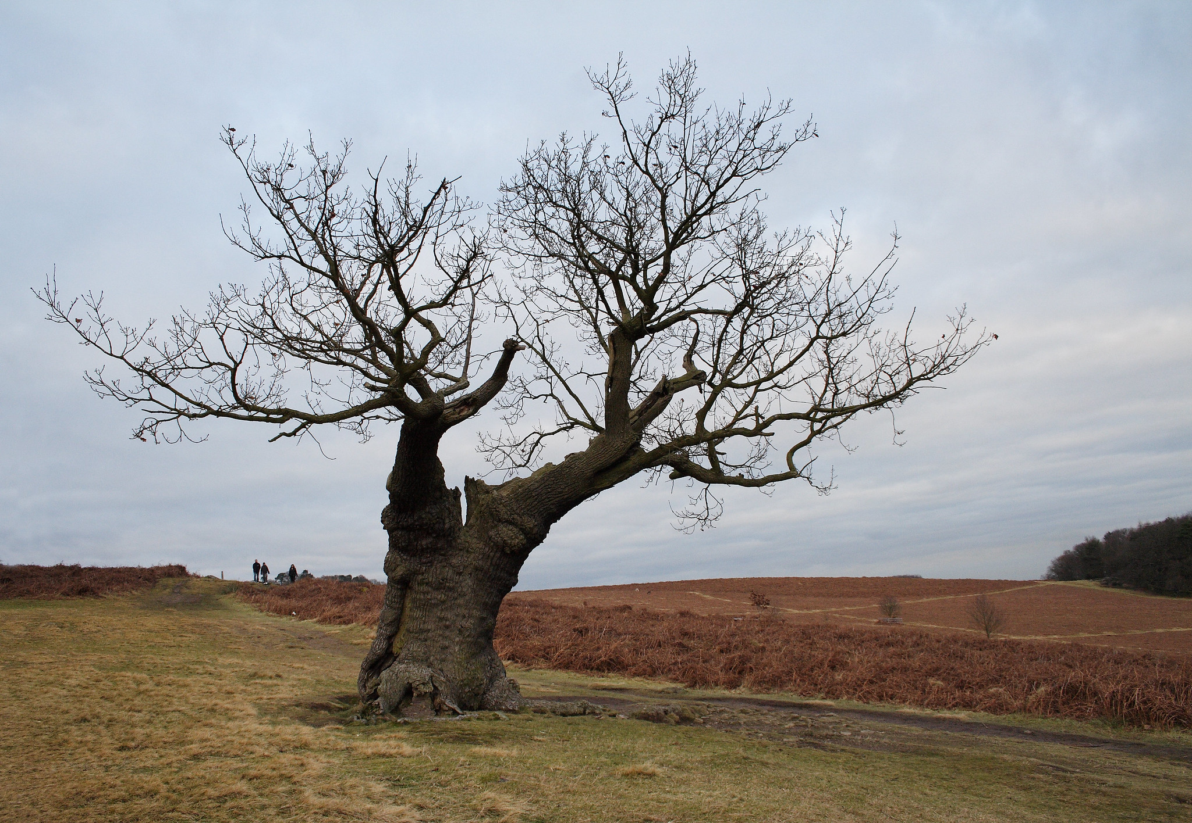
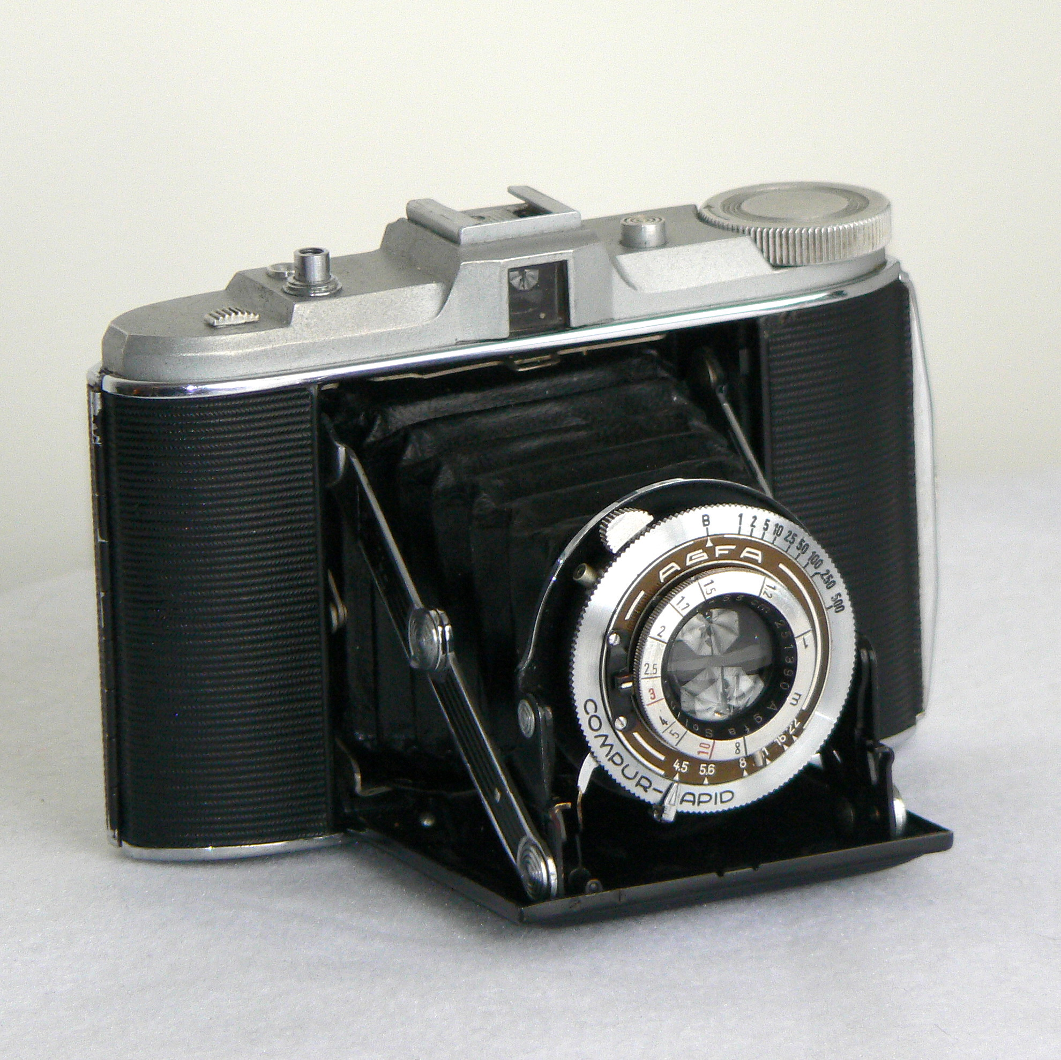
Structure of Data

Slide 25
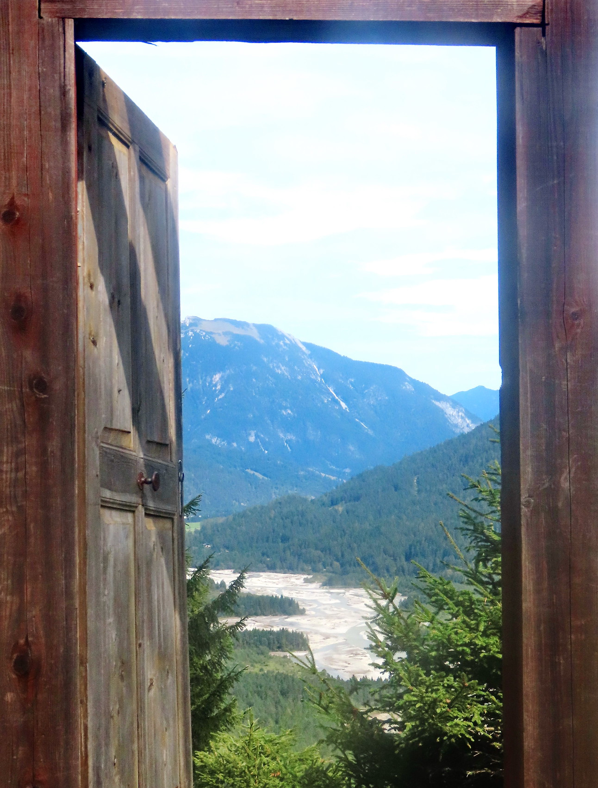
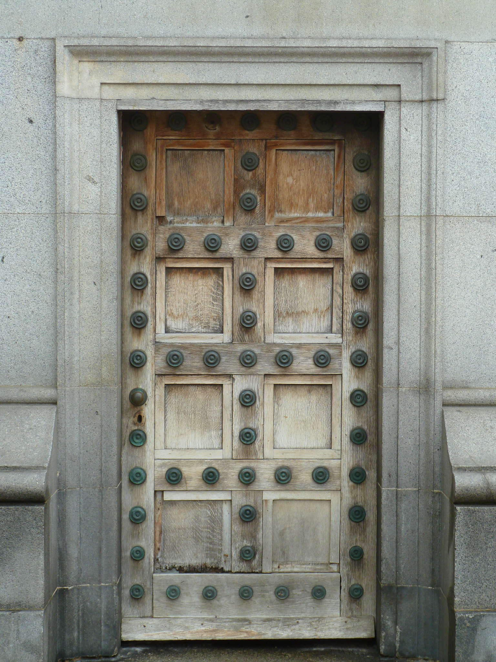
Confidentiality
Sensitive Personal Information
Business Confidential
Personal Information
Open Data

Slide 26
Data Usage
Operational Analytical
Optimized for:
Read, Write, Update
Reading and Aggregation
Logical structure:
Dimensional Modeling
(Star Schema)
Normal Forms (3NF, BCNF)
Additional info:
ETL
Reporting Systems
ACID

Slide 27
Outline
What data means?
History of data
Basic properties of data
Big Data
Cloud and its impact on data
Open discussion

Slide 28
Big Data
Buzzword

Slide 29
Big Data
“Datasets which could not be captured, managed, and processed
by general computers within an acceptable scope.”
2010, Apache Hadoop
“The next frontier for innovation, competition, and productivity”
2011, McKinsey
“Big data refers to datasets whose size is beyond the ability of typical database software tools to capture, store, manage, and analyze.”
2011, McKinsey

Slide 30
Big Data
5 V’s
V
V
V
V
V

Slide 31
Big Data
V
Volume
Velocity
V
V
Value
V
Variety
Veracity
V

Slide 32
Big Data Ecosystem

Slide 33
Outline
What data means?
History of data
Basic properties of data
Big Data
Cloud and its impact on data
Open discussion

Slide 34
Cloud Solutions
Application
Application
Application
Application
Data
Data
Data
Data
Runtime
Runtime
Runtime
Runtime
Middleware
Middleware
Middleware
Middleware
OS
OS
OS
OS
Virtualization
Virtualization
Virtualization
Virtualization
Storage
Storage
Storage
Storage
Networking
Networking
Networking
Networking
Servers
Servers
Servers
Servers
Infrastructure as a Service (IaaS)
Platform as a Service (PaaS)
Software as a Service (SaaS)
On Premises

Slide 35
Function as a Service (FaaS)

Slide 36
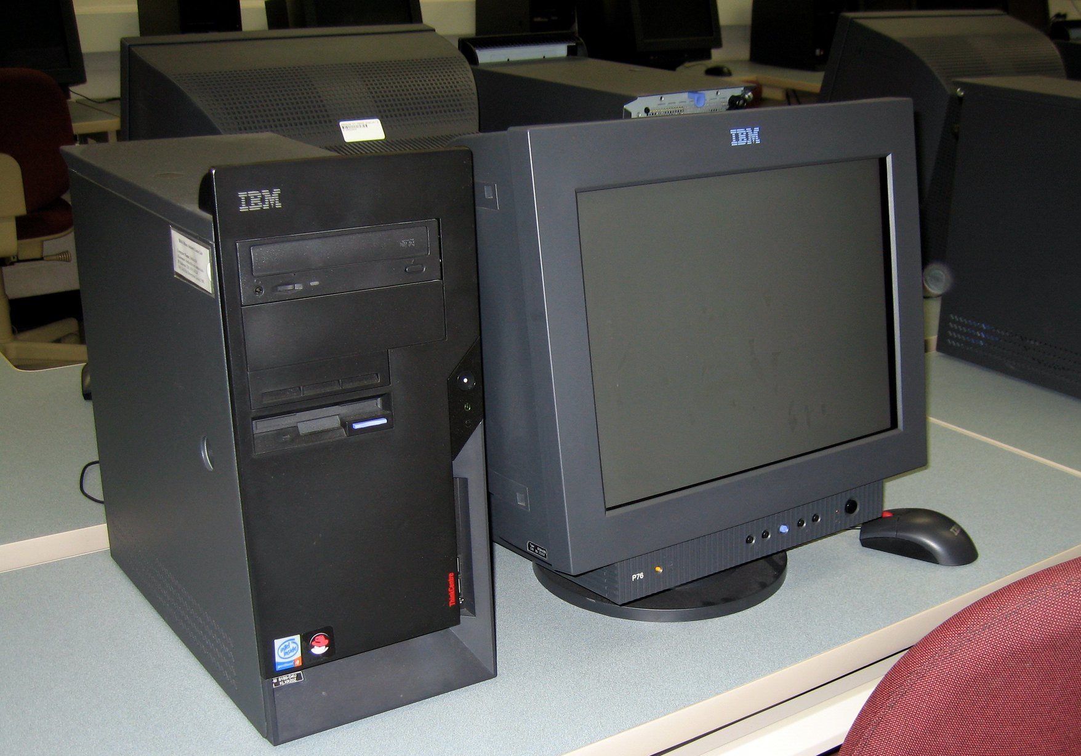
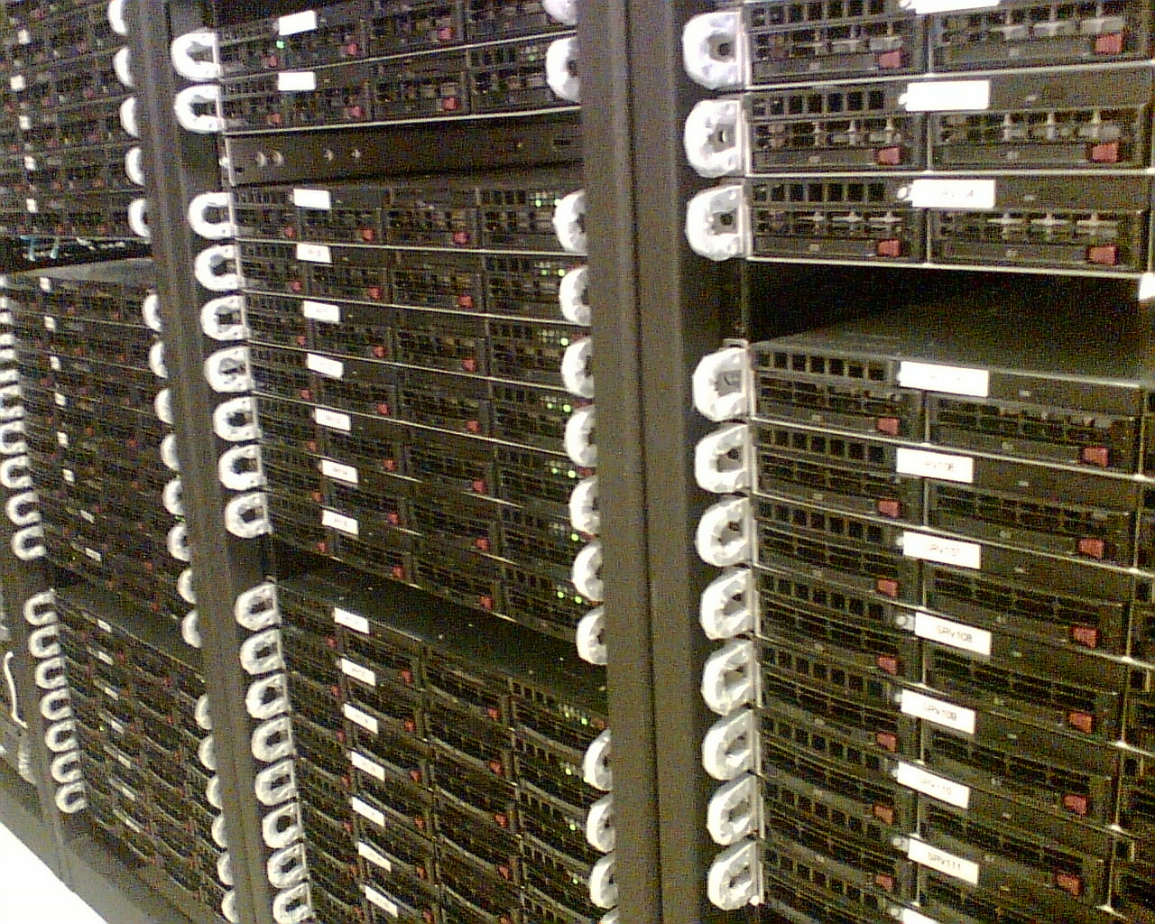
Handling Data in Cloud
Hardware
Software
Data
Hardware
Software
Data
Hardware
Software
Data

Slide 37
Data Lakes
Central repository
Large amounts of data
Diverse data
Structured
Semi-Structured
Unstructured
Using native format

Slide 38
Data Lakehouse
Combining features of data lakes and analytical systems

Slide 39
NoSQL
SQL became the “lingua franca” of data
= Not Only SQL
Not necessarily adhering to relational data structures
Distributed In-memory Caches
Key-Value Pairs
Document Stores
Graph Databases

Slide 40
Outline
What data means?
History of data
Basic properties of data
Big Data
Cloud and its impact on data
Open discussion

Slide 41
References
Pictures
Black Pencil by William Warby (CC BY 2.0)
the impostor by uncoolbob (CC BY 2.0, background removed)
Pencil by Andrew Taylor (CC BY 2.0, background removed, cropped)
M206 Computer Lab
by EdTech Stanford University (CC BY-NC-ND 2.0)
Lecture Lecture by Alan Levine (Public Domain)
Magnifies by auntjojo (CC BY-NC 2.0)
Crossroads by Richard Elzey (CC BY-NC 2.0)
data-analysis-icon by Oscar de Lama (CC BY-NC 2.0)
Coloured Pencil III
by Peter Toporowski (CC BY 2.0, background removed)
Edicts of Ashoka from Wikipedia
Dead sea scrolls from Wikipedia
Res Gestae Divi Augusti by Brunt P. A. and Moore J. M.
pencil and eraser on paper by Shawn Campbell (CC BY 2.0)
Giraffen_divansofa_2 by Sweef (CC BY 2.0)
Lufthansa D-AIDM @TXL by sebaso
golden gears by mh.xbhd.org (CC BY 2.0, background removed)
Stream by hanzabean (CC BY-NC-ND 2.0)
Honeywell Thermostat by CORGI HomePlan (CC BY 2.0)
60103 Ground Crew Front by Brickset (CC BY 2.0)
066/366 Playing Games by Mark Seton (CC BY-NC 2.0)
Brick wall by Open Grid Scheduler
Bradgate Park Walk 1/08 by Ted and Jen (CC BY 2.0)
Agfa Isolette by Sigmund (CC BY-NC 2.0)
Open door to the mountains by Reiner Ehlers (CC BY 2.0)
Door by givingnot (CC BY-NC 2.0)
Lock by oatsy40 (CC BY 2.0)
Safe by Jan Tik (CC BY 2.0)
Pencil by 0Four (CC BY-NC 2.0, background removed)
Pencils by Elle (CC BY 2.0)
5 pencils by Rosmarie Voegtli (CC BY 2.0)
Clouds by Thomas Crenshaw (CC BY 2.0)
Cloud by Jason Pratt (CC BY 2.0)
Ghost by Good Ware on flaticon.com
wiki servers by Domas Mituzas (CC BY 2.0)
IMG_0076 by aaltonen (CC BY 2.0)
Stout Lake by Scrubhiker (USCdyer) (CC BY-NC 2.0)
Colored pencils by Kain Kalju (CC-BY 2.0)
Conference room by Bonnie Bogle (CC BY 2.0)
Colouring Pencils by William Warby (CC BY 2.0)
Literature
International Data Corporation
Merriam-Webster Dictionary
Global - 2021 Forecast Highlights by CISCO
What is a data lake? by AWS
What is Data Lake? by google
The Data Warehouse Toolkit – The Definitive Guide
to Dimensional Modeling (Third Edition) by
Ralph Kimball and Margy Ross
A Very Short History of Big Data, Forbes by Gil Press

Slide 42
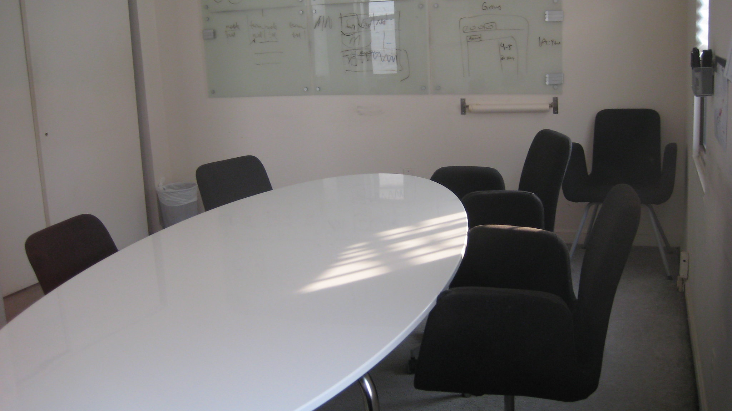
Discussion

Slide 43
Thank You

