Slide 1
Kafka
András Varga
IBM Consulting

Slide 2
Business Card
Apache Kafka is an open-source distributed event streaming platform used by thousands of companies for high-performance data pipelines, streaming analytics, data integration, and mission-critical applications

Slide 3
Use Cases
Log Aggregation
Website Activity Tracking
Streaming
External Commit Log

Slide 4
Outline
What Kafka really is?
Kafka Cluster
Messages
Producer – Consumer
Kafka Usage
Kafka Connect
Streaming
Messaging systems

Slide 5
Actors and Properties
Asynchronous communication
Messaging System
Sender\
Producer
Receiver\
Consumer
Bandwidth
Latency

Slide 6
Message Queue
Producer
Consumer
Point-to-point
Delivery guaranteed
Ordering
Deleting upon delivery

Slide 7
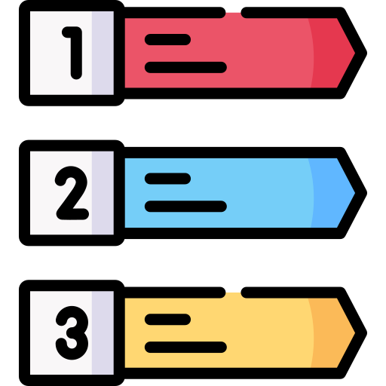
Publish-Subscribe
Newsfeed
Subscription
Producer
Consumer
Topic

Slide 8
Outline
Messaging systems
Kafka Cluster
Messages
Producer – Consumer
Kafka Usage
Kafka Connect
Streaming
What Kafka really is?

Slide 9
Kafka
Publish-Subscribe Messaging System with Tweaks
TCP/IP
TCP/IP
Producer
Consumer

Slide 10
Kafka
Deployed over a Cluster
Producer
Consumer
Brokers

Slide 11
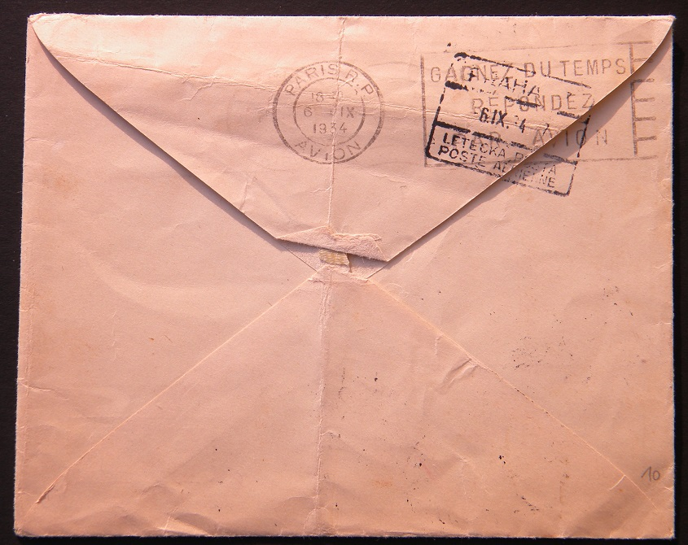
Kafka Message
Record, Event
Header
Timestamp
Key
Value

Slide 12
Kafka Topics
Buckets / Partitions
Ordered
Immutable

Slide 13
Kafka Topics
Offset: Unique ID of records in a partition
1
2
3
4
5
1
2
3
Incoming Writes
1
2
3
4
Old
New

Slide 14
Kafka Topics
1
2
3
4
5
1
2
3
1
2
3
4
Retention Period: Time records are stored regardless of consumption

Slide 15
Kafka Topics
1
2
3
4
5
1
2
3
1
2
3
4
Stored
Consumer Offset: Position of consumers; can “jump” on partitions

Slide 16
Simple Example
Writes
1
2
3
4
5
6
7
8
Reads
Offset: 4
Offset: 7

Slide 17
Producer
Writes
1
2
3
4
5
6
7
8
Chooses topic
Chooses partition (random by default)

Slide 18
Consumer Groups
Partitions are split between consumers of the same group
Expected behavior: Broadcasting
Instead: Splitting work
1
2
3
4
5
6
1
2
3
4
5
1
2
3
4
1
2
3
4
5

Slide 19
Outline
Messaging systems
What Kafka really is?
Messages
Producer – Consumer
Kafka Usage
Kafka Connect
Streaming
Kafka Cluster

Slide 20
Replication over Brokers

Slide 21
Replication over Brokers
Partition leaders are uniformly distributed
Partitions are replicated
Leader
Any number of followers

Slide 22
Replicated Commit Log
Partition leaders are uniformly distributed
Partitions are replicated
Leader
Any number of followers
Producers and Consumers of a topic partition always communicate with the leader
Followers replicate leader changes

Slide 23
Broker Failures
Brokers are “alive”:
Regular metadata updates (active session)
Followers are not “too far” behind

Slide 24
Broker Failures
New leader is needed for the partition
Leader election?

Slide 25
“In Sync” Replicas (ISR)
Handles
Serialization
Commits after all ISR finishes copying
ISR maintains a copy from a leader
1
2
3
Copy
1
1
1
2
2
2
3
3

Slide 26
“In Sync” Replicas (ISR)
Minimal ISR size can be set up
1
2
3
Any server form ISR can take over as leader
Stored in Zookeeper
f+1 servers can handle f failures!
1
1
1
2
2
2
3
3

Slide 27
Unclean Election
Unclean election is disabled by default (consistent strategy)
1
2
3
Consistency – wait for the first ISR replica to come online
Availability – allow any replica to take over outside of ISR
1
1
1
2
2
2
3
3

Slide 28
Storing Metadata
Zookeeper
KRaft

Slide 29
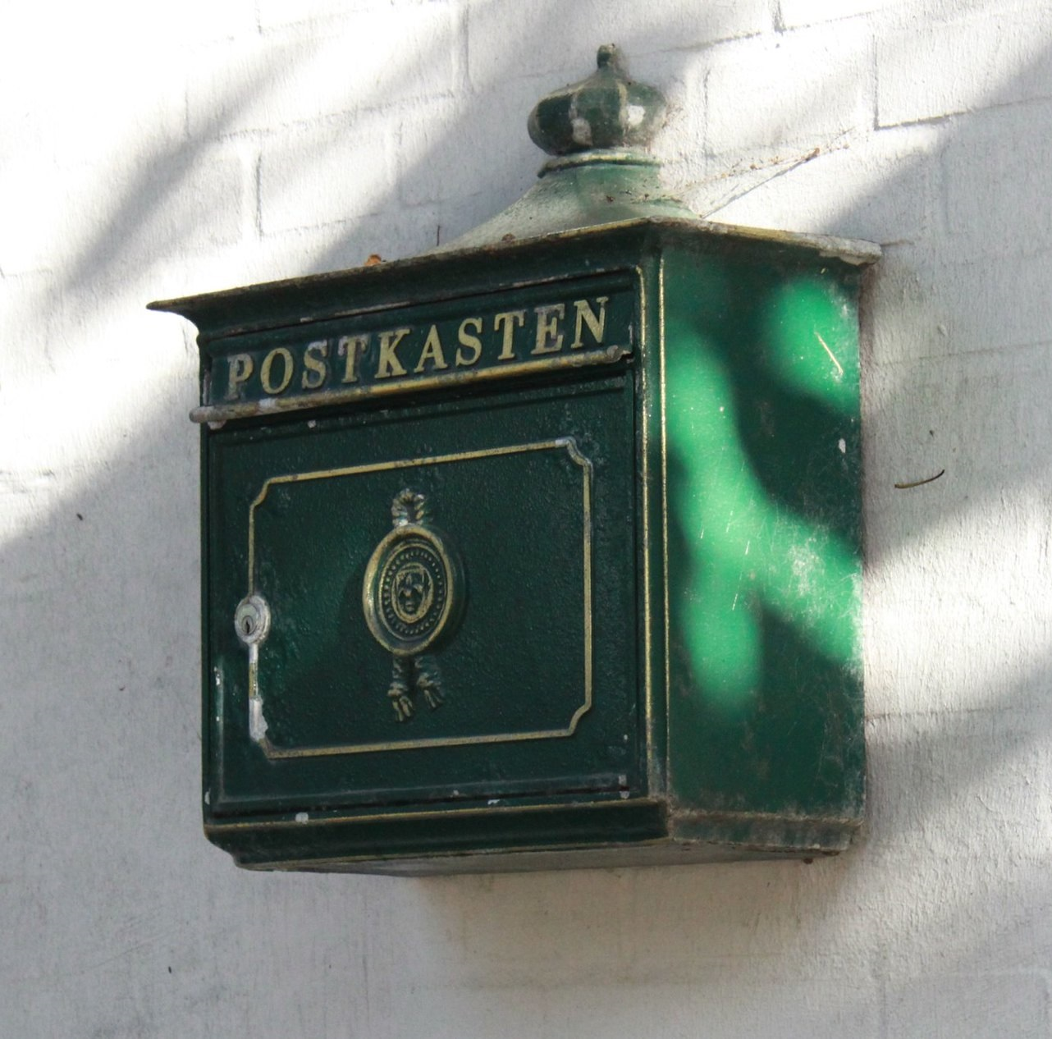
Storing Messages
Messages are stored on disk instead of memory
Speed is achieved by using OS provided caching

Slide 30
Outline
Messaging systems
What Kafka really is?
Kafka Cluster
Producer – Consumer
Kafka Usage
Kafka Connect
Streaming
Messages

Slide 31
Kafka Message
When key is set, its hash determines the partition, i.e., same key = same partition
Kafka
Header
Timestamp
Binary or null
Key
1 MB
Application
Binary or null
Changeable
Value
Huge amount of small messages

Slide 32
I/O Optimization
Huge amount of small messages
I/O can be a bottleneck
Messages are grouped into record batches
Lowers messaging overhead

Slide 33
Bandwidth
Record Batch – written on disk
Record Batch Header
Compression
gzip
snappy
lz4
zstd
Written batch differs from sent batch

Slide 34
Outline
Messaging systems
What Kafka really is?
Kafka Cluster
Messages
Kafka Usage
Kafka Connect
Streaming
Producer – Consumer

Slide 35
Producer
Collects messages in memory before sending them in a batch
Time
Amount of data
Publisher obtains respond (choice):
Once message is committed by leader
Once message is fully replicated
Asynchronous

Slide 36
Producer
Collects messages

Slide 37
Producer
Time

Slide 38
Producer
Data

Slide 39
Producer
Response choice

Slide 40
Producer
Leader

Slide 41
Producer
Entire ISR

Slide 42
Producer
Asynchronous

Slide 43
Producer Failure
If producer fails during publishing messages can be lost
Re-sending the message can lead to duplicates
Message lost can be ignored
Using idempotent delivery:
Producer gets ID
Message gets a sequence number by Producer
Kafka identifies duplicates

Slide 44
Consumer
Fetches from broker, i.e., pulls messages
Can “jump” by setting offset
Can re-consume messages
Can get several messages for one fetch request

Slide 45
Consumer
Pulls

Slide 46
Consumer
Jumps

Slide 47
Consumer
Re-consume

Slide 48
Consumer
Several messages

Slide 49
Consumer Failure
at-least-once
Delivery Semantics
Re-set offset
1
2
3
4
5
6
7
Continue reading
at-most-once

Slide 50
Consumer Failure
Transactional Producer
Delivery Semantics
1
2
3
4
5
6
1
2
3
4
5
6
7
Messages grouped into a transaction are visible to consumers together

Slide 51
Consumer Failure
exactly-once
Delivery Semantics
1
2
3
4
5
6
7
It can read the last successfully read offset
writes last read offset and message together
1
2
3
4
5
6
7

Slide 52
Outline
Messaging systems
What Kafka really is?
Kafka Cluster
Messages
Producer – Consumer
Kafka Connect
Streaming
Kafka Usage

Slide 53
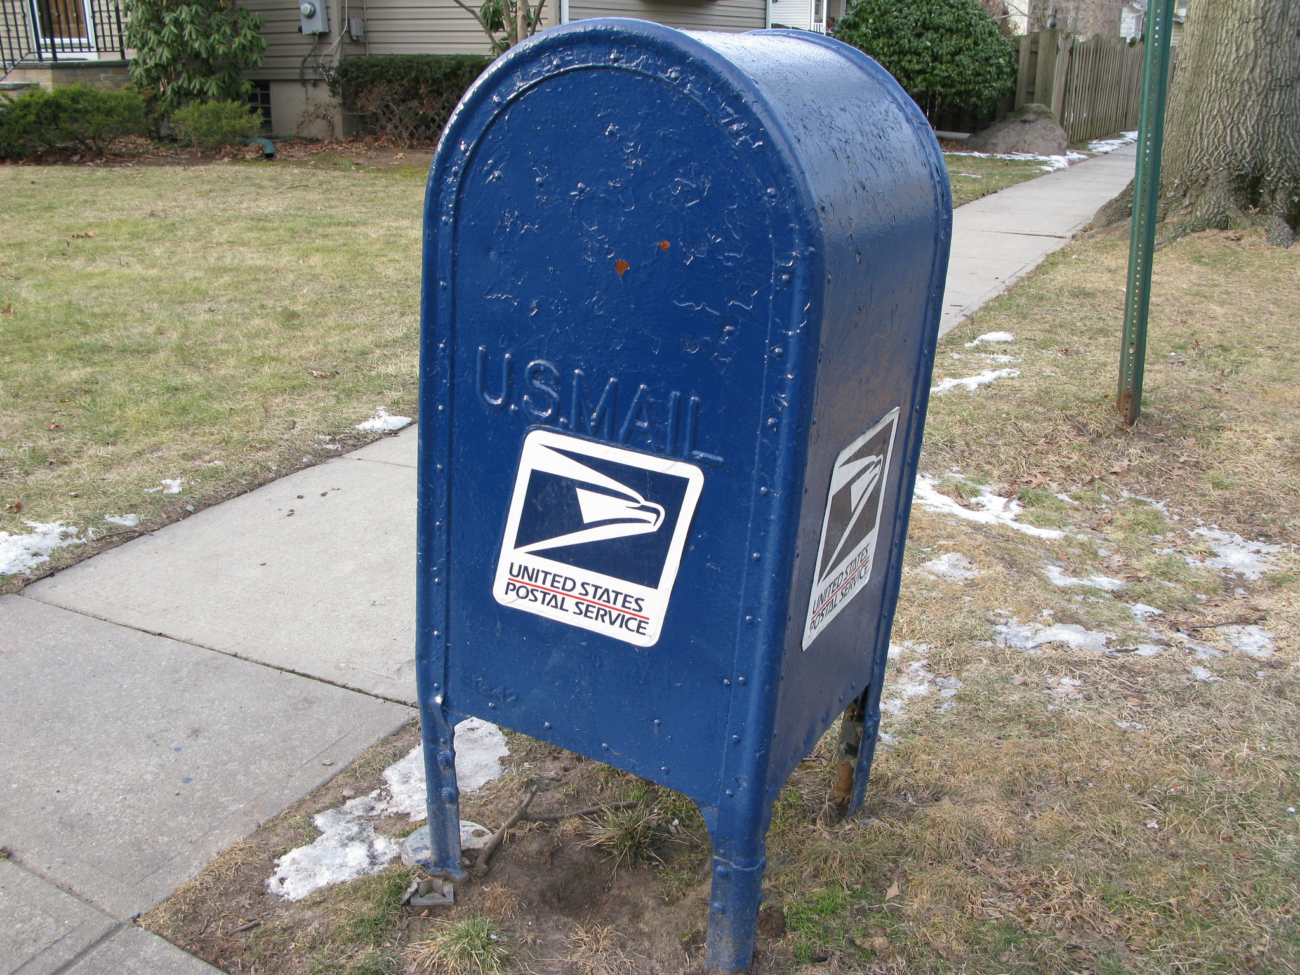
Install
Configure Zookeeper or KRaft
Brokers
Logs
Compression
SSL
etc.
bin/kafka-server-star.sh

Slide 54
Docker
less options
docker pull
docker run
When adding new brokers to an existing cluster they start empty

Slide 55
Security
SSL
Authorization
ACL

Slide 56
Outline
Messaging systems
What Kafka really is?
Kafka Cluster
Messages
Producer – Consumer
Kafka Usage
Streaming
Kafka Connect

Slide 57
Kafka Connect
Default solution to connect with standard applications
Databases
Elasticsearch
HDFS
etc.
Source
Sink

Slide 58
Outline
Messaging systems
What Kafka really is?
Kafka Cluster
Messages
Producer – Consumer
Kafka Usage
Kafka Connect
Streaming

Slide 59
How to Stream in Kafka?
Process single messages
Streams = Topics
Stream partitions = Topic partitions
Message keys used to direct messages to partitions
Low-latency

Slide 60
Kafka Streams
Kafka client library to analyze streams
Stream – Table duality
Time windows
Processing
State
Input Stream
Output Stream
Exactly-once semantics

Slide 61
References
Pictures
C4 envelope by Shou-Hui Wang (CC BY-SA 2.0, cropped)
Air mail by Tyler Spaeth (CC BY 2.0, background removed)
Post-IT by Open Grid Scheduler (Public Domain)
Registry by xnimrodx on flaticon.com
Recipient by Muhammad_Usman on flaticon.com
Postman by Freepik on flaticon.com
Sender by Jagat Icon on flaticon.com
Email by Freepik on flaticon.com
Email by rukanicon on flaticon.com
List by Freepik on flaticon.com
old computer by Jeff Dray (CC BY 2.0)
HMS computer by kitschweb (CC BY-ND 2.0)
C.I.D.N.A. Air Mail Cover (black)
by afvintage (CC BY-NC-ND 2.0)
postbox by The Poss (CC BY-NC-ND 2.0)
Culture by Muhammad_Usman on flaticon.com
Crown by Freepik on flaticon.com
Air Freight & Mail by Elad Rahmin (CC BY-NC 2.0)
Sept 23/10 Old German postbox
by Judith Doyle (CC BY-ND 2.0)
FROM: Jamie in Oregon by Bianca J (CC BY-NC 2.0)
Header by Freepik on flaticon.com
Blockchain by juicy_fish on flaticon.com
US Post Box by Ann Oro (CC BY-SA 2.0)
Configuration by Freepik on flaticon.com
Unboxing by Febrian Hidayat on flaticon.com
Horse car by Freepik on flaticon.com
Play-button by Wahyu.Setyanto on flaticon.com
sealed by Justin Henry (CC BY 2.0)
Newcastle upon Tyne … NE1 37
by bazzadarambler (CC BY 2.0, cropped)
Literature
Official Kafka Site by Apache
cognitiveclass.ai
Messaging Concepts (ActiveMQ) by Apache
Message Delivery Guarantees by Confluent

Slide 62
Thank You

