Slide 1
Spark
András Varga
IBM Consulting

Slide 2
Business
Card
Apache Spark™ is a multi-language engine for executing data engineering, data science, and machine learning on single-node machines or clusters.
Java
Scala
Python
SQL
R

Slide 3
Spark Components
Spark SQL
Structured Streaming
spark.ml
GraphX
Spark Core
Standalone
YARN
Mesos
K8s

Slide 4
Spark Applications
Application
Isolation
In memory
Tasks
Driver
Executors

Slide 5
Application in Cluster
Worker Node
Executor
Task
Task
Cache
Driver Program
SparkContext
Worker Node
Cluster Manager
Executor
Task
Task
Cache

Slide 6
Outline
Spark Core
APIs
Spark SQL
RDD
spark.ml
Scala
Running an Application
GraphX
Newer Abstractions
Structured Streaming

Slide 7
Outline
Spark Core
APIs
Spark SQL
RDD
spark.ml
Scala
Running an Application
GraphX
Newer Abstractions
Structured Streaming

Slide 8
Scala Basics
OOP
JVM
Functional Language
Statically typed
Side effects

Slide 9
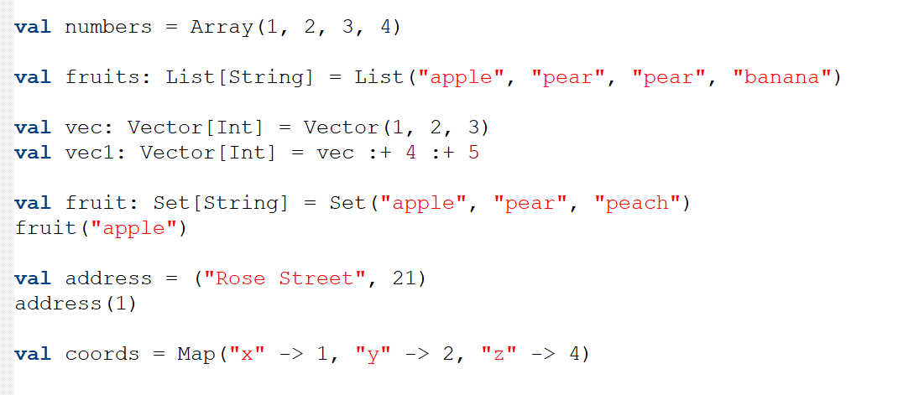
Collections
Fixed size
append(), prepend()
Immutable, Indexed
No duplicates
Tuple
Tuples

Slide 10
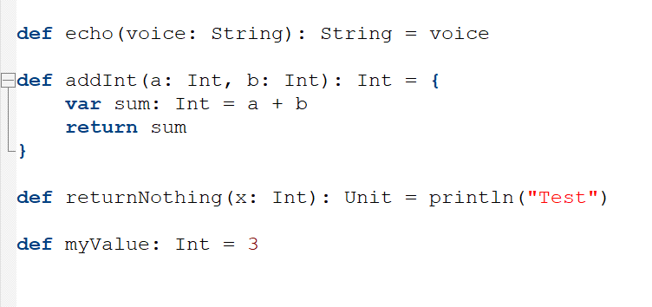
Methods
Returns at most one value
Return type
Method looks like field
Infix notation

Slide 11
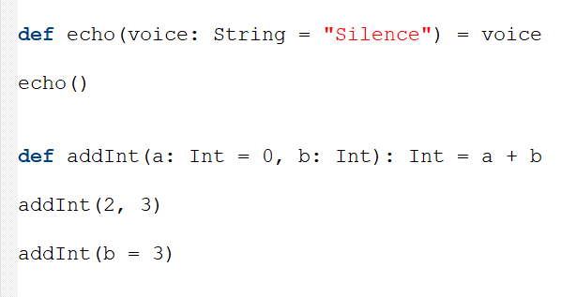
Arguments
Defaults
Call using names

Slide 12
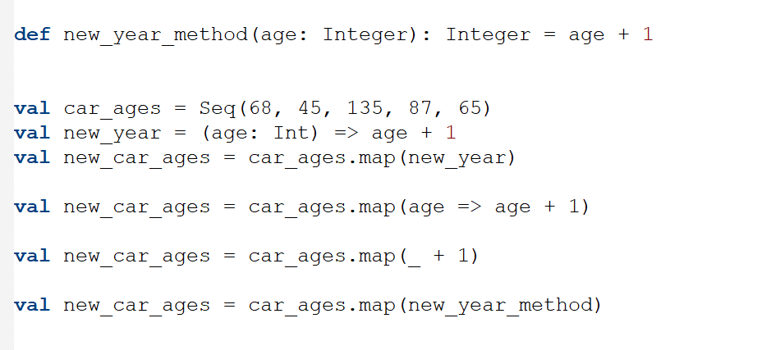
Higher Order Functions
map
filter
reduce
groupBy
Function
map()
Type inference
Anonym function
Method as a function

Slide 13
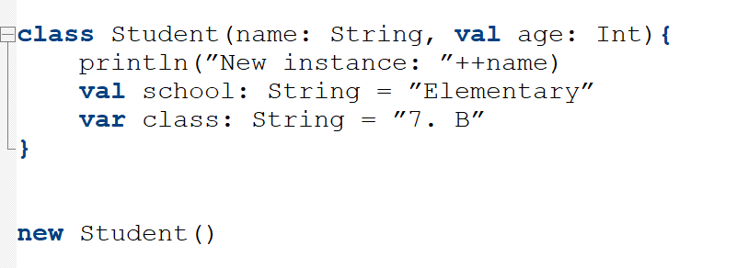
Classes
Promoted argument
Visible to outside
Immutable
Mutable
Type inference
Constructor

Slide 14
Objects
Lazy Singleton
Created in this step
Same instance used here

Slide 15
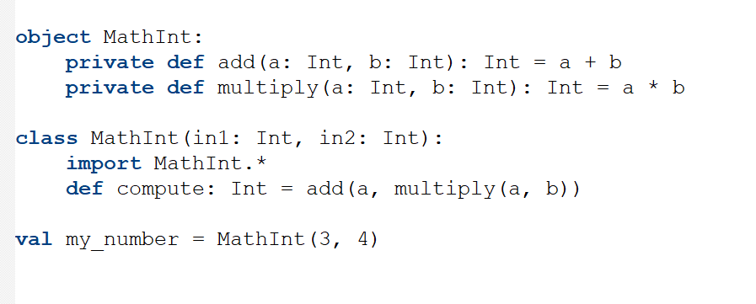
Companions
Class members are public by default
private
companions
Same name
Can access private methods

Slide 16
Outline
Spark Core
APIs
Spark SQL
RDD
spark.ml
Scala
Running an Application
GraphX
Newer Abstractions
Structured Streaming

Slide 17
Outline
Spark Core
APIs
Spark SQL
RDD
spark.ml
Scala
Running an Application
GraphX
Newer Abstractions
Structured Streaming

Slide 18
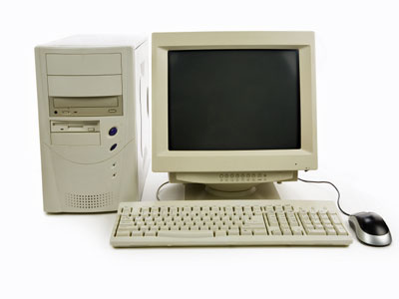
Data in Spark
Data abstraction

Slide 19
Data Abstractions
Distributed collection of data
Immutable
RDD
DataFrame
DataSet
Transformations
Actions

Slide 20
Creating an RDD
parallelize
“Standard” data on driver
load
S3 or HDFS
transform

Slide 21
Partitions

Slide 22
Partitions
Partitions inherited
load
S3 or HDFS
transform

Slide 23
Partitions
partitionBy()
causes shuffle
partition size

Slide 24
Transformations
transform
Load file
map(func)
reduceByKey(func)
groupByKey()
filter(func)
union(RDD)
intersection(RDD)
cartesian(RDD)
…

Slide 25
Transformations
Are Lazy
words
english
english_pairs
english_counts
dictionary

Slide 26
Transformations
Are Lazy
toDebugString()
words
english
english_pairs
english_counts
dictionary
Actions
DAG is created
Data is partitioned, sent to Executors
DAG is copied between nodes

Slide 27
Actions
Count()
First()
Take(num)
Collect()
foreach(func)
saveAsTextFile(file)
…

Slide 28
Persistence
words
english
english_pairs
english_counts
dictionary

Slide 29
Persistence
Can be replicated
Fault-tolerant
words
english
english_pairs
english_counts
dictionary
Lazy!
checkpoint

Slide 30
Persistence
cache() = persist(MEMORY_ONLY)
words
english
english_pairs
english_counts
dictionary
MEMORY_ONLY
MEMORY_AND_DISK
DISK_ONLY
...
persist()

Slide 31
Outline
Spark Core
APIs
Spark SQL
RDD
spark.ml
Scala
Running an Application
GraphX
Newer Abstractions
Structured Streaming

Slide 32
Outline
Spark Core
APIs
Spark SQL
RDD
spark.ml
Scala
Running an Application
GraphX
Newer Abstractions
Structured Streaming

Slide 33
Submitting Applications
submit

Slide 34
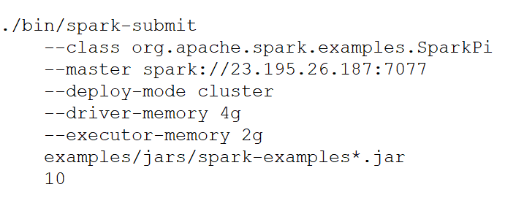
Submitting Applications
pyspark
main class
master url
yarn option reads connection from config file

Slide 35
Submitting Applications
driver executed on worker node
client
local driver
other options
application argument
JAR location

Slide 36
Spark Context
communicate
Driver
SparkContext

Slide 37
Spark Context
do not hardcode cluster information
usual name

Slide 38
Variable Scope
When a function passed to a Spark operation (e.g. map) is
executed, it works on separate copies of all variables

Slide 39
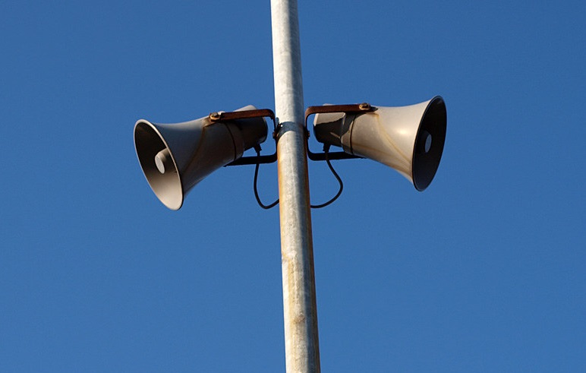
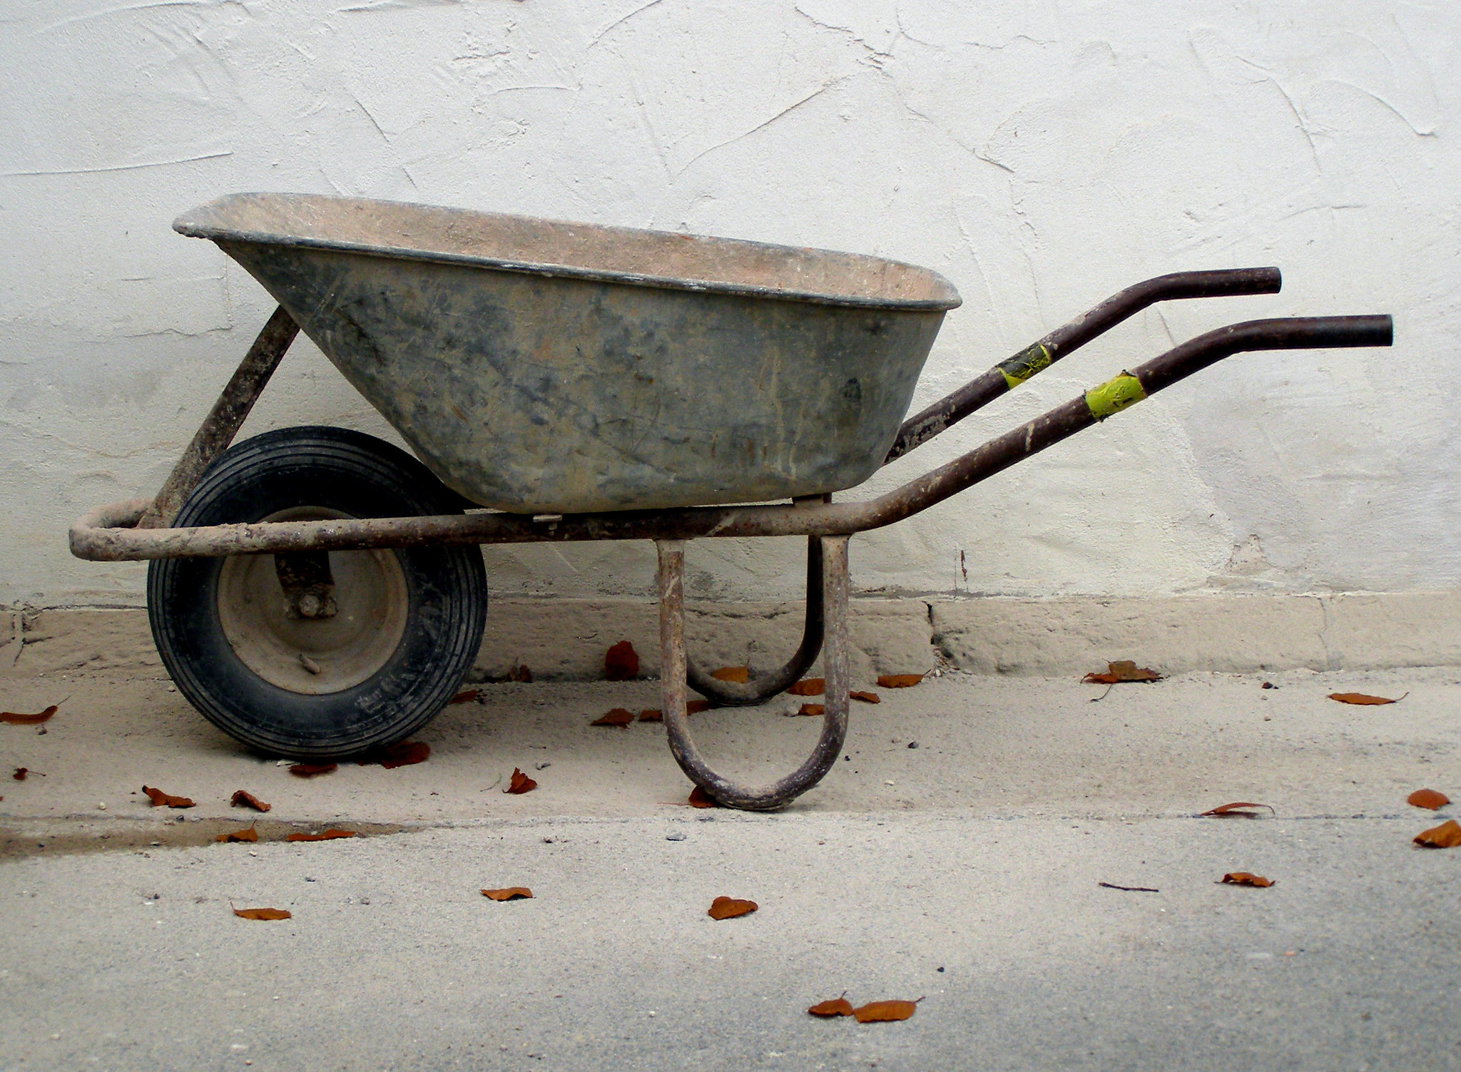
Shared Variables
Broadcast
Accumulator

Slide 40
Broadcast
cache
sc.broadcast()
Small but important data

Slide 41
Accumulator
Numbers supported natively:
Counters
Sums
Commutative
Associative
Read-only
Small but important data

Slide 42
Best Practices
Caching
Cache after data preparation, e.g., filtering
unpersist()
count() forces caching of all partitions
Monitoring
Web UI port 4040
Use external tools

Slide 43
Best Practices
Use broadcasting variables and accumulators
Data serialization
Java
Kyro (faster with less types)
Memory
Prefer primitives and arrays
Avoid nested structures
Proper GC

Slide 44
Outline
Spark Core
APIs
Spark SQL
RDD
spark.ml
Scala
Running an Application
GraphX
Newer Abstractions
Structured Streaming

Slide 45
Outline
Spark Core
APIs
Spark SQL
RDD
spark.ml
Scala
Running an Application
GraphX
Newer Abstractions
Structured Streaming

Slide 46
DataFrame
RDD
DataFrame
DataSet
Unstructured
Partitioned
Persistable
Relational data
Partitioned
Persistable

Slide 47
DataFrame Operations
SparkSession
Load from external source
select(colName)
filter(condition)
groupBy(colName)
DataFrame
RDD
Schema

Slide 48
DataSets
RDD
DataFrame
DataSet
Unstructured
Partitioned
Persistable
Relational data
Partitioned
Persistable
Abstraction
Semi-structured
Partitioned
Persistable
Optimized
DataFrame = DataSet[Row]

Slide 49
Outline
Spark Core
APIs
Spark SQL
RDD
spark.ml
Scala
Running an Application
GraphX
Newer Abstractions
Structured Streaming

Slide 50
Outline
Spark Core
APIs
Spark SQL
RDD
spark.ml
Scala
Running an Application
GraphX
Newer Abstractions
Structured Streaming

Slide 51
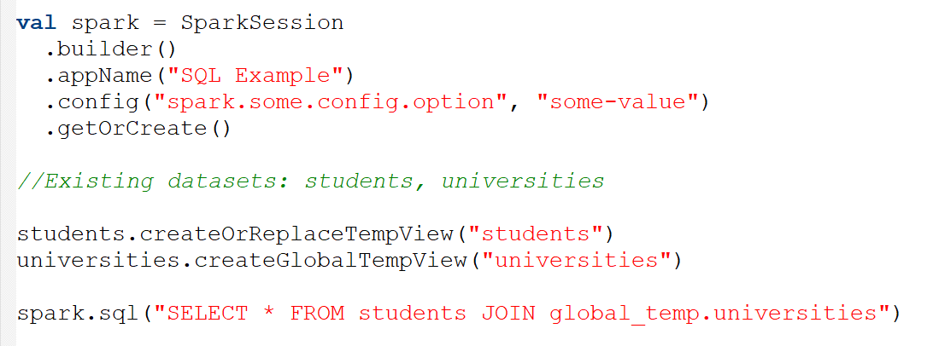
SQL in Spark
Valid only for the given session
Alias for a table
Execute SQL

Slide 52
Using Hive Tables
Hive can use spark as an execution engine
hive-site.xml
core-site.xml
hdfs-site.xml

Slide 53
Outline
Spark Core
APIs
Spark SQL
RDD
spark.ml
Scala
Running an Application
GraphX
Newer Abstractions
Structured Streaming

Slide 54
Outline
Spark Core
APIs
Spark SQL
RDD
spark.ml
Scala
Running an Application
GraphX
Newer Abstractions
Structured Streaming

Slide 55
Machine Learning
RDD
DataFrame DataSet
MLlib
spark.ml

Slide 56
Machine Learning
MLlib
spark.ml
Distributed
Local
Matrices
Matrices
Vectors
RDD[rows]

Slide 57
Vectors
Dense
Sparse
1,5,0,41,58,42,69,88,102
0,5,0,0,0,42,0,0,17,0,0,0,57
Indices
1, 5 , 8, 12
Values
5,42,17,57

Slide 58
Matrices
Dense
Sparse
58, 61
74, 22
26, 89
0, 0, 1, 5
2, 0, 0, 0
9, 6, 0, 8
Column-major
Values
2, 9, 6, 1, 5, 8
58, 74, 26, 61, 22, 89
Row index
1, 2, 2, 0, 0, 2
Col pointers
0, 2, 3, 4, 6

Slide 59
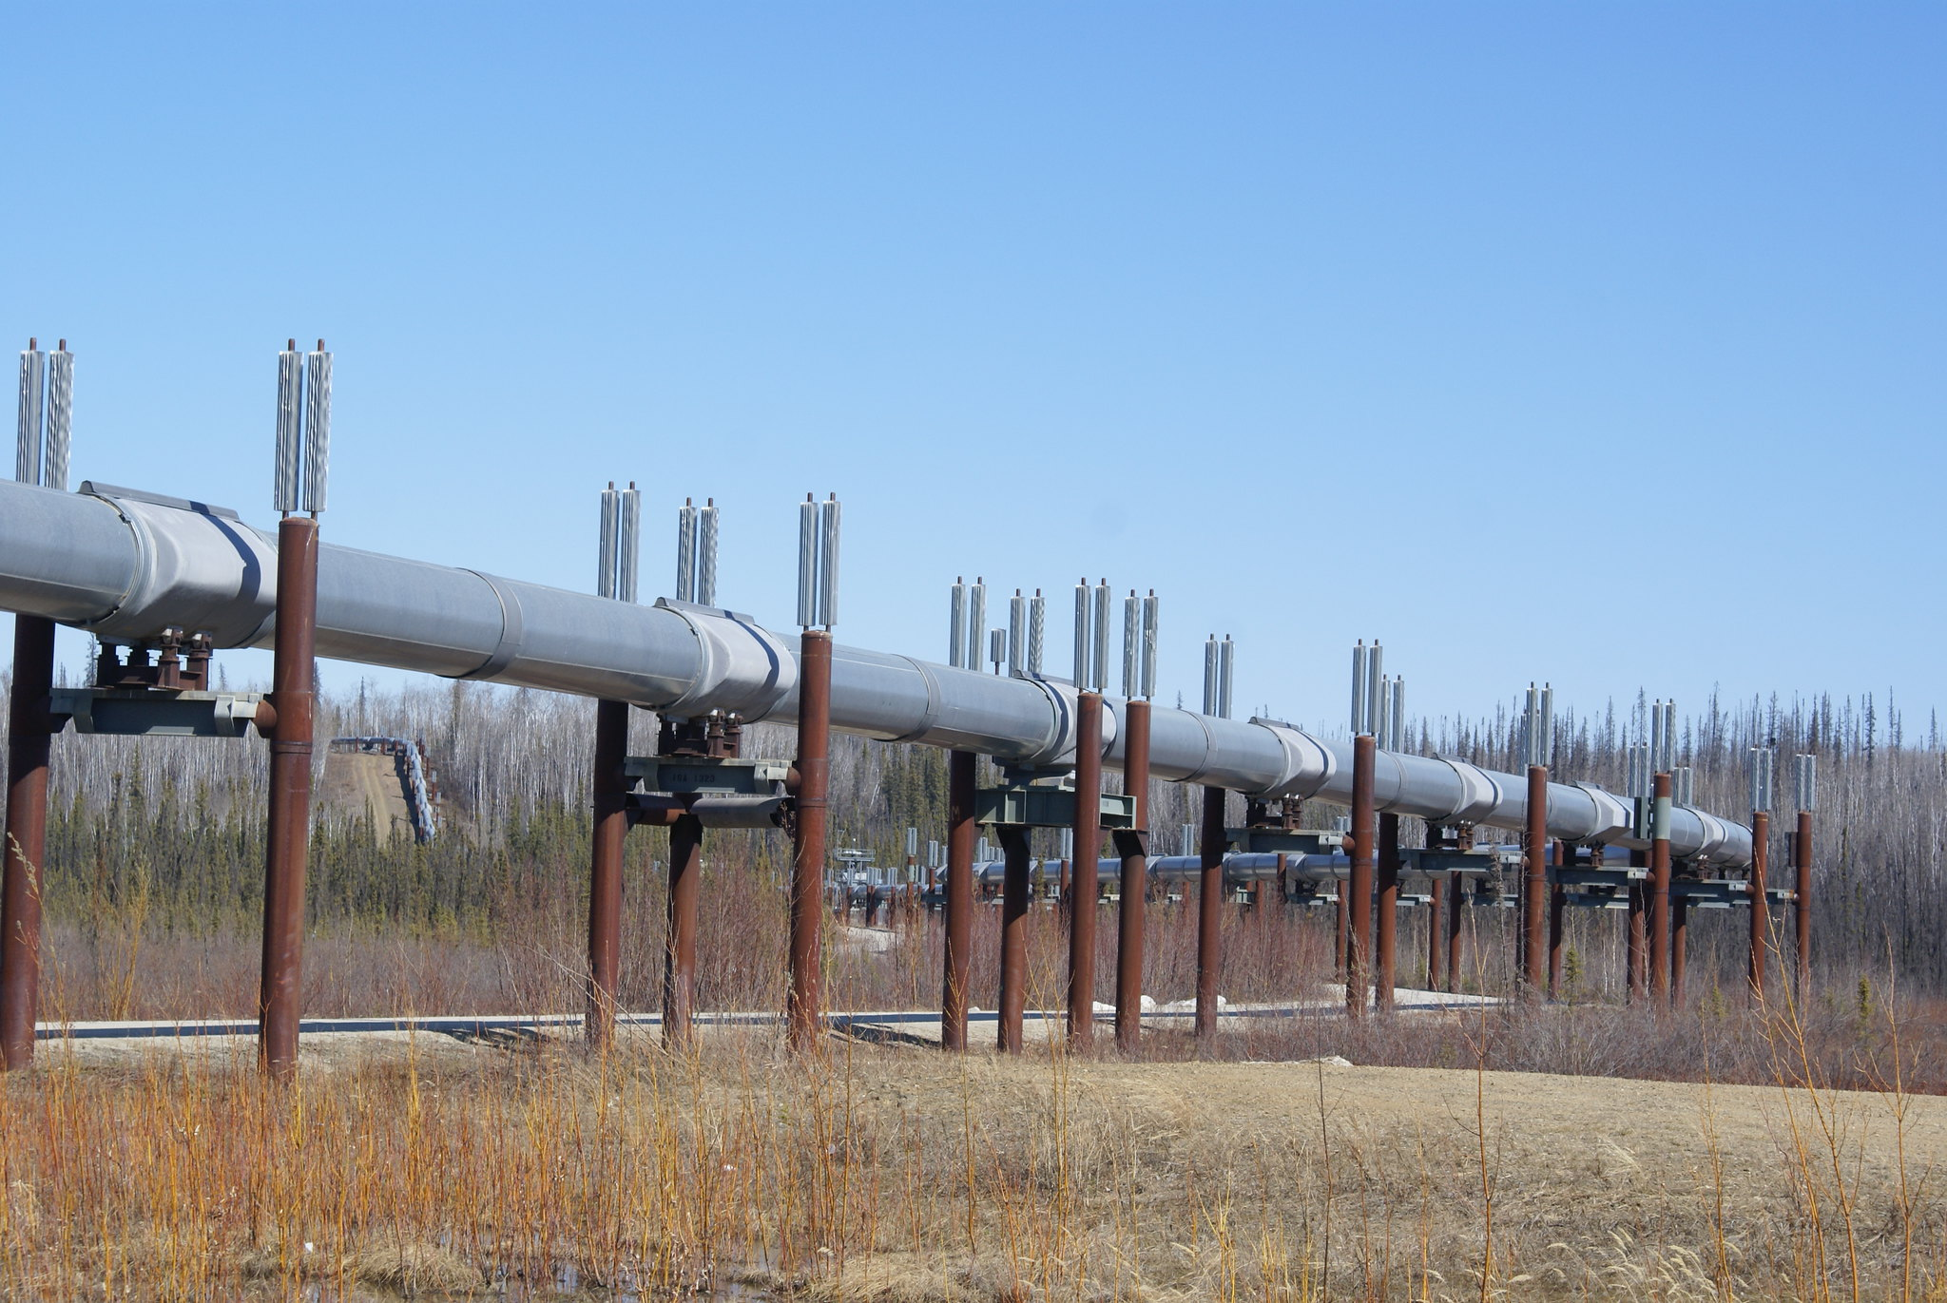
Capabilities
Classification
Regression
Decision Trees
Random Forests
Clustering
…
Pipelines

Slide 60
Outline
Spark Core
APIs
Spark SQL
RDD
spark.ml
Scala
Running an Application
GraphX
Newer Abstractions
Structured Streaming

Slide 61
Outline
Spark Core
APIs
Spark SQL
RDD
spark.ml
Scala
Running an Application
GraphX
Newer Abstractions
Structured Streaming

Slide 62
Property Graph
Directed
15
8
Multigraph
7
8 → 42
20
Unique Vertex ID
42

Slide 63
Property Graph
Vienna
15
Prague
Train
Objects attached
8
Train
Bus
Bus
Train
Plane
7
Train
Bratislava
20
Plane
Budapest
42
Berlin

Slide 64
Graph Operations
Vienna
15
Prague
Train
mapVertices
mapEdges
collectNeighbors
reverse
subgraph
joinVertices
8
Train
Bus
Bus
Train
Plane
7
Train
Bratislava
20
Plane
Budapest
42
Berlin

Slide 65
Graph Operations
Vienna
Graph-based Map/Reduce
15
Prague
Train
8
Train
Bus
sendMsg
mergeMsg
Bus
Train
Plane
7
Train
Bratislava
20
Plane
Budapest
42
Berlin

Slide 66
Graph Algorithms
PageRank
Connected Components
Shortest Path
Triangle Counting

Slide 67
Building Graphs
Read
partitionBy()
Property Graph
Graph file format
Distribute it over the cluster

Slide 68
Outline
Spark Core
APIs
Spark SQL
RDD
spark.ml
Scala
Running an Application
GraphX
Newer Abstractions
Structured Streaming

Slide 69
Outline
Spark Core
APIs
Spark SQL
RDD
spark.ml
Scala
Running an Application
GraphX
Newer Abstractions
Structured Streaming

Slide 70
Problem Statement
Spark

Slide 71
Structured Streaming
Integrated with Kafka
Built on top of the SQL engine
Micro-batch
Continuous
[Experimental]

Slide 72
Unbounded Table
Message 1
Message 2
Message 3
Message 4
Message 5
Message 6
Message 7
Data is treated as an ever-growing table

Slide 73
Output
Complete output
Spark
Pezinok | 20
Senec | 15
Pezinok | 13
Pezinok | 20
Senec | 15
Pezinok | 13
Stupava | 36
Senec | 22
Pezinok | 33
Senec | 15
Pezinok | 33
Senec | 37
Stupava | 36

Slide 74
Output
Append output
Spark
Pezinok | 20
Senec | 15
Pezinok | 13
Pezinok | 20
Senec | 15
Pezinok | 13
Stupava | 36
Senec | 22
Pezinok | 33
Senec | 15
Stupava | 36

Slide 75
Output
Update output
Spark
Pezinok | 20
Senec | 15
Pezinok | 13
Pezinok | 20
Senec | 15
Pezinok | 13
Stupava | 36
Senec | 22
Pezinok | 33
Senec | 15
Stupava | 36
Senec | 37

Slide 76
Aggregation Input
Data growth needs to be limited
Pezinok | 20
Senec | 15
Pezinok | 13
Stupava | 36
Senec | 22
Time Windows

Slide 77
Time Windows
Tumbling Window
fixed size = 5 mins
win1
win2
win3
win4
win5
0:02
0:04
0:06
0:12
0:14
0:22

Slide 78
Time Windows
Sliding Window
fixed size = 10 mins
slide = 5 mins
win3
win2
win1
0:02
0:04
0:06
0:12
0:14
0:22

Slide 79
Time Windows
Session Window
duration = 5 mins
win1
win2
win3
0:02
0:04
0:06
0:12
0:14
0:22

Slide 80
Watermarks

Slide 81
Watermarks
timestamp | data
0.00 | Pezinok | 20
0.01 | Senec | 15
0.02 | Pezinok | 13
0.25 | Stupava | 36
0.32 | Senec | 22
timestamp
data
timestamp
data
0.15 | Samorin | 42

Slide 82
Watermarks
timestamp | data
0.00 | Pezinok | 20
0.01 | Senec | 15
0.02 | Pezinok | 13
0.15 | Samorin | 42
0.25 | Stupava | 36
0.32 | Senec | 22
timestamp
data
timestamp
data
Wait threshold can be defined

Slide 83
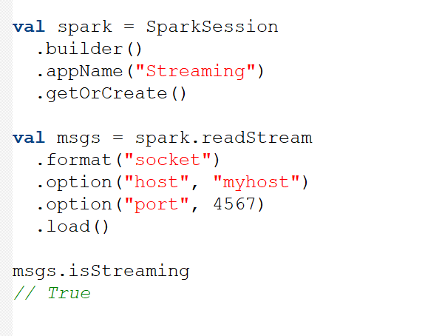
Example

Slide 84
Example

Slide 85
Outline
Spark Core
APIs
Spark SQL
RDD
spark.ml
Scala
Running an Application
GraphX
Newer Abstractions
Structured Streaming

Slide 86
References
Pictures
Construction Worker by gungyoga04 on flaticon.com
Driver by Freepik on flaticon.com
Manager by Flat Icons on flaticon.com
sparking by katie wheeler (CC BY-NC 2.0)
Flame by Dovydas Čioménas (CC BY 2.0)
alone by Ak~i (CC BY 2.0, cropped)
old computer by Jeff Dray (CC BY 2.0)
HMS computer by kitschweb (CC BY-ND 2.0)
Word by Roman Káčerek on flaticon.com
Programmer by Freepik on flaticon.com
Shield by Michael Coghlan (CC BY-SA 2.0)
Distributed by Freepik on flaticon.com
File by Kiranshastry on flaticon.com
Table by Freepik on flaticon.com
Paint with flame by Sheri (CC BY-NC-ND 2.0)
Firegraph, the Burning
by Stephen Dann (CC BY-SA 2.0)
Wheelbarrow by Erich Ferdinand (CC BY 2.0)
Pain! by 5auge (CC BY-NC-ND 2.0)
Firing match by Vomir-en-costard (CC BY-SA 2.0)
Excel by xnimrodx on flaticon.com
Workflow by xnimrodx on flaticon.com
IMG_1187 by Martin Jakobsen (CC BY 2.0, resized)
Alaska pipeline by toffehoff (CC BY-SA 2.0)
Spark by Mike chernucha (CC BY-NC-ND 2.0)
Knowledge Graph by Grafixpoint on flaticon.com
Box by monkik on flaticon.com
Letter by Freepik on flaticon.com
Flaming Match by Derek Gavey (CC BY 2.0)
Letter by IconBaandar on flaticon.com
2009-09-20 Smoke and Matches 209
by Tim Miller (CC BY-NC 2.0)
Literature
Spark Official Site by Apache
cognitiveclass.ai
Scala Official Documentation
Databricks Documentation and Glossary

Slide 87
Thank You

