Slide 1
Zookeeper
András Varga
IBM Consulting

Slide 2
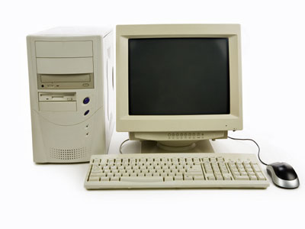
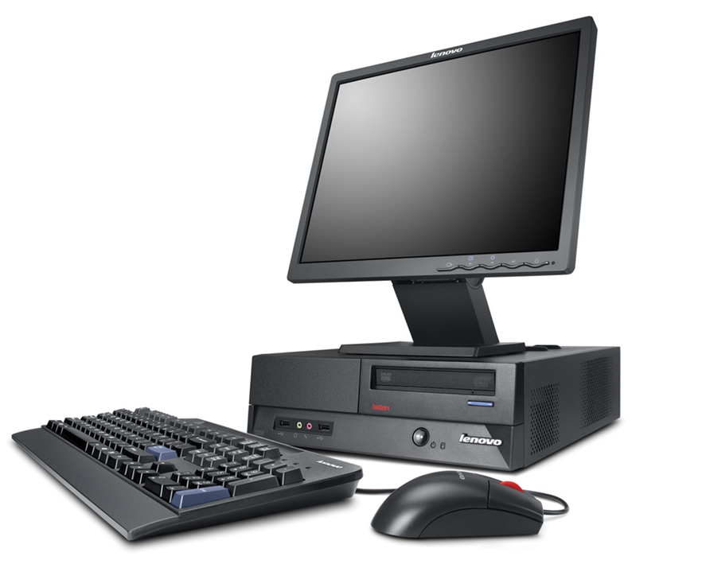
Motivation
Maintain configuration
Synchronization
Race Conditions
Some sort of custom solution
Maintenance Co-operation
Distributed System

Slide 3
Business Card
“Because Coordinating Distributed Systems is a Zoo”
Maintaining configuration
Naming
Distributed coordination

Slide 4
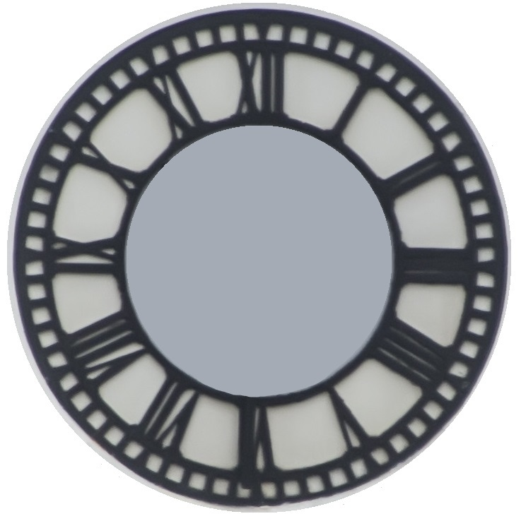
Outline
Recipes
Leader Election in Zookeeper
Basic Properties
Leader Election in General
Architecture
Workflow

Slide 5
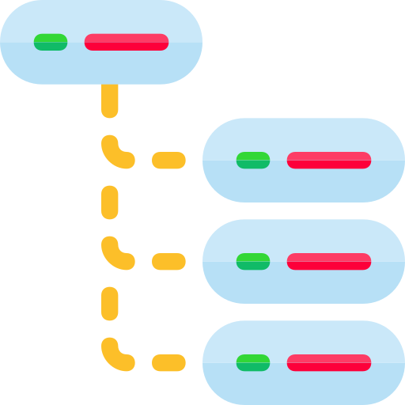
Basics
Shared
Hierarchical
Namespace
Ensemble
High-Availability
Performance
Ordered
Transactions

Slide 6
Consistency Guarantees
Sequential Consistency: Client updates are applied in order
Atomicity
Single System Image: Client sees the same view regardless of the server it connects to
Reliability: If the update succeeds it persists
Timelessness: Client view is up-to-date within a time-period

Slide 7
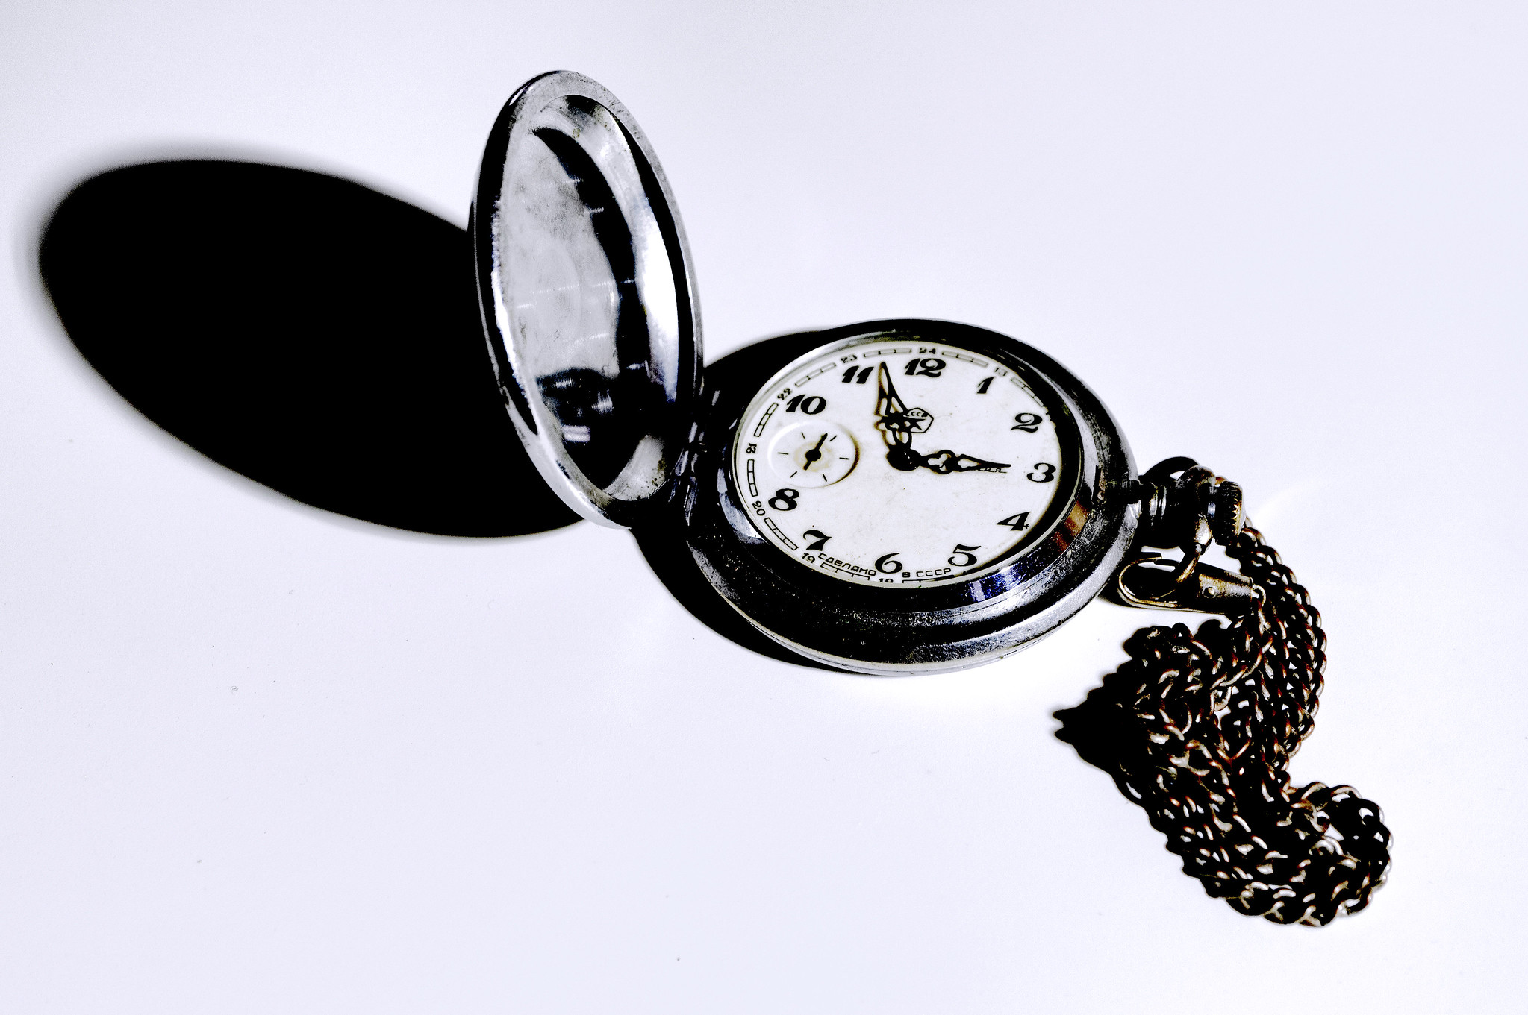
Configuration
conf/zoo.cfg
tickTime
dataDir
clientPort
bin/zkServer.sh start
initLimit
syncLimit
server.1=ip:port:port
server.2=ip:port:port
Communication:Election
Odd number

Slide 8
Outline
Recipes
Leader Election in Zookeeper
Basic Properties
Leader Election in General
Architecture
Workflow

Slide 9
The Namespace
root element
/
/app1
/app2
Hierarchical
In memory
/app1/p1
/app1/p3
/app2/p1
/app1/p2
/app2/group1
/app2/group1/p2
/app2/group1/p3
znode

Slide 10
The Namespace
Can store data AND have children
Can not be deleted with children
Stat Structure:
metadata
ACL
version
Limited storage

Slide 11
Ephemeral
ZNode
Session creates a temporary znode
Removed once session is closed
No chlidren

Slide 12
Sequential
ZNode
Counter owned by the parent node
Can be persistent or ephemeral
Sequential znode has a counter associated
Counter is automatically and monotonically increased
/app2/block1
0000000002
/app2/block1/my_prop0000000001
/app2/block1/my_prop0000000002

Slide 13
Read, Write and Versions
Atomic writes and reads
Re-write increases version of znode
ACL
CREATE
READ
WRITE
DELETE (a child)
ADMIN

Slide 14
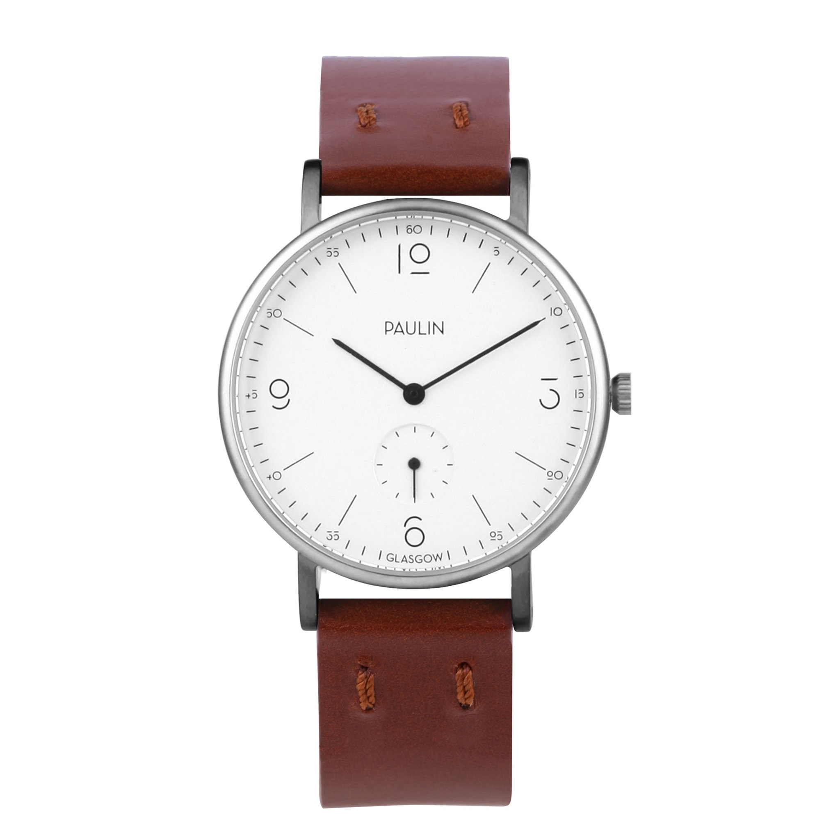
The Ensemble
Zookeeper Service
Leader
Server
Server
Server
Server
Server
Each server maintain a local copy of the transaction log
Majority

Slide 15
Clients
Zookeeper Service
Session
Leader
Server
Server
Server
Server
Server
Single server
TCP Connection

Slide 16
Sessions
Connecting, Connected, Close, …
Zookeeper Service
Session
Leader
Server
Server
Server
Server
Server
Created upon connection
Clients keeps it alive by heartbeats
Requests processed in FIFO
Client has a list of IP:Ports of servers to connect

Slide 17
Time
Zookeeper Transaction ID
zxid
Total ordering of all changes
Version numbers
znode
version, cversion, aversion
Ticks
Internal time
Inter-server communication
Real time
For timestamps

Slide 18
Watches Motivation
znode change
Zookeeper Service
Leader
Server
Server
Server
Server
Server
Cyclic requests are inefficient
Wait!

Slide 19
Watches
znode change
Zookeeper Service
Leader
Server
Server
Server
Server
Server
Sends value without additional request
Read request
Set watch for znode

Slide 20
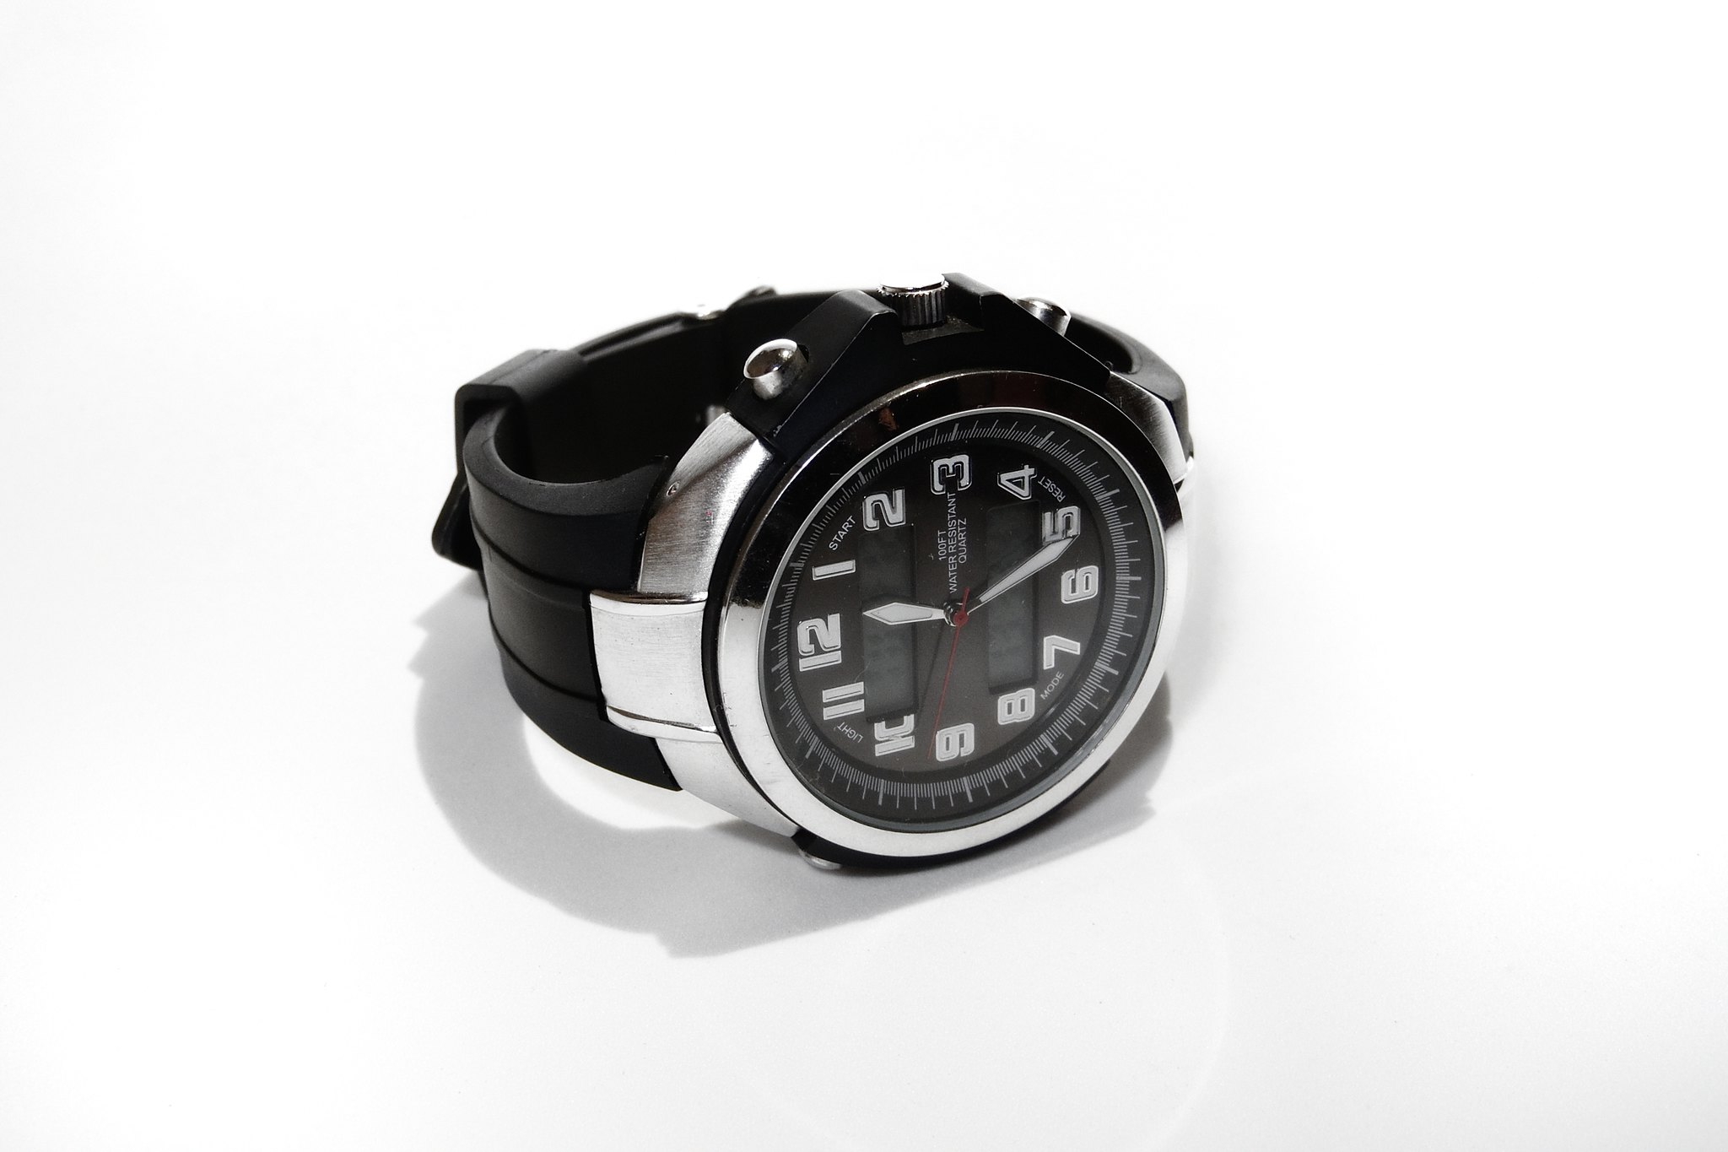
Watches
Classic Watch (One-time use)
Recursive Watch
Persistent Watch

Slide 21
Watches
First change and associated data is sent to client
Two type:
Data change
Child change

Slide 22
Outline
Recipes
Leader Election in Zookeeper
Basic Properties
Leader Election in General
Architecture
Workflow

Slide 23
High-Level
Zookeeper Service
Leader
Server
Server
Server
Server
Server
Reading is
Local
Request Processor
Replicated Database
Atomic Broadcast

Slide 24
Quorum
Ensemble
Zookeeper Service
Leader
Server
Server
Server
Server
Server
Majority
Weights
Hierarchy groups
Quorum

Slide 25
Two-Phase Commit
Works over the quorum
Messages sent via FIFO
TCP commnuication
Leader
Server
Server
Server
Propose
Propose
Prepare
Phase
Ack
Ack
Atomic Broadcast – Active Messaging
Commit
Commit
Commit
Phase
Prepares everything locally
Waits for all responses

Slide 26
Outline
Recipes
Leader Election in Zookeeper
Basic Properties
Leader Election in General
Architecture
Workflow

Slide 27
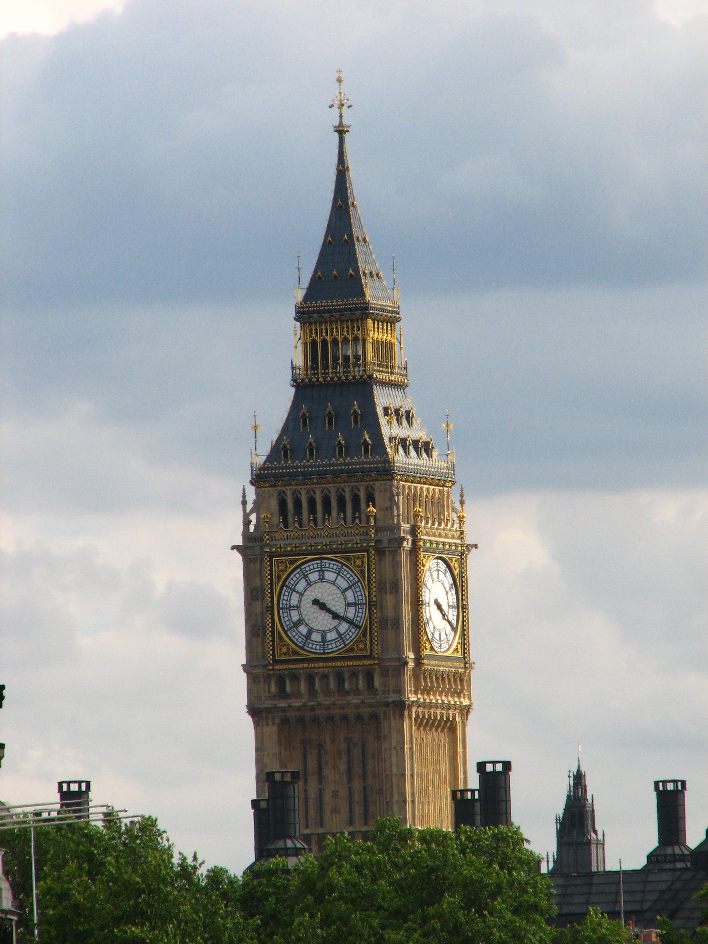
Leader Election
Select a single designated coordinator for a distributed computation among several available nodes
Processes may fail
Messages are delivered reliably
Zookeeper specifics:
Complete graph
Servers have IDs

Slide 28
Bully Algorithm
1
Algorithm:
Each node sends out a message to get elected
Nodes with lower ID accepts higher IDs as leaders
Node with accept messages from all nodes becomes a leader
Announces itself as leader
6
3
4
5

Slide 29
Outline
Recipes
Leader Election in Zookeeper
Basic Properties
Leader Election in General
Architecture
Workflow

Slide 30
Zookeeper Leader Election
Bully Algorithm
Most recent transaction log
Highest ID of those nodes
1
6
Leader Election
3
4
Synchronization
5

Slide 31
Post-Election Synchronization
1
Steps:
Leader creates a new transaction ID
Sends out a NEW_LEADER request with the new ID
Follower ACK, when it synced with the server
6
3
4
5

Slide 32
Post-Election Synchronization
1
Steps:
Leader creates a new transaction ID
Sends out a NEW_LEADER request with the new ID
Follower ACK, when it synced with the server
Leader COMMITs when a quorum is established
6
3
4
5
During the synchronization no proposals are accepted from clients

Slide 33
Outline
Recipes
Leader Election in Zookeeper
Basic Properties
Leader Election in General
Architecture
Workflow

Slide 34
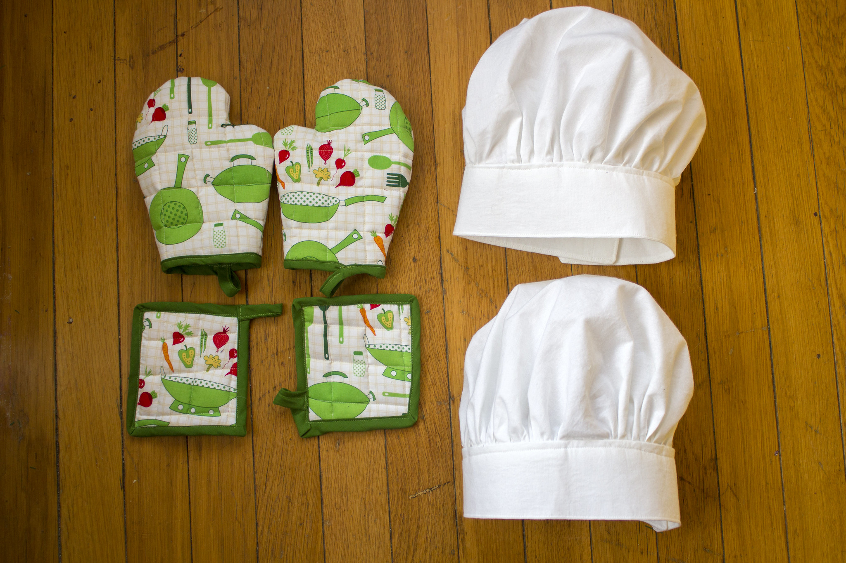
How to Use Zookeeper?
Using Zookeeper efficiently is hard!
Recipes
Barriers
Locks
Two-phase commit
Leader election
…

Slide 35
Barrier

Slide 36
Barrier
Barrier znode
Algorithm
Process calls exists() with a watch
If exists() returns true wait for the watch event
When the watch is triggered, the barrier is removed and computation can continue
If exists() returns false continue

Slide 37
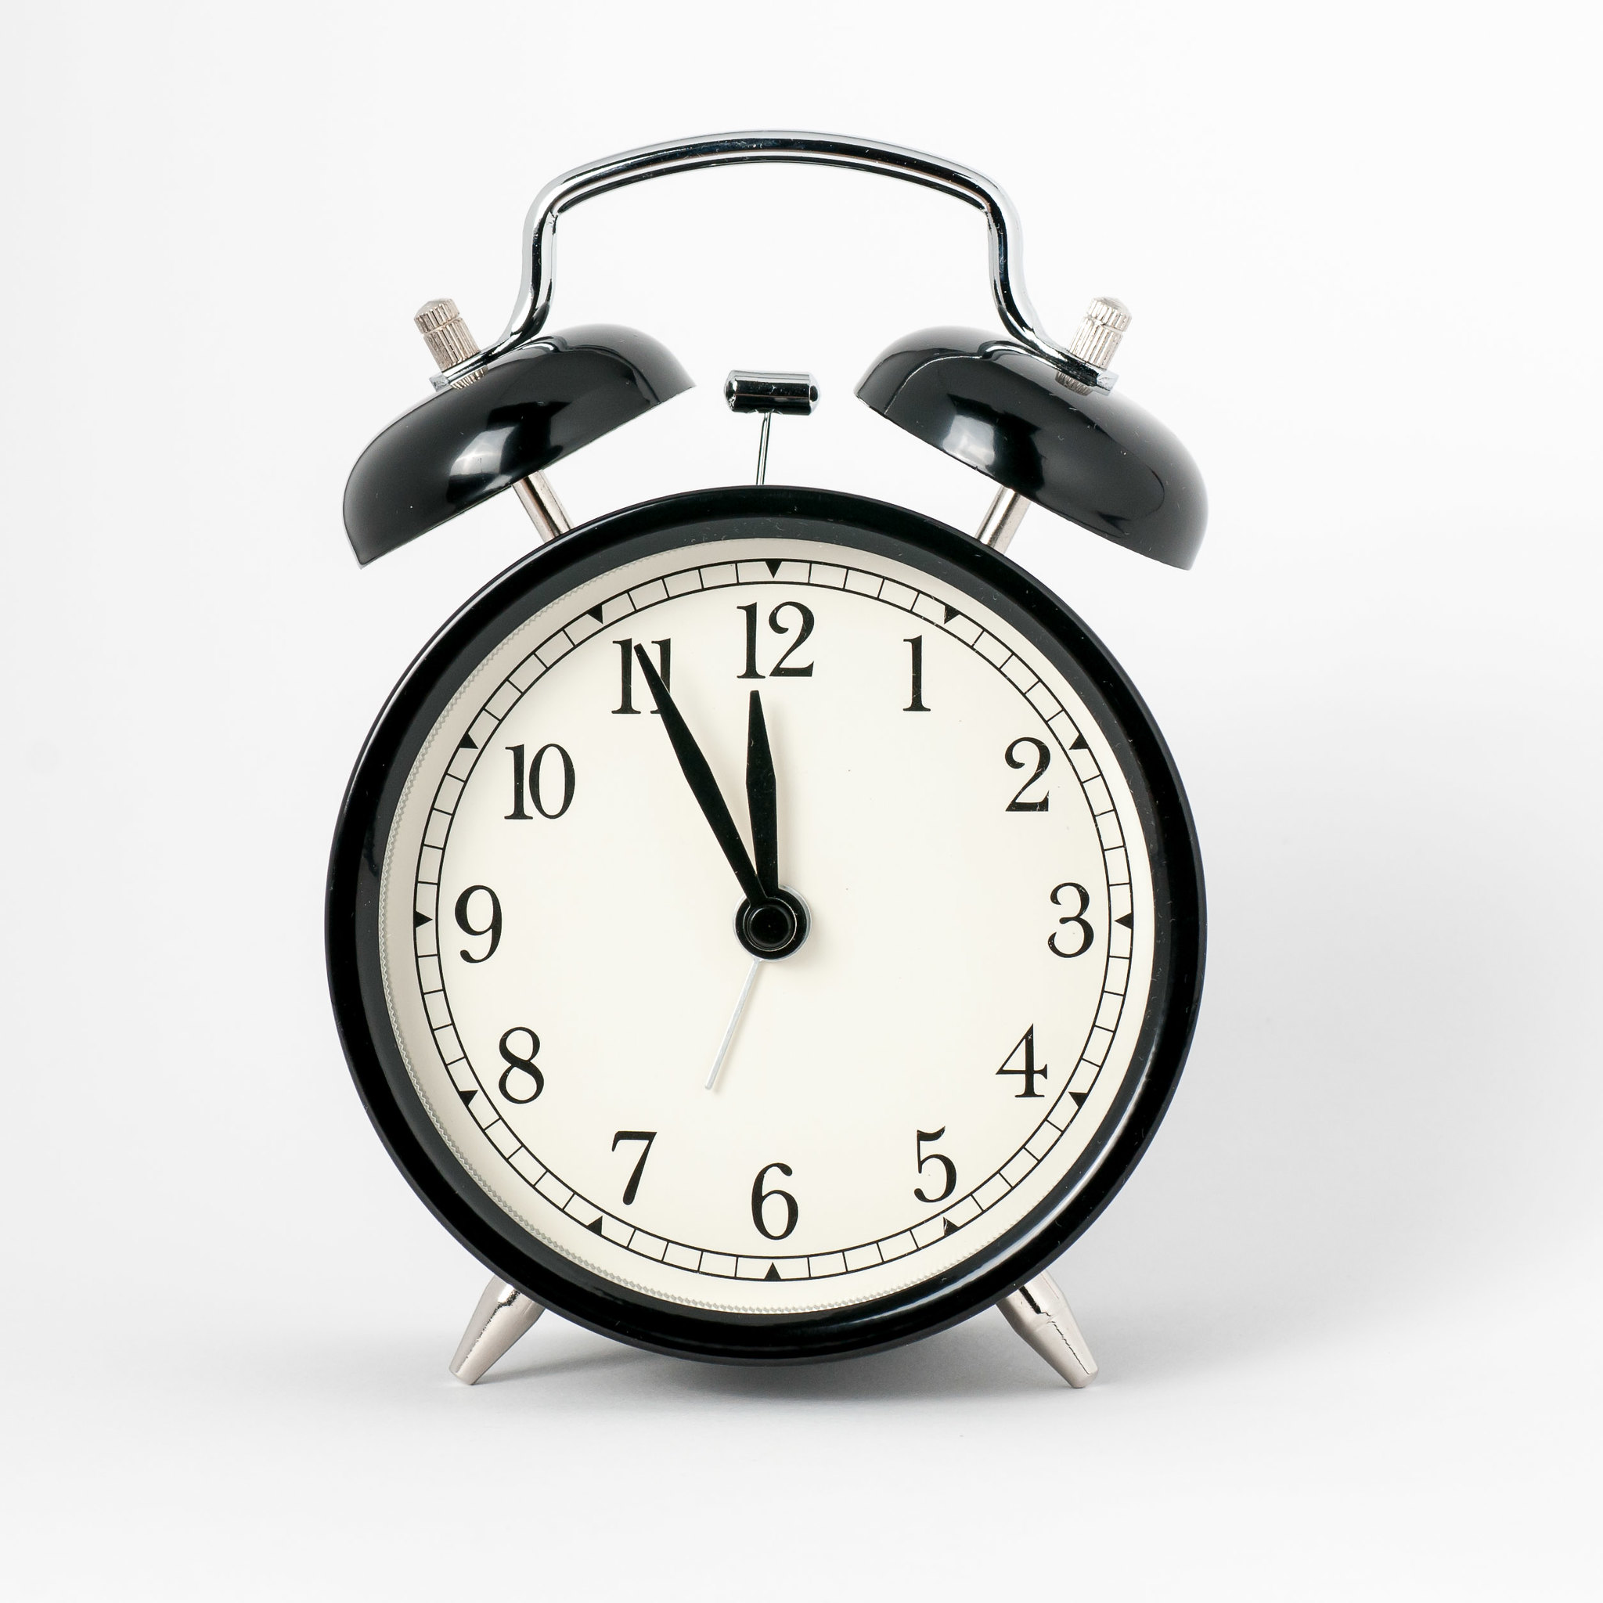
References
Pictures
old computer by Jeff Dray (CC BY 2.0)
HMS computer by kitschweb (CC BY-ND 2.0)
Clocktower Regents Bridge Gardens
by Mark Morgan (Outline created, CC BY 2.0)
Queue by Erix on flaticon.com
Computer networks by juicy_fish on flaticon.com
Java by Freepik on flaticon.com
Directory by Ivan Abirawa on flaticon.com
IMG_8493 by Oleksandr K (CC BY-SA 2.0)
play by VectorPortal on flaticon.com (Color changed to green)
Configuration by Freepik on flaticon.com
Unboxing by Febrian Hidayat on flaticon.com
Commuter nummerical watch - brown £180
by Glasgow School of Art (CC BY-NC-ND 2.0)
04_Thinkpad_ P72_Hero_Rear _facing_left
by BTNHD Production (CC BY-NC-ND 2.0)
7/52 by Sarah…….. (CC BY-ND 2.0)
Wecker by Anka Albrecht (CC BY 2.0)
Partheon by Freepik on flaticon.com
Persistence by Jagat Icon on flaticon.com
Branch by Freepik on flaticon.com
server by Creatype on flaticon.com
postman by I Wayan Wika on flaticon.com
cpu by Nurlaili on flaticon.com
settings by Freepik on flaticon.com
counting by Freepik on flaticon.com
brick by Freepik on flaticon.com
obligatory Big Ben shot by Dalton (CC BY-NC-ND 2.0)
Oven mitts, pot holders, chef hats
by Quinn Bombrowski (CC BY-SA 2.0)
Watch (artificial light) by Luiz Cristo (CC BY-NC-ND 2.0)
Literature
Zookeeper Official Page by Apache
cognitiveclass.ai
Zookeeper Official Documentation by Apache
Tutorialspoint for Zookeeper
Patterns of Distributed Systems by Unmesh, Fowler

Slide 38
Thank You

